Slide 1
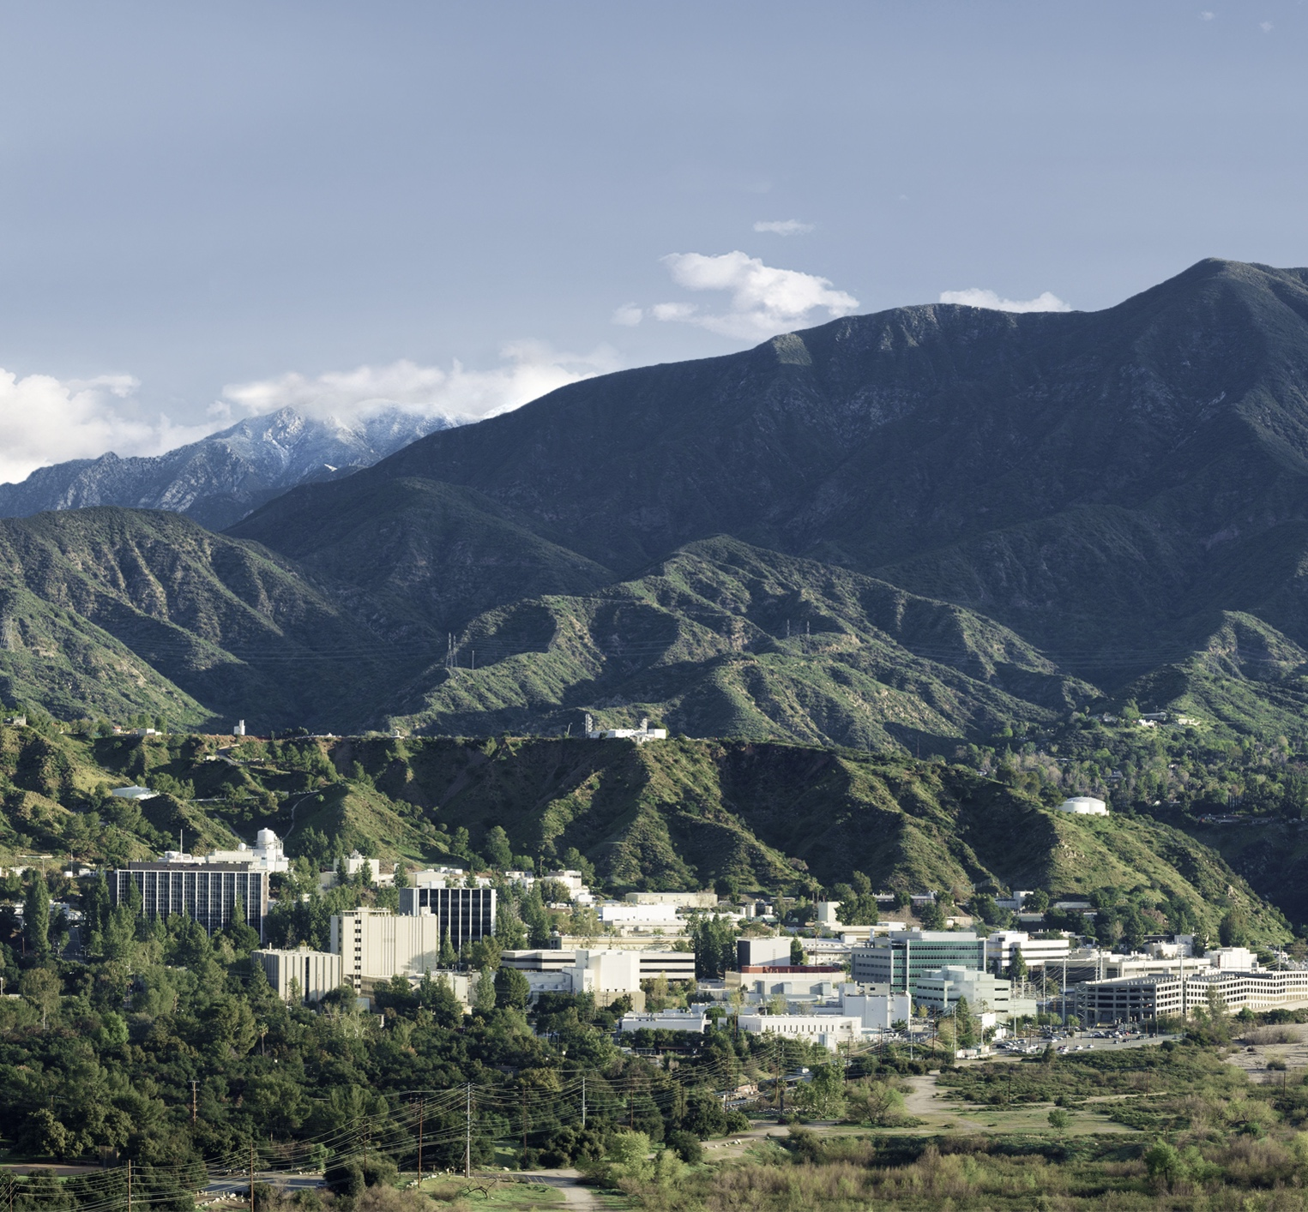
Ground Truth Data Collection for CADRE and More
Minsoo Kang
Robotics Intern – 347R

Slide 2
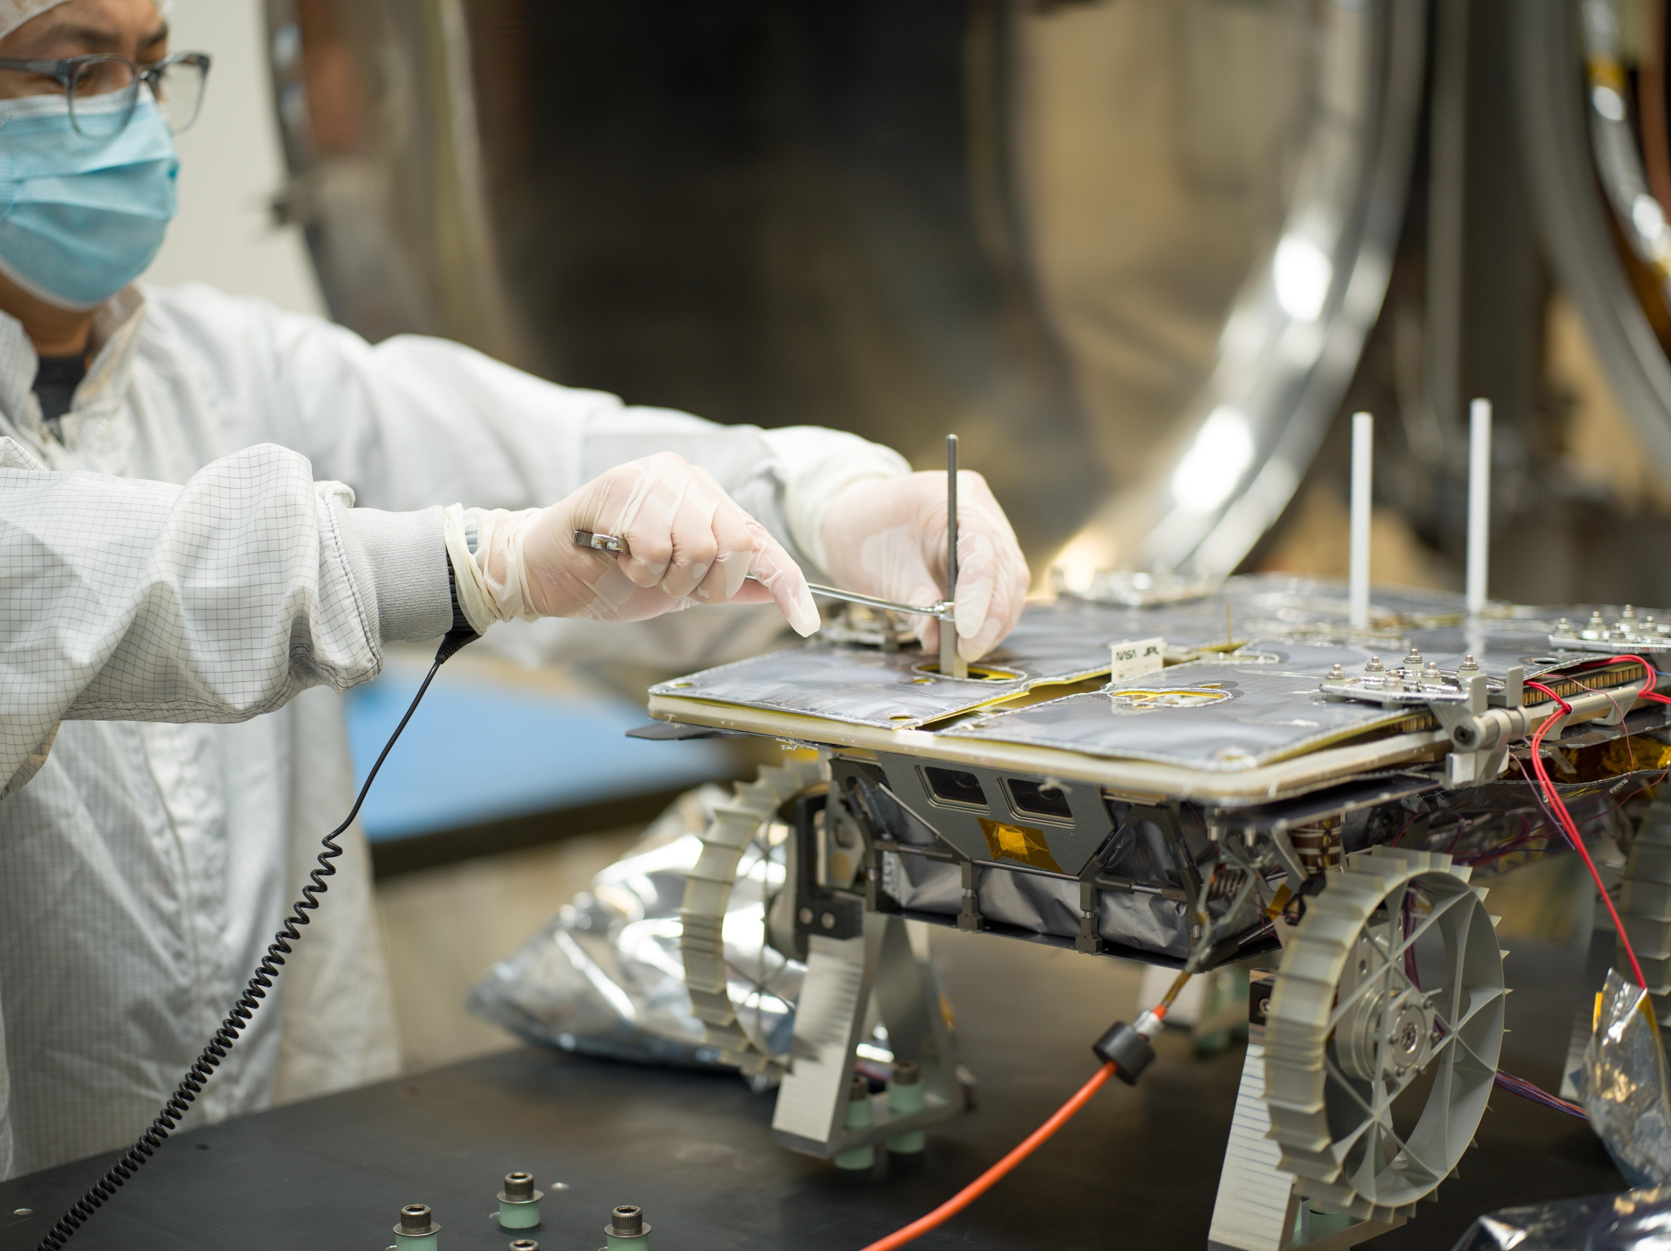
Presentation Overview
CADRE (Cooperative Autonomous Distributed Robotic Exploration)
Introduction
  Who is Minsoo Kang
CADRE Overview
  What is CADRE and Minsoo’s role on the project
Ground Truth Data Collection
  Why is it important
  Ground Truth Data Collection development
More CADRE V&V Support
  What else did Minsoo do
Lessons, Inspirations, and Future
  Takeaways from the internship
Closure
  Acknowledgements
  Questions
  Closing Statement

Slide 3
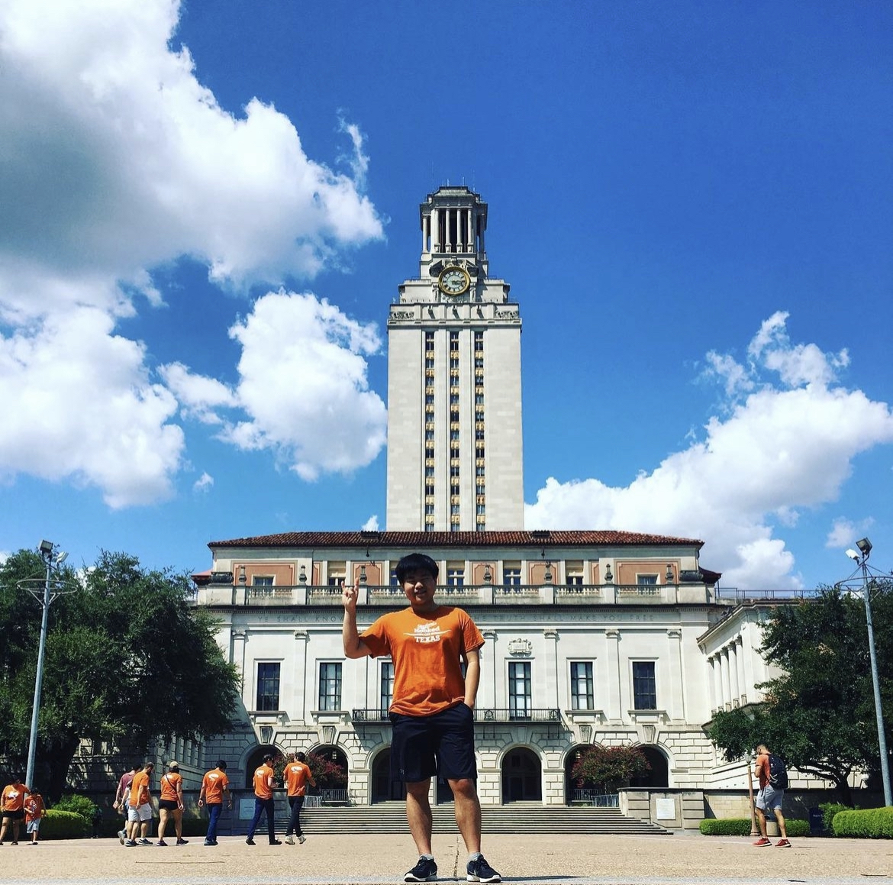
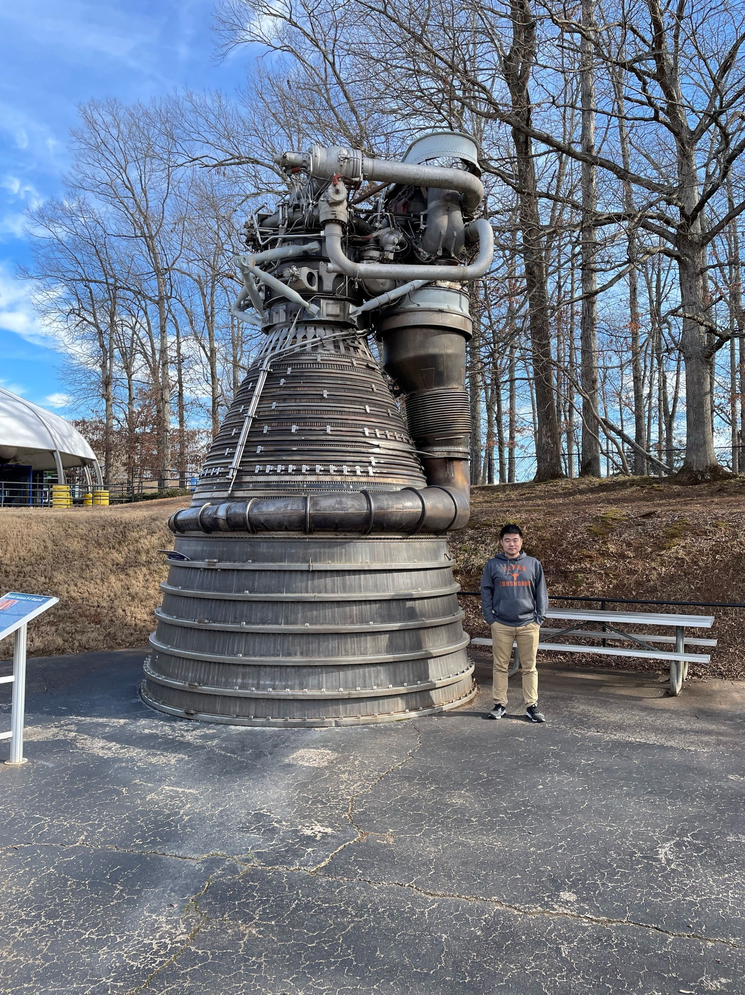

Introduction
CADRE (Cooperative Autonomous Distributed Robotic Exploration)
Who is Minsoo?
Senior undergraduate mechanical engineering student at UT Austin
Grew up with passion in space and robotic explorers of JPL
Academically focusing on robotics/mechatronics
Member of TREL (Texas Rocket Engineering Lab)
Interned at Marshall Space Flight Center during spring

Slide 4
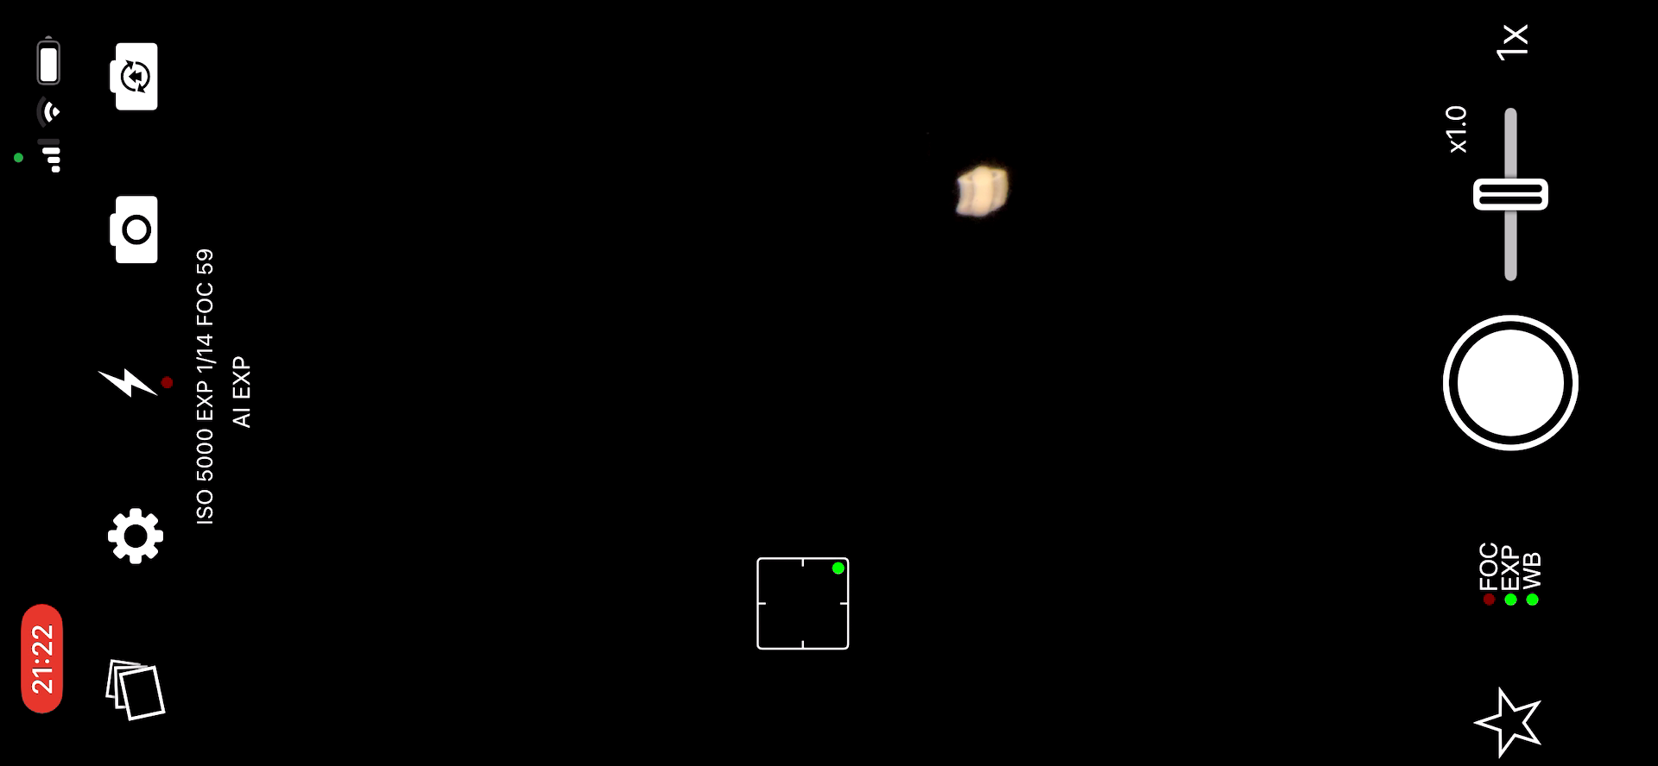
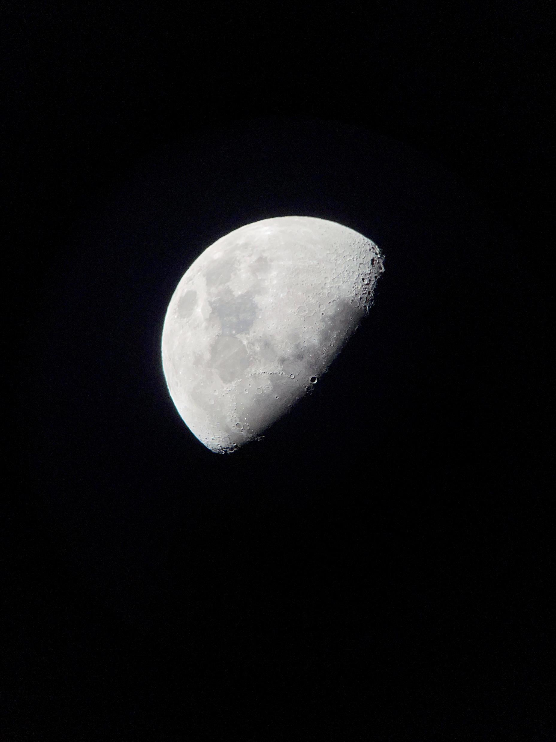
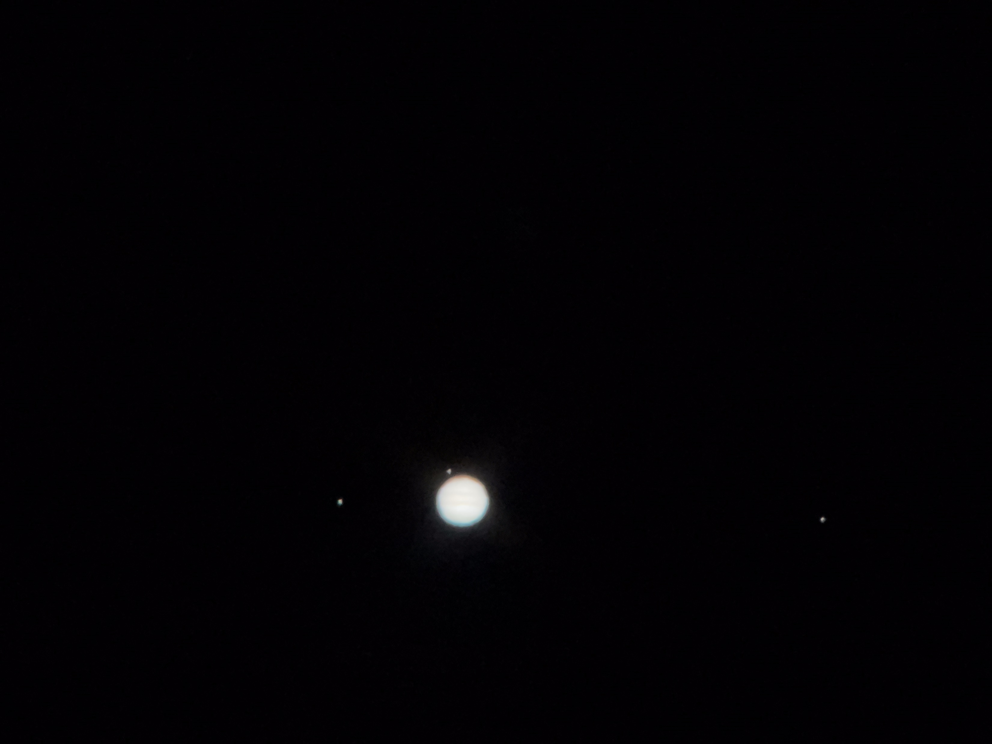
Introduction
CADRE (Cooperative Autonomous Distributed Robotic Exploration)
Stargazing
Stargazing with telescope since I was 8
The origin of my inspiration and passion until…

Slide 5
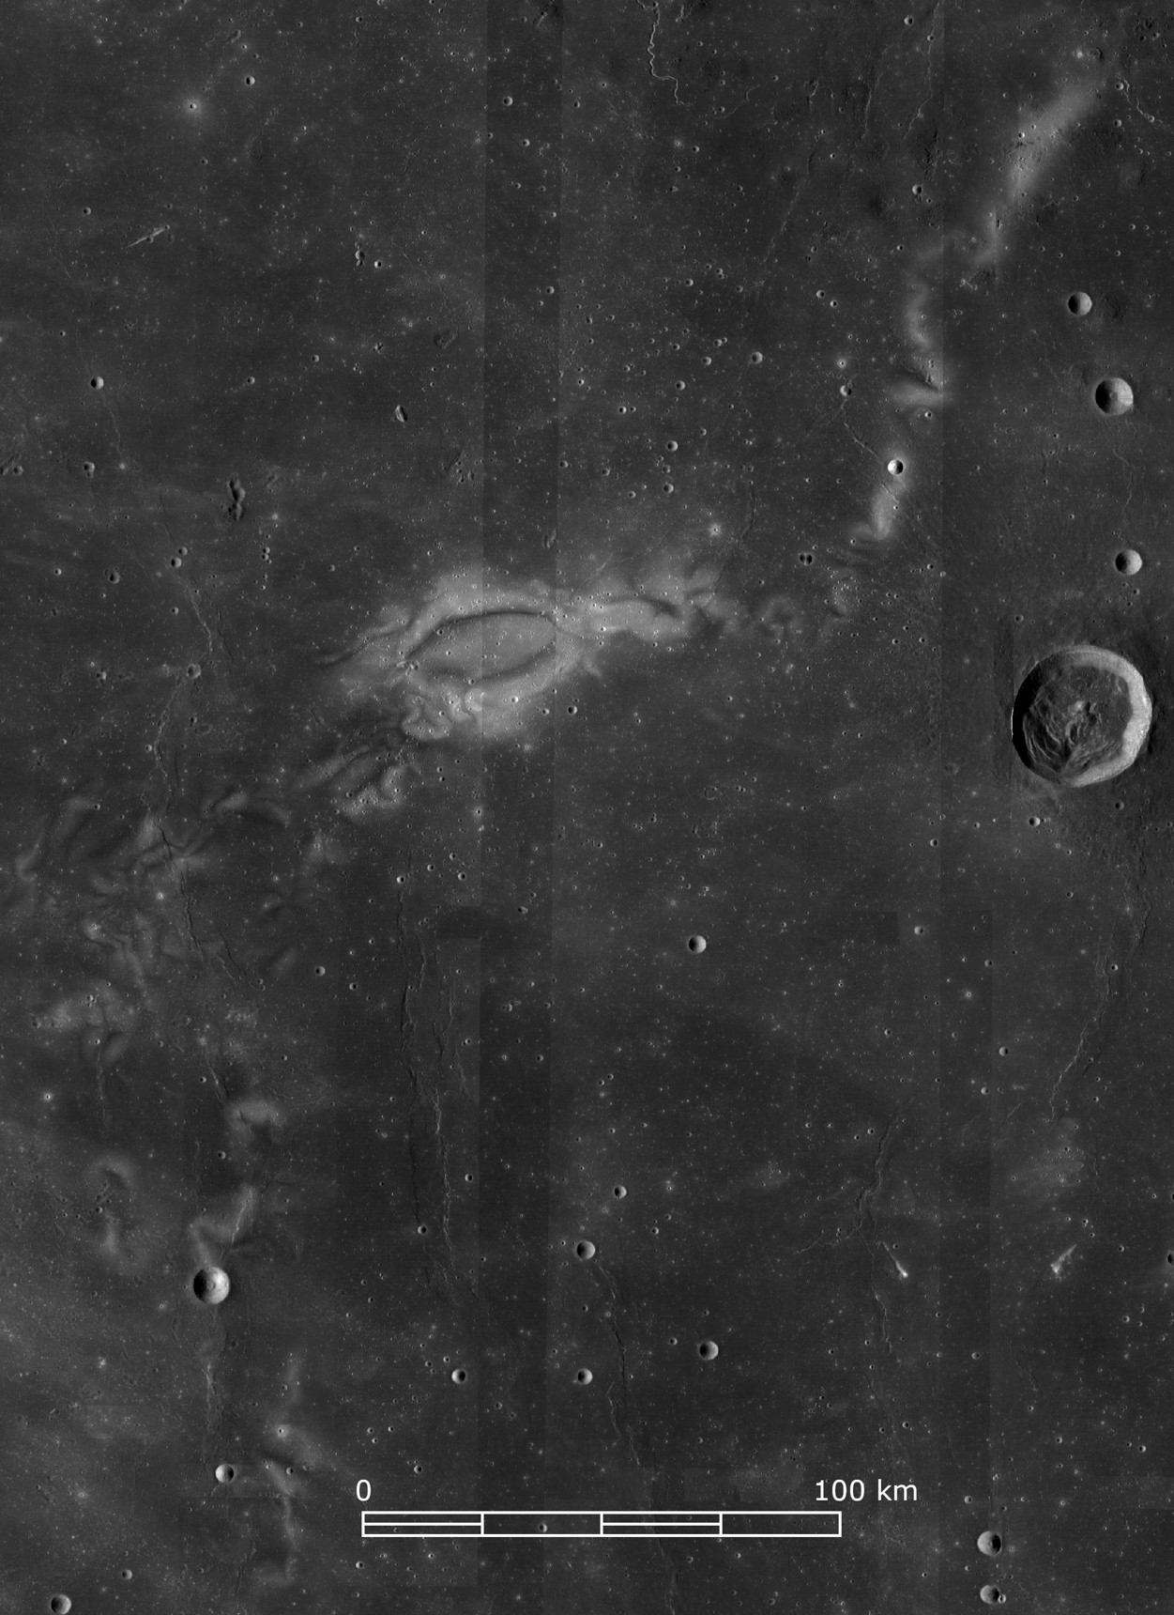
CADRE Overview
CADRE (Cooperative Autonomous Distributed Robotic Exploration)
Demonstrate a game-changing distributed & adaptable multi-static measurements to obtain 3D subsurface imagery using multiple GPR (Ground Penetrating Radar)
CADRE will be launched to Reiner Gamma on Falcon 9 launch vehicle with Intuitive Machine’s Nova-C lander

Slide 6
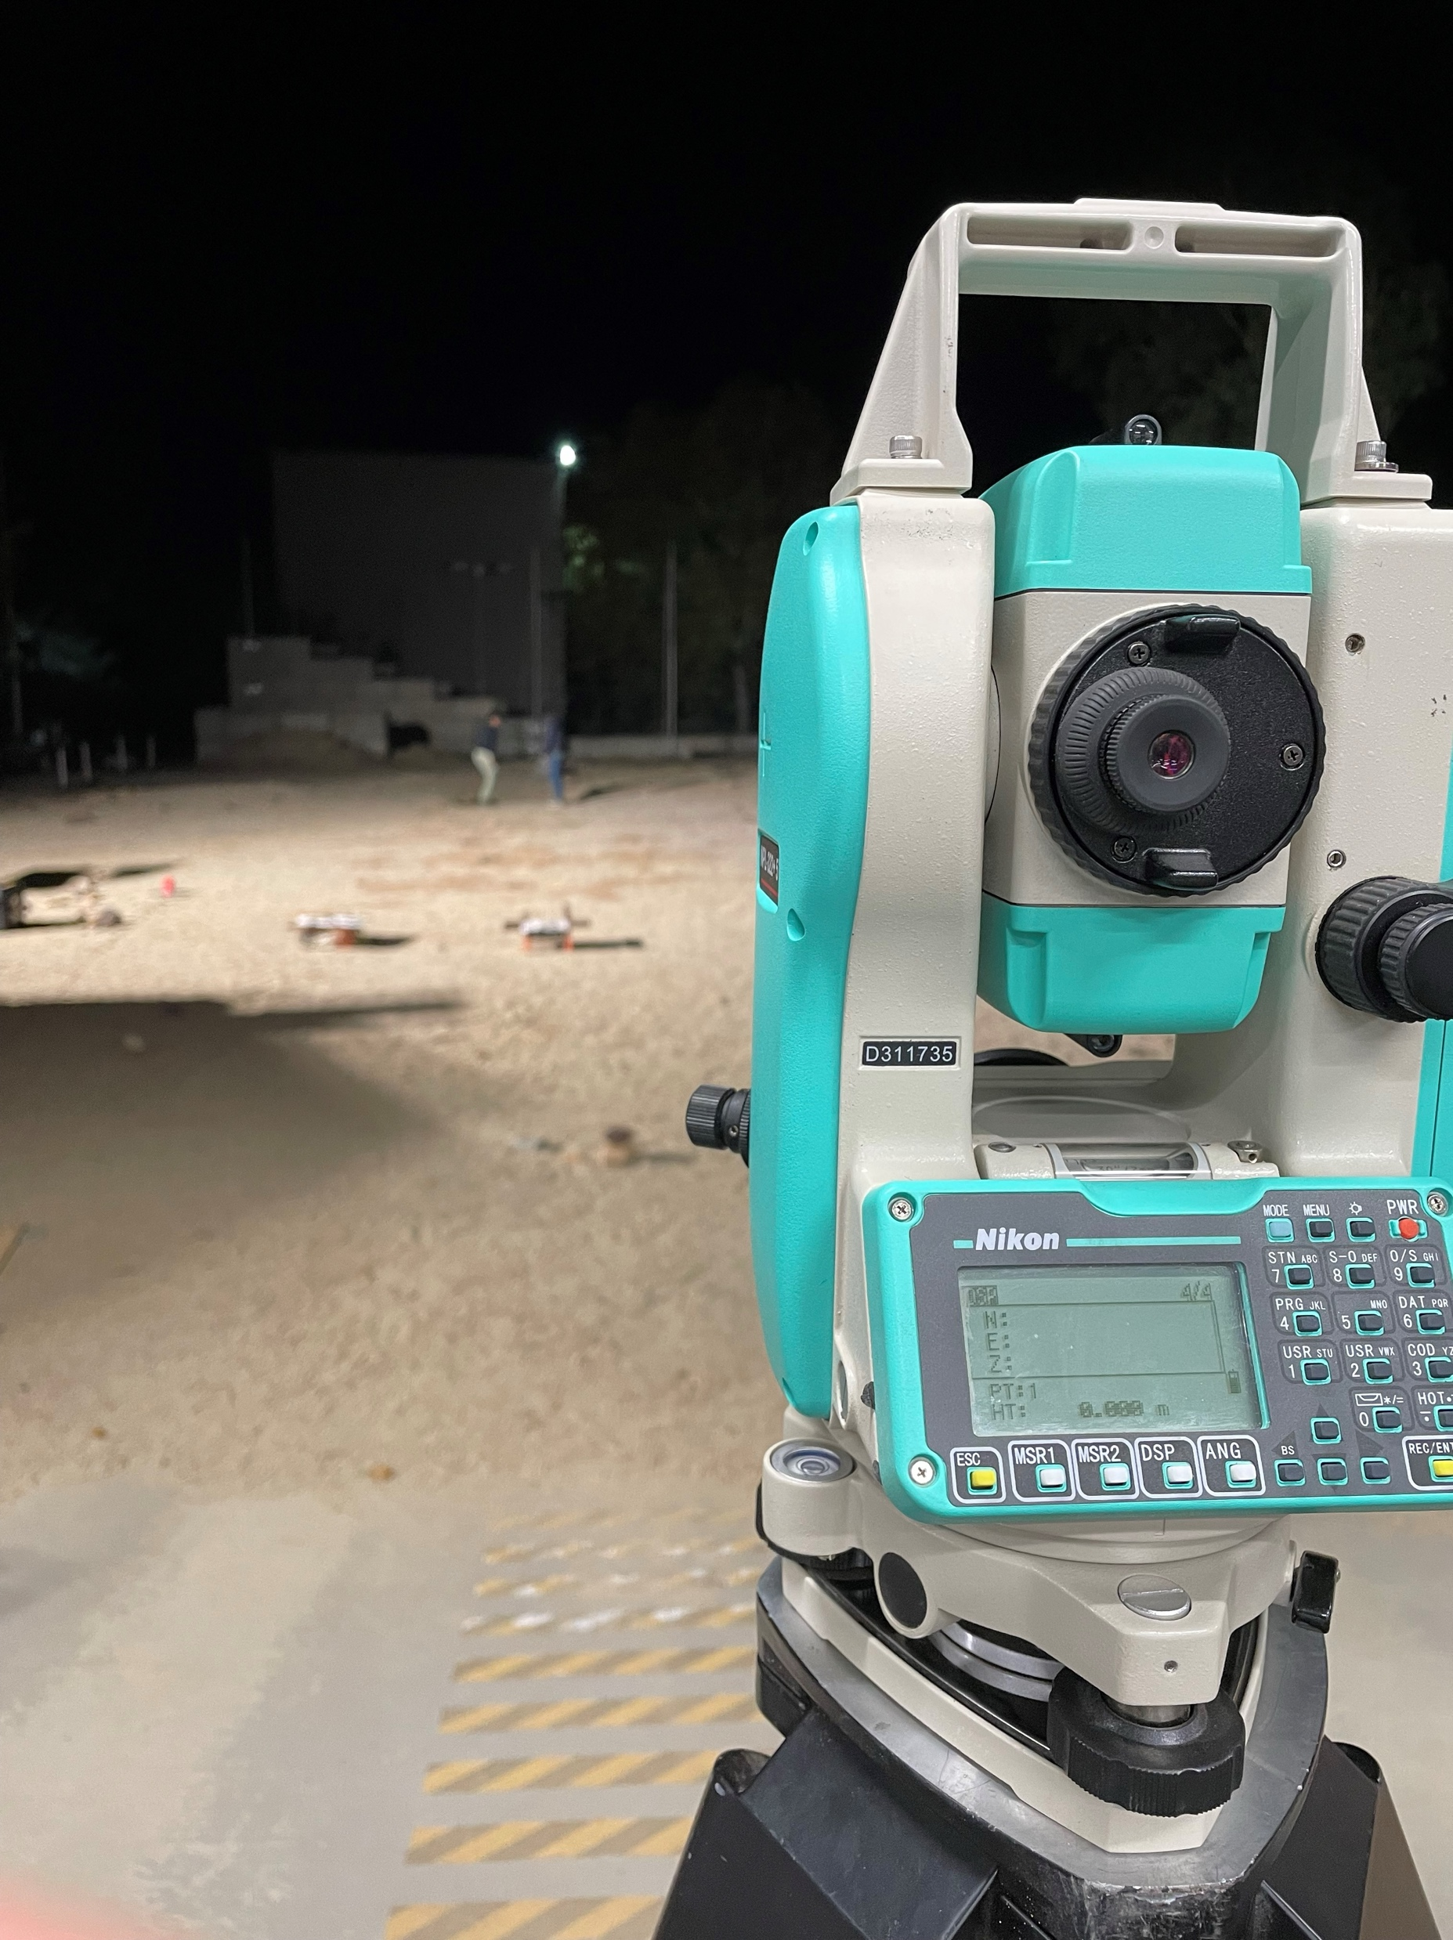
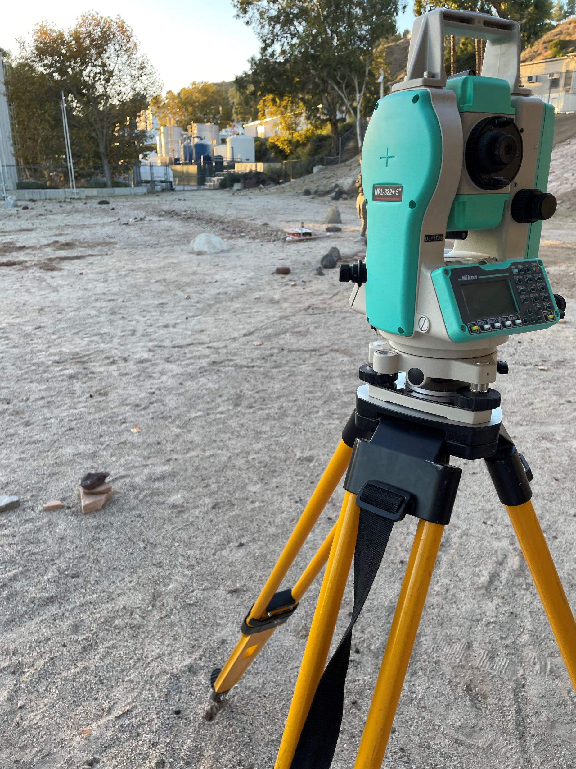
Ground Truth Data Collection Overview
CADRE (Cooperative Autonomous Distributed Robotic Exploration)
The development of state estimation without the ground truth has been difficult
As a solution, Ben Morrell allowed the Total station to be used during the tests
Utilization of Total station has proven highly effective

Slide 7
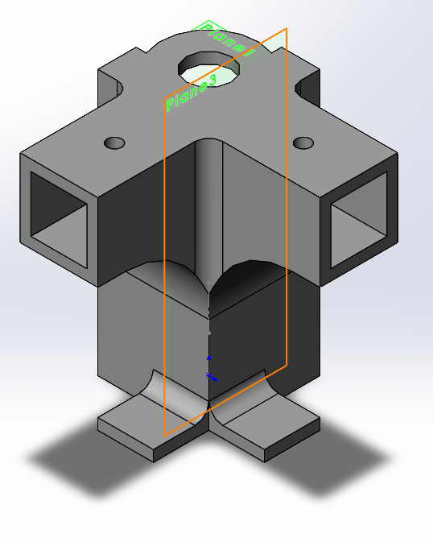
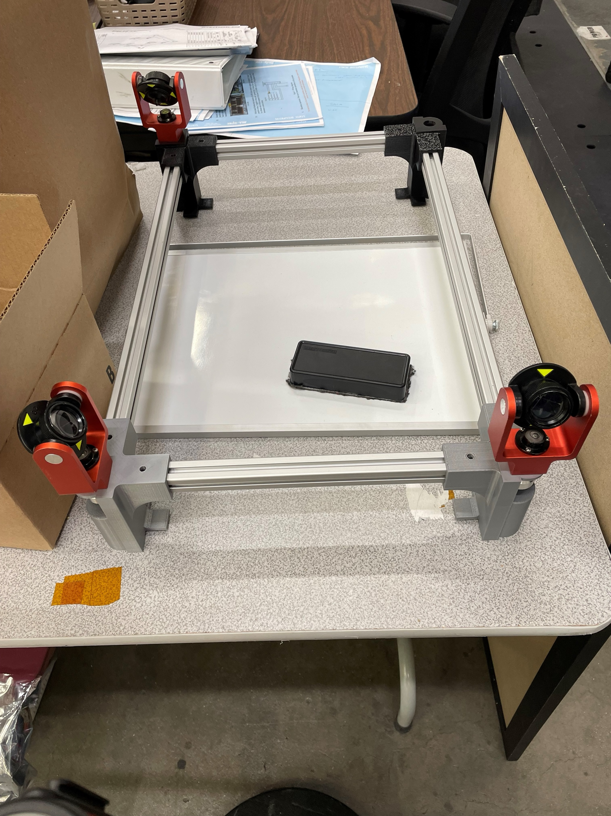
Ground Truth Data Collection
CADRE (Cooperative Autonomous Distributed Robotic Exploration)
Ground Support Equipment & Procedure Overview
The Total station utilizes laser reflecting off the prism using time of flight to determine the coordinates of the prism
The GSE consists of a frame of 8020s and “prism brackets” connecting the corners of the frame and have the prisms mounted on to be mounted on the DM with defined dimensions
There are three prisms on the frame, fully defining the 6-dof of the DM

Slide 8
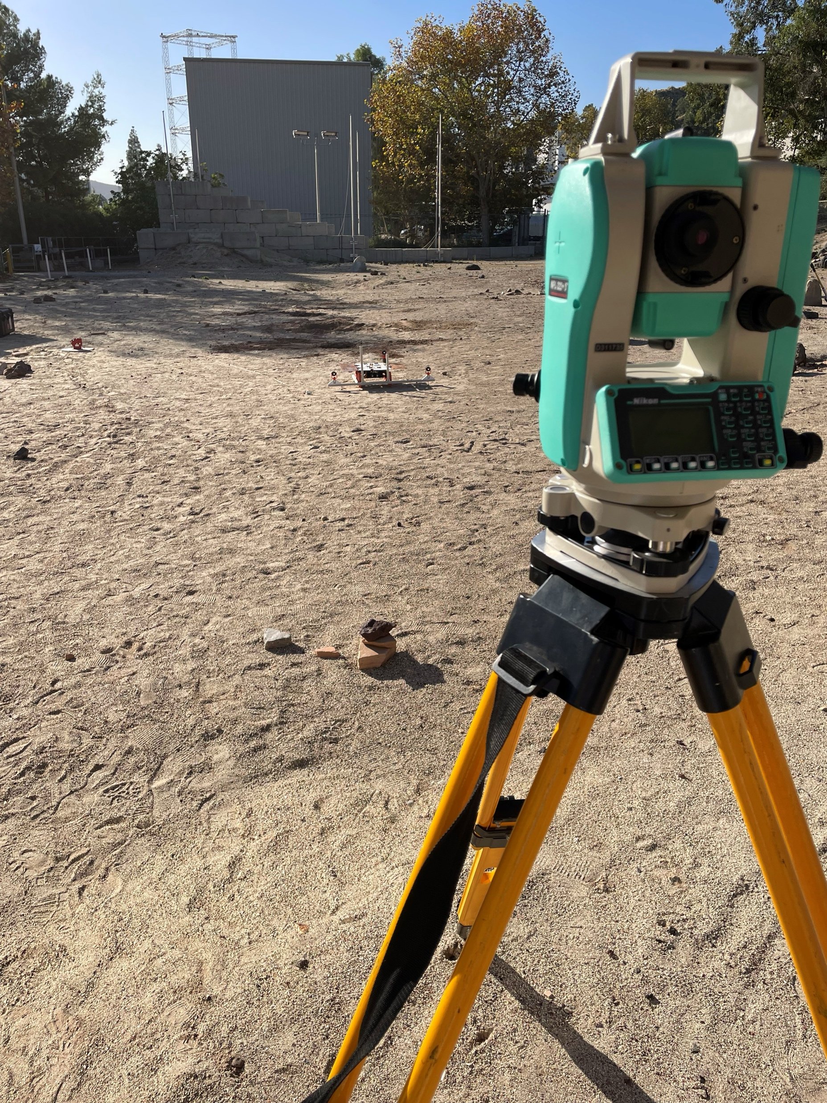
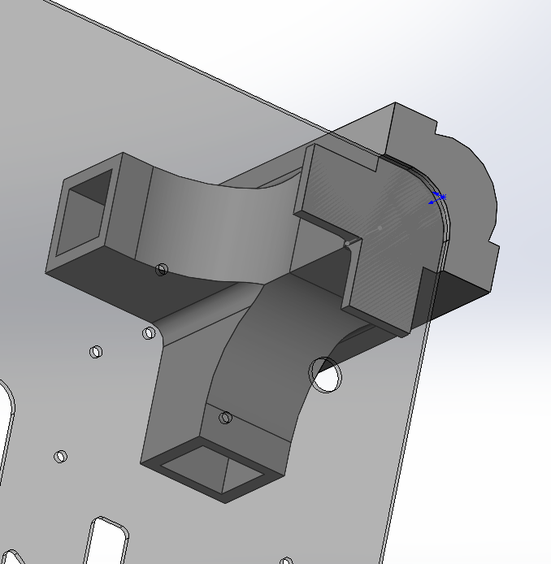
Ground Truth Data Collection
CADRE (Cooperative Autonomous Distributed Robotic Exploration)
Ground Support Equipment Development
Rapid prototyping and frequent testing has enabled iterative development of the prism brackets, as well as the procedures
The prism brackets have a groove to fit tightly at the round corners of the DM radiator plate, minimizing the sources of errors
Each prism brackets have varying height by 2mm, for identification of the individual prisms after the data collection

Slide 9
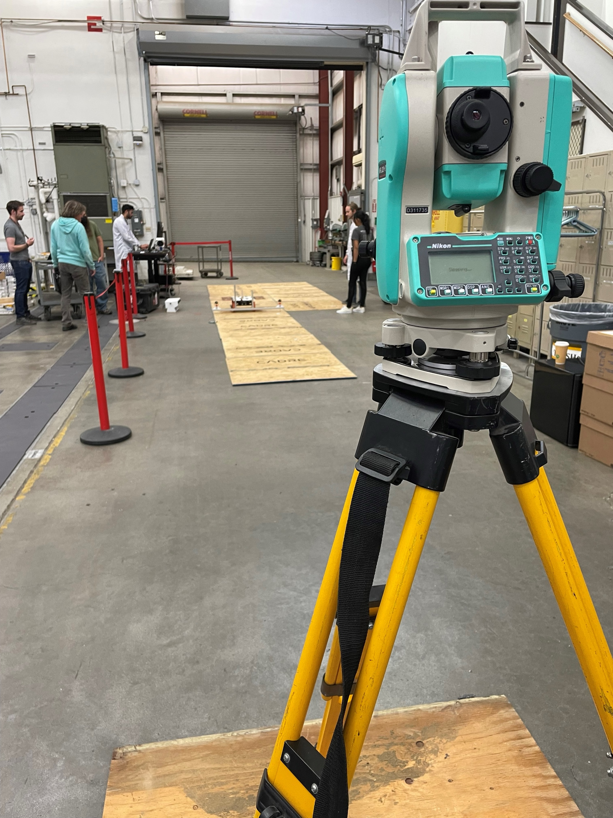
Ground Truth Data Collection
CADRE (Cooperative Autonomous Distributed Robotic Exploration)
Data Collection Procedure Development
Setting up the Total station
  Tripods
  Telescope leveling
Mounting the GSE
  Fit the brackets on the radiator plate
Measure the coordinates
  Obtain the coordinates using buttons and dials
Upload the data

Slide 10
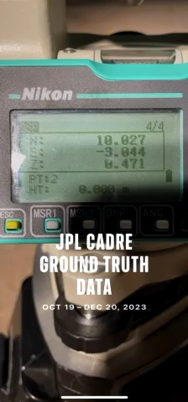
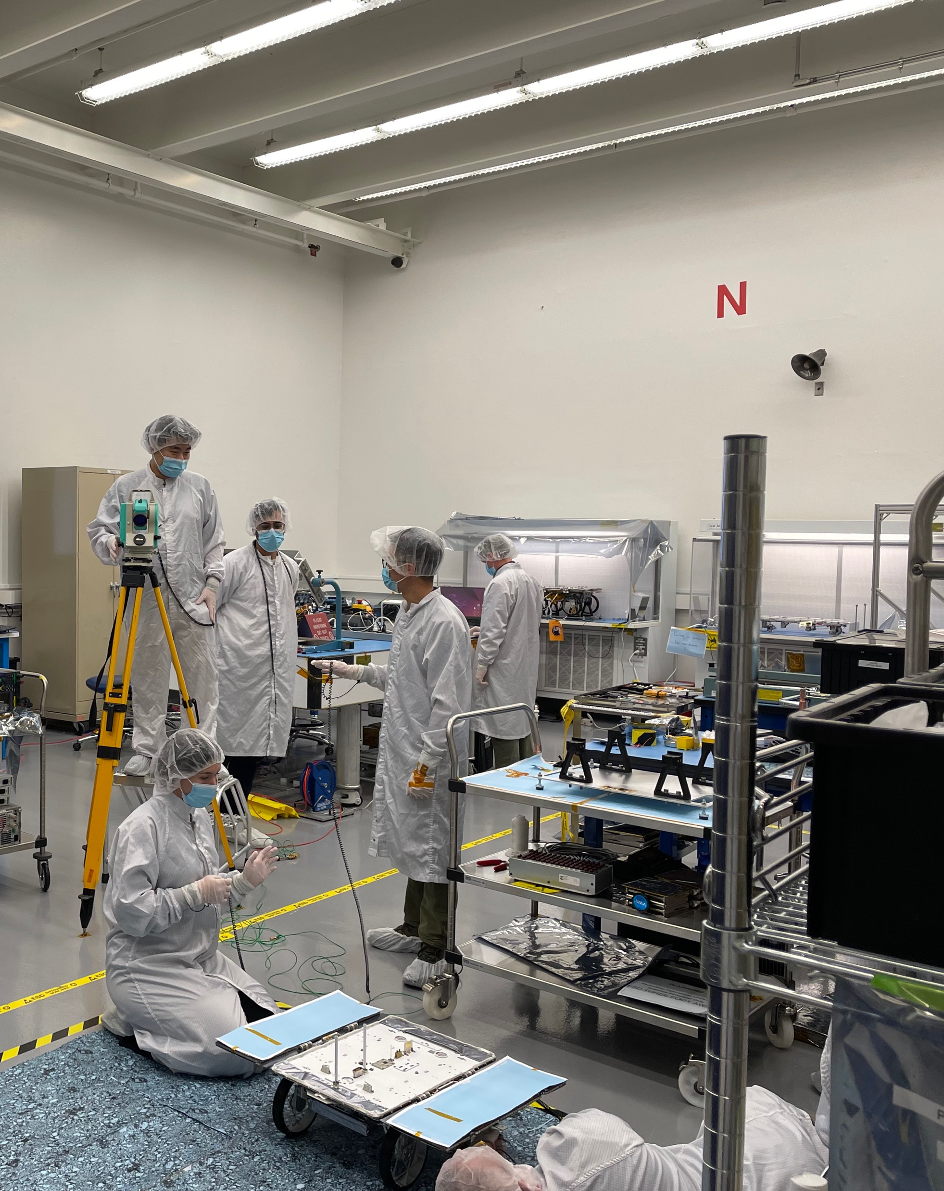
Ground Truth Data Collection
CADRE (Cooperative Autonomous Distributed Robotic Exploration)
Project Contribution Status
Collected over 300 coordinates
Assisted CADRE GNC development
Documented the development & procedures
Supporting CADRE Flight Model GNC checkouts in ATLO

Slide 11
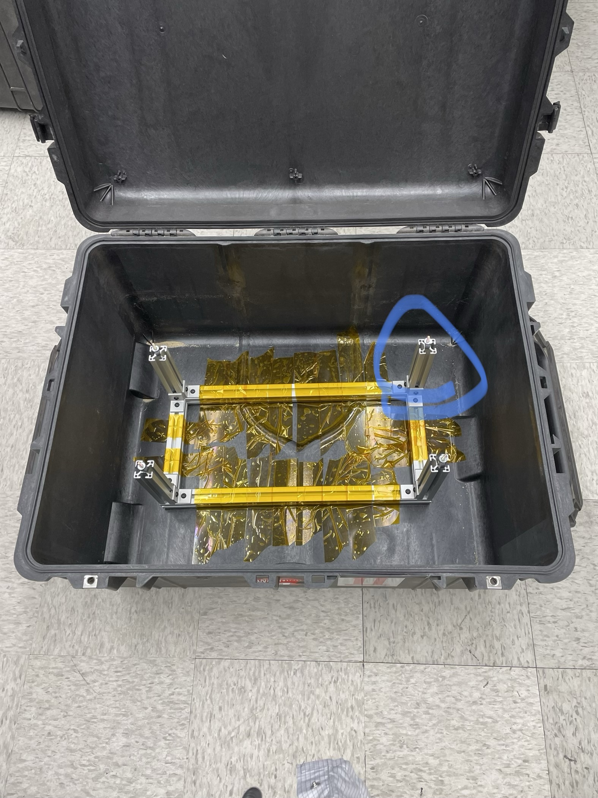
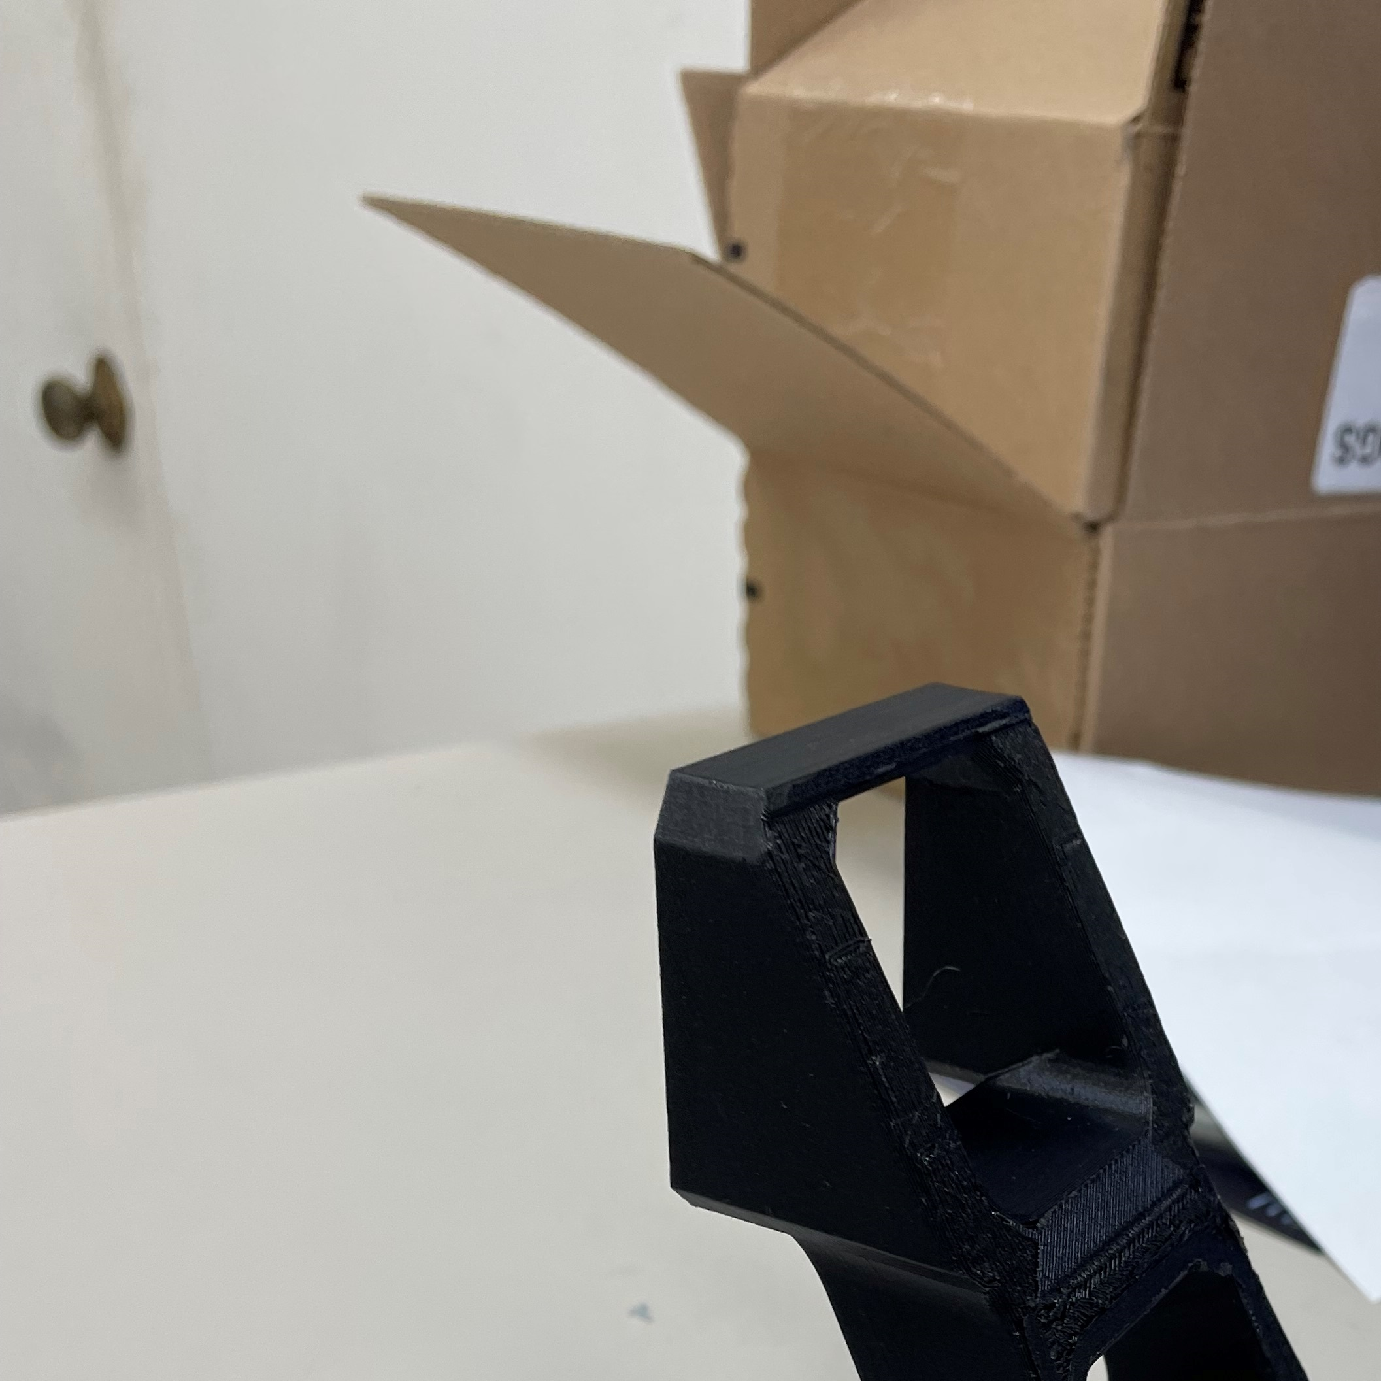
More CADRE V&V Support
CADRE (Cooperative Autonomous Distributed Robotic Exploration)
What else did Minsoo do?
Set up the Mars Yard testing
Design and manufacture various miscellaneous components
Charge/set up rovers for tests
Modify and manufacture DM wheels
Build the CAD assembly of the rover
Installed dampers to the rover transport frames

Slide 12
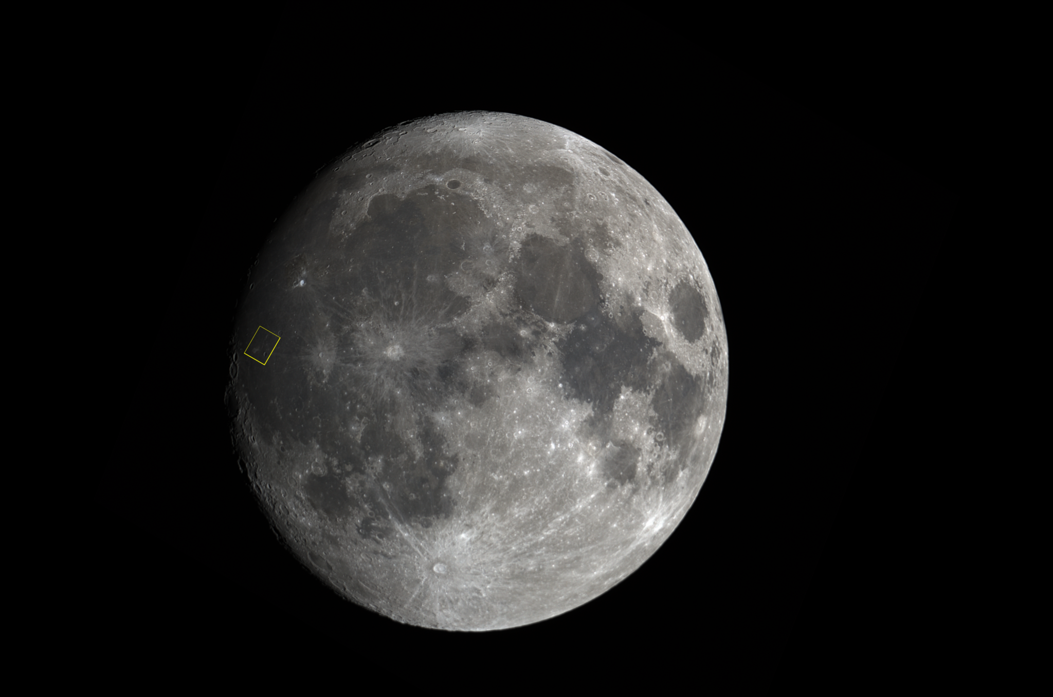
Lessons, Inspirations, and Future
CADRE (Cooperative Autonomous Distributed Robotic Exploration)
Takeaways from the internship
Invaluable hands-on experience on a flight mission
Experienced what is like to work on space robotics
Gained critical interests in autonomy
New goals to pursue graduate education

Slide 13
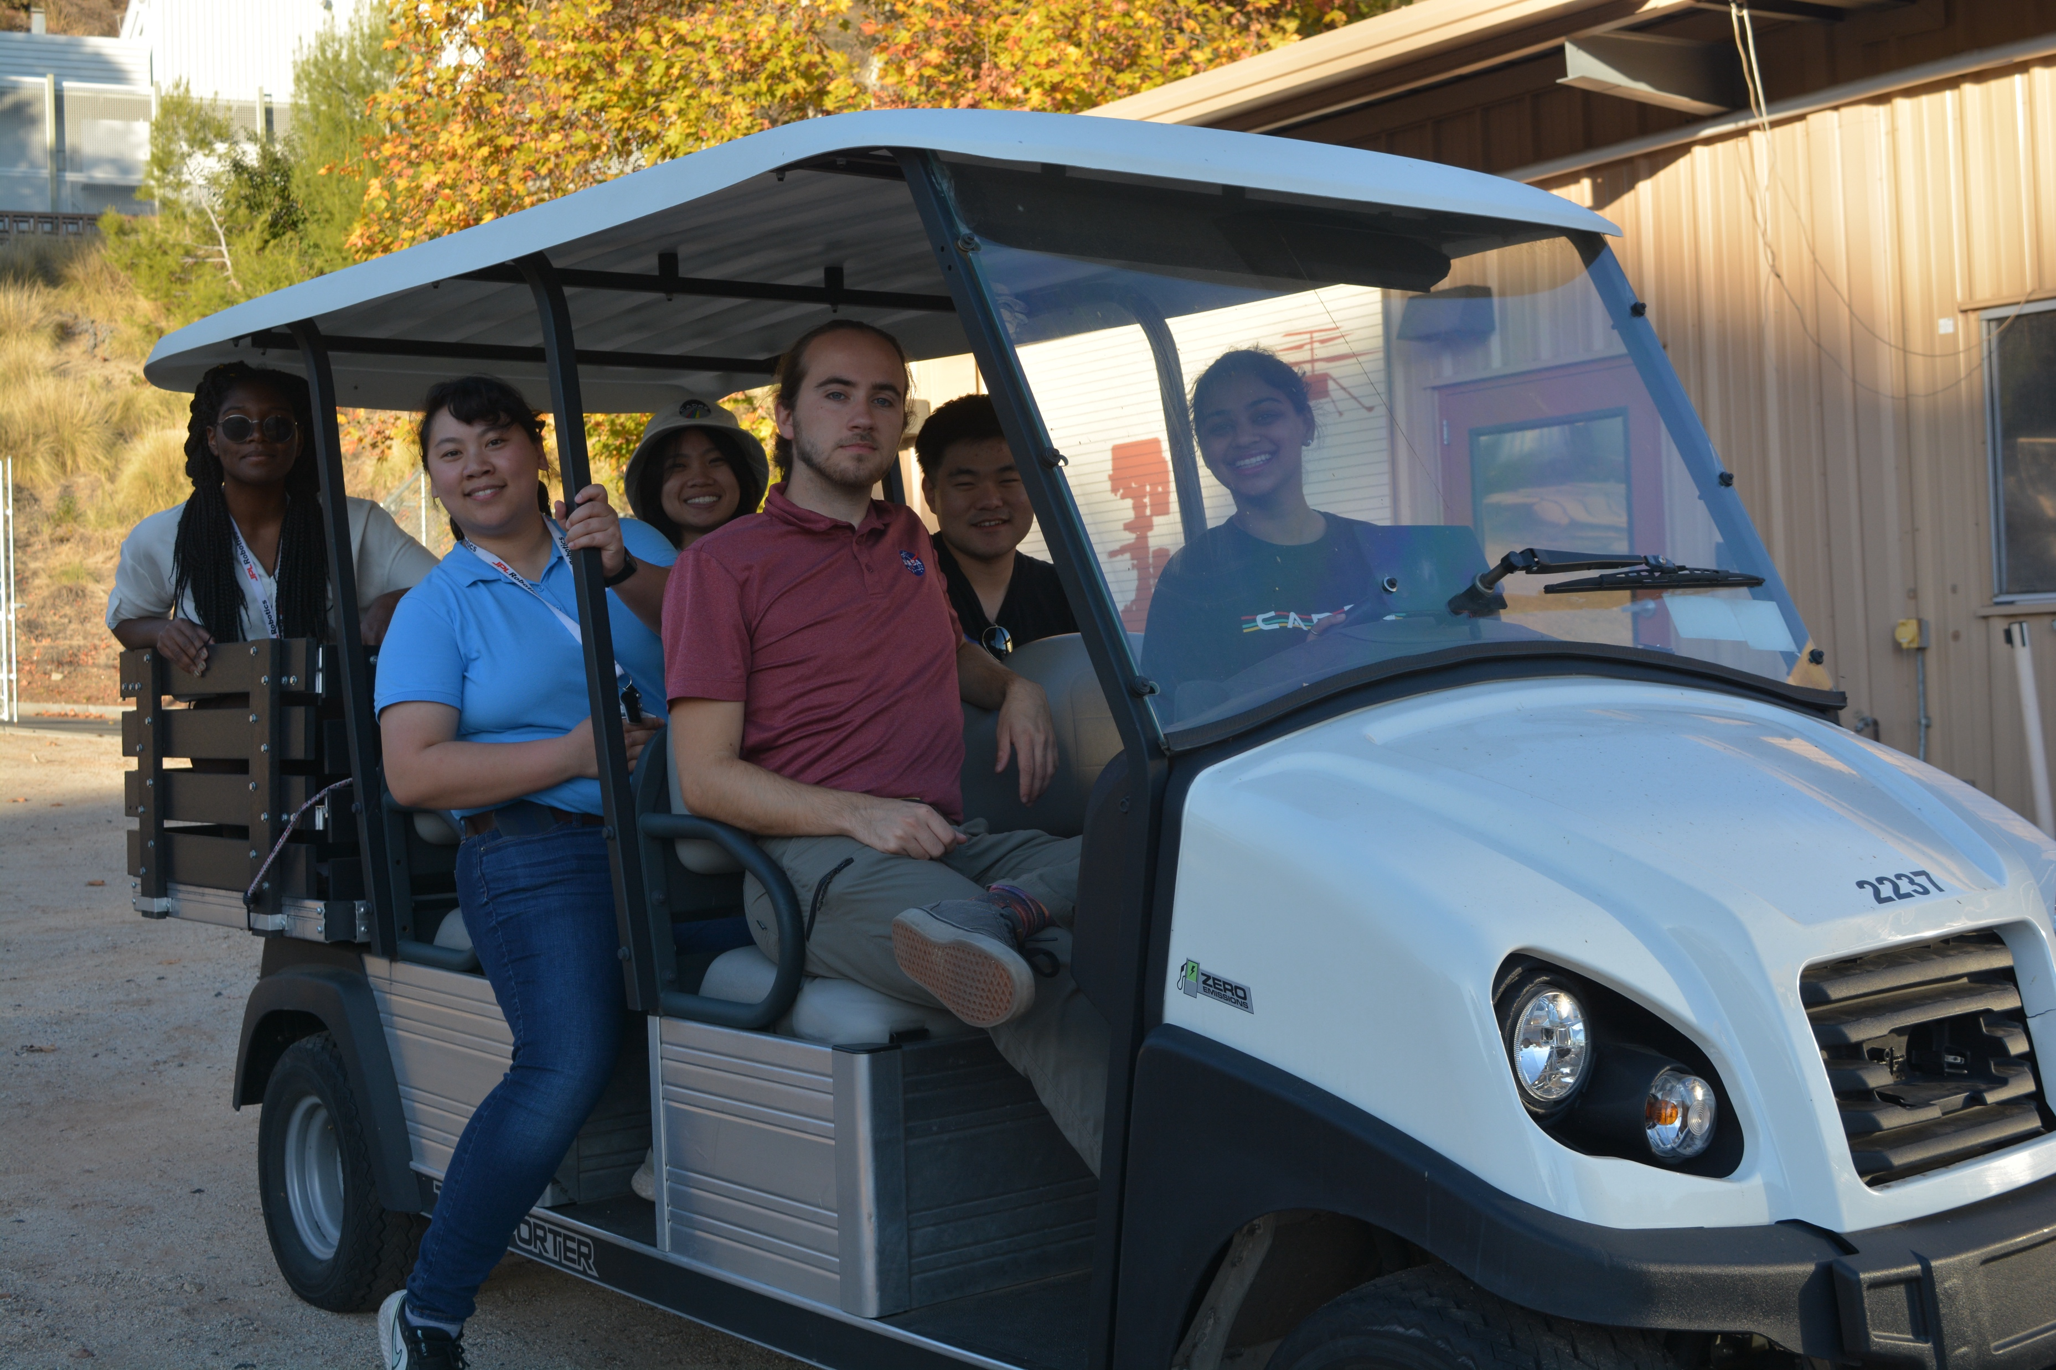
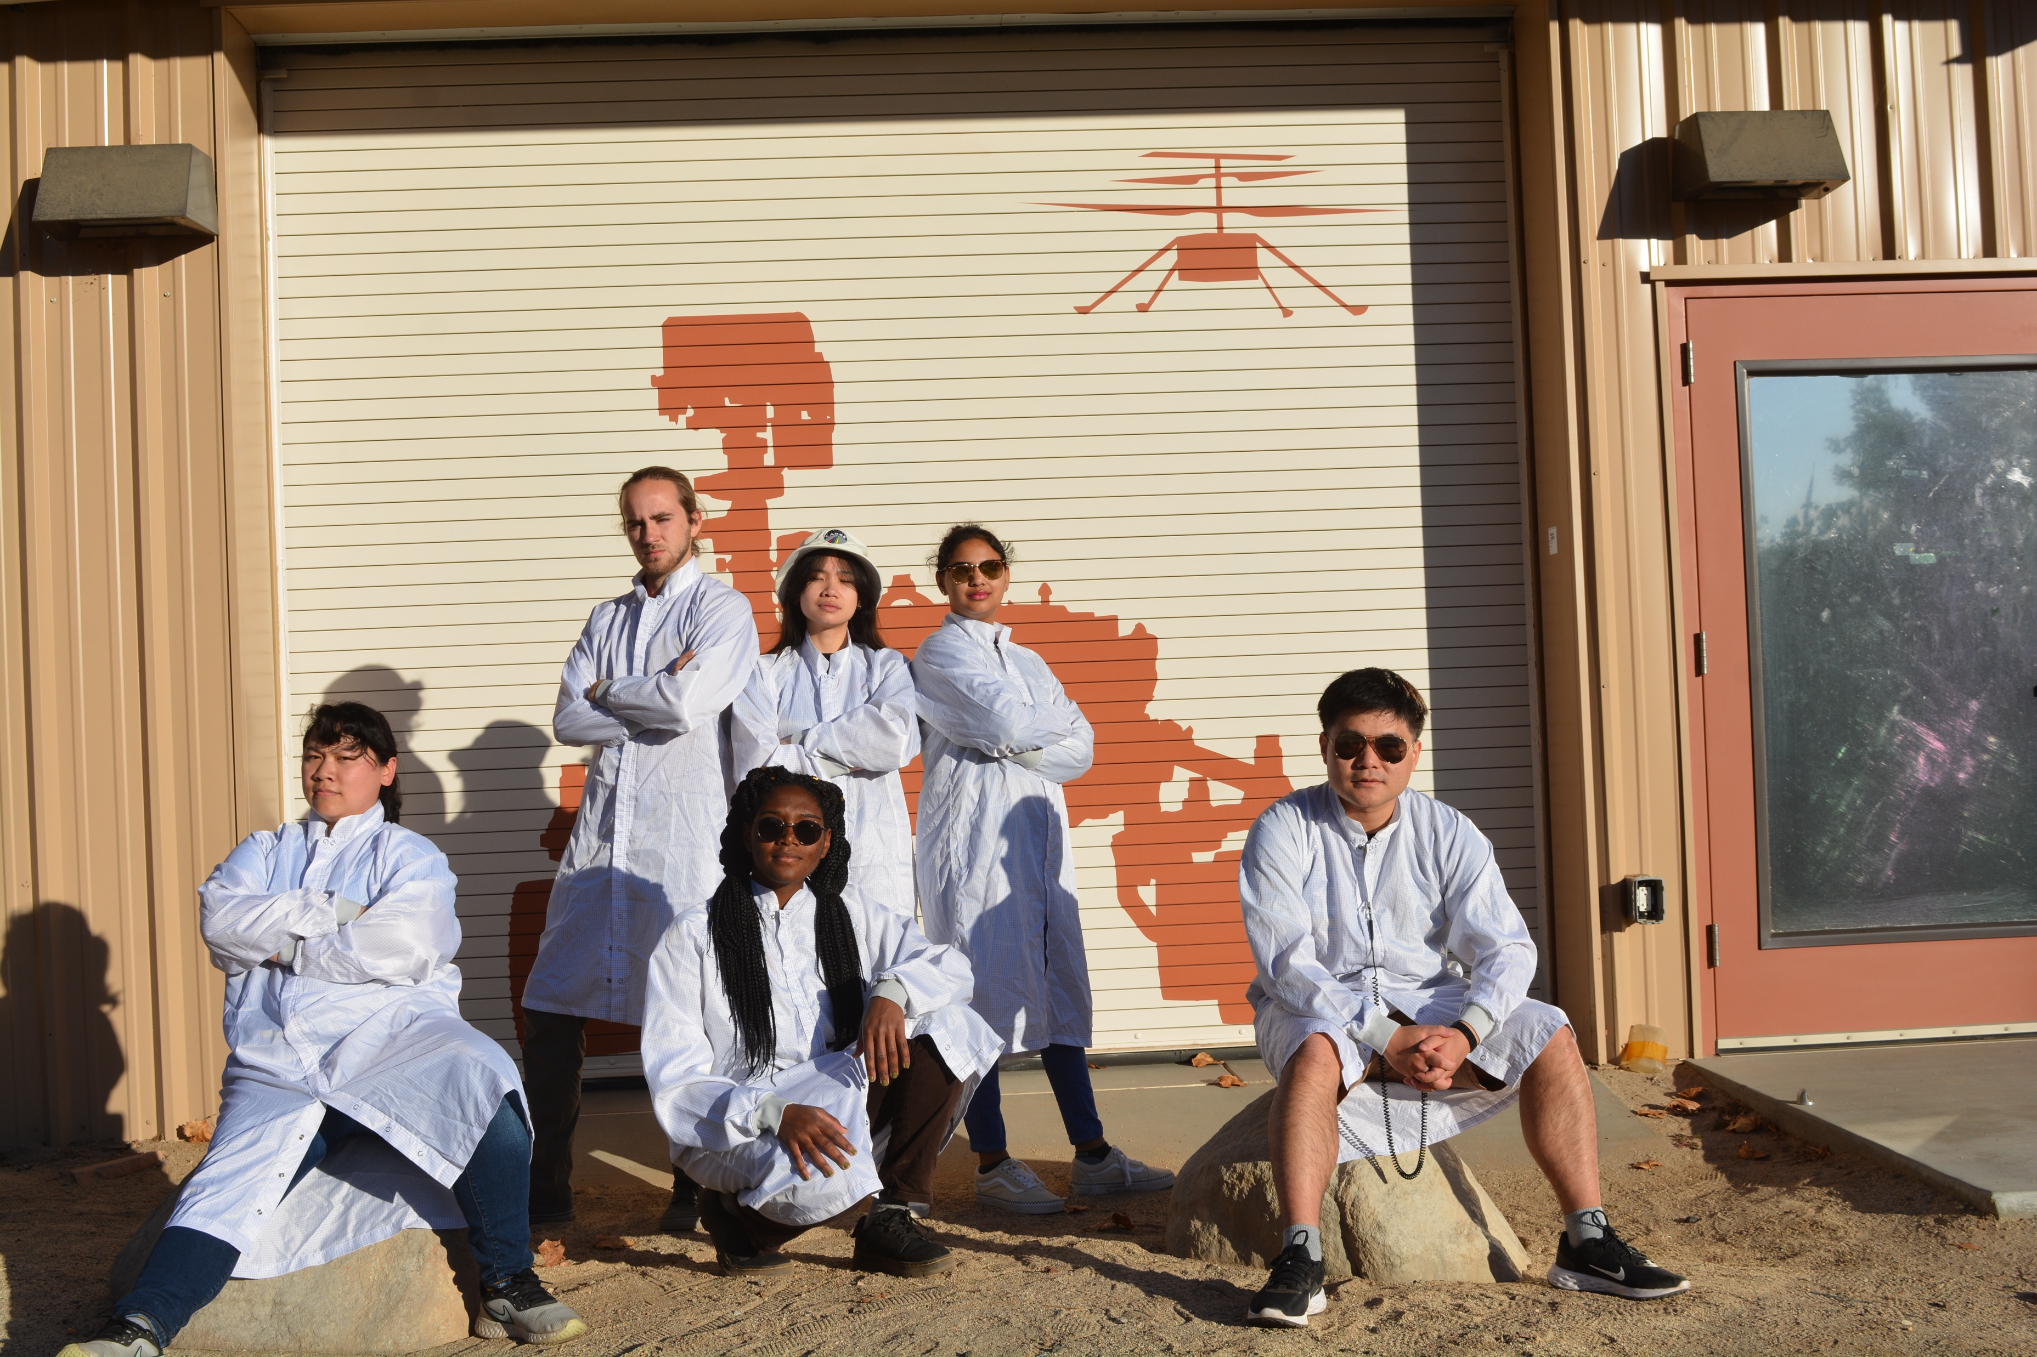
Acknowledgement
CADRE (Cooperative Autonomous Distributed Robotic Exploration)
Sawyer, Nihal, Baylor, and Philip
Natalie, Melissa, Janelle, Kaiy, and Niall
Rob, Jeff, Pedro, Keenan and Roland
Dustin and Grace
Tonya, Camden, Tomas, and more!

Slide 14
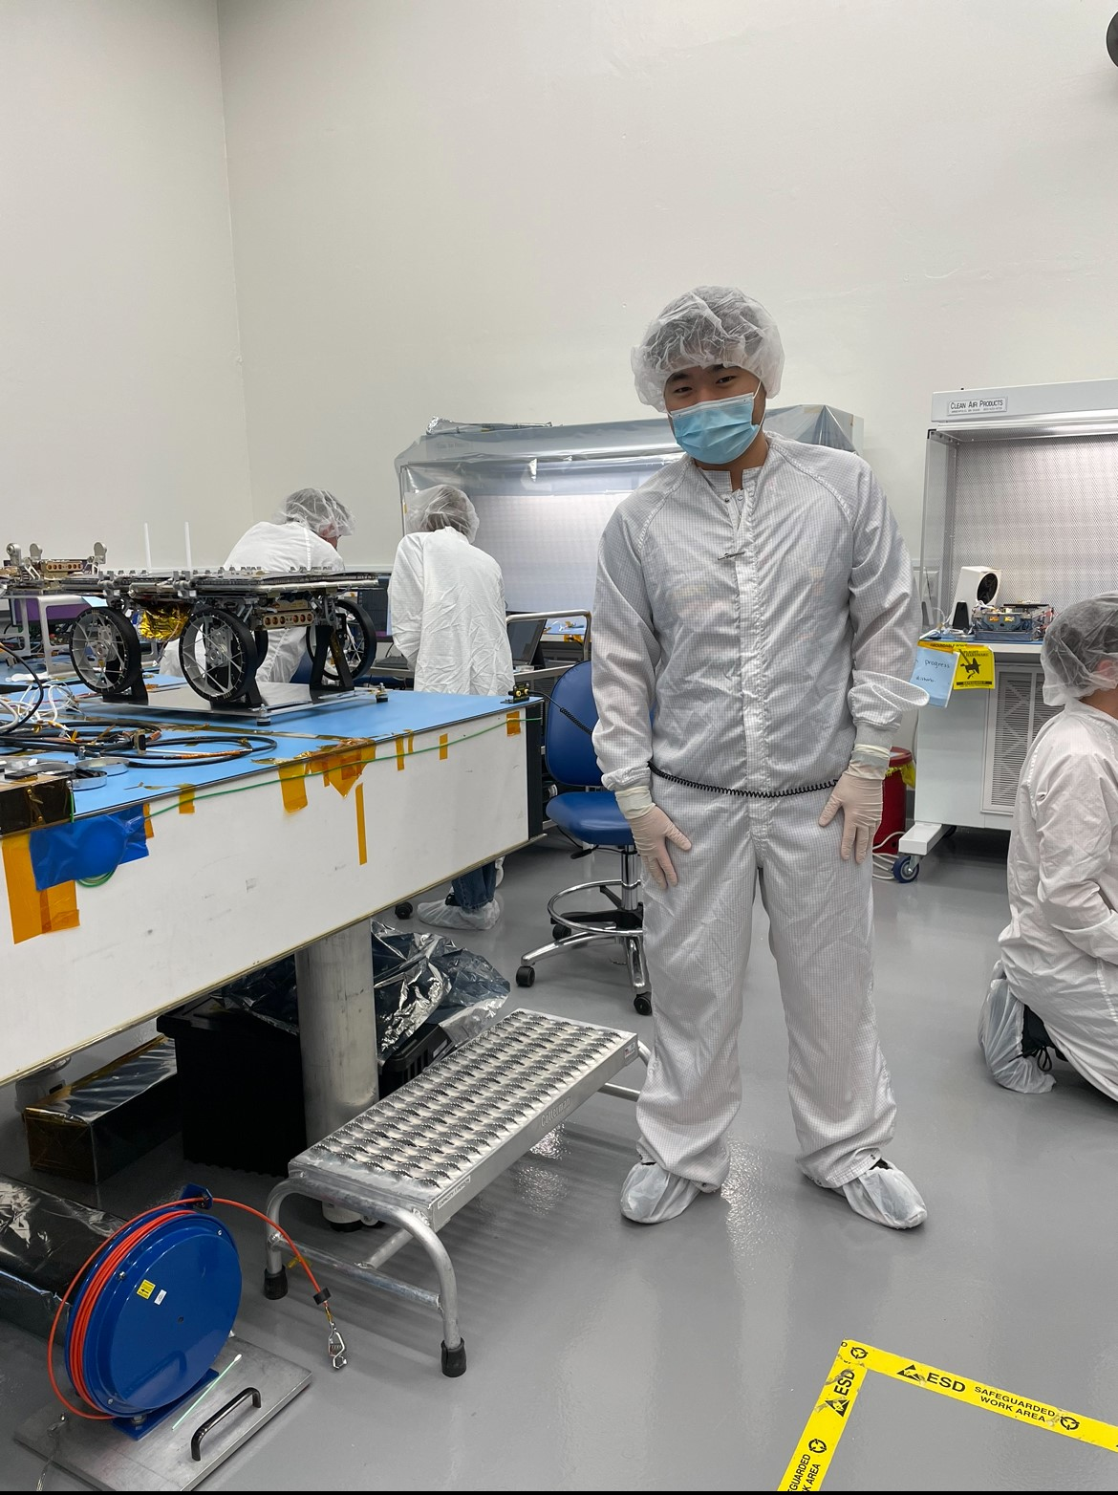
Additional Photos
CADRE (Cooperative Autonomous Distributed Robotic Exploration)

Slide 15
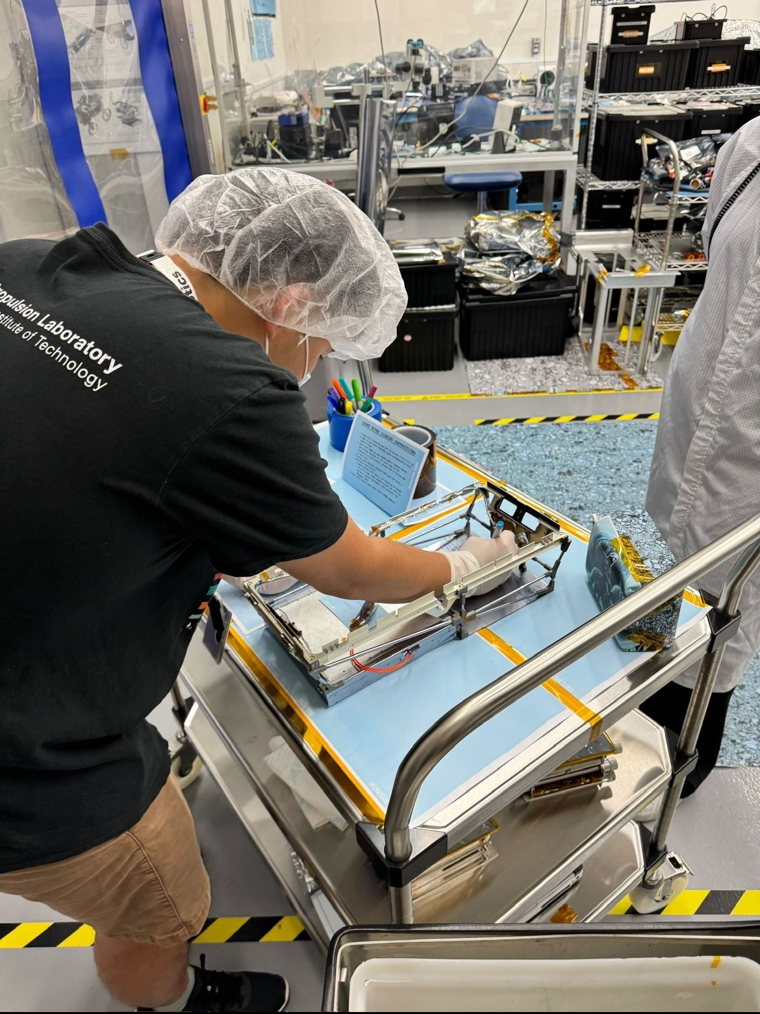
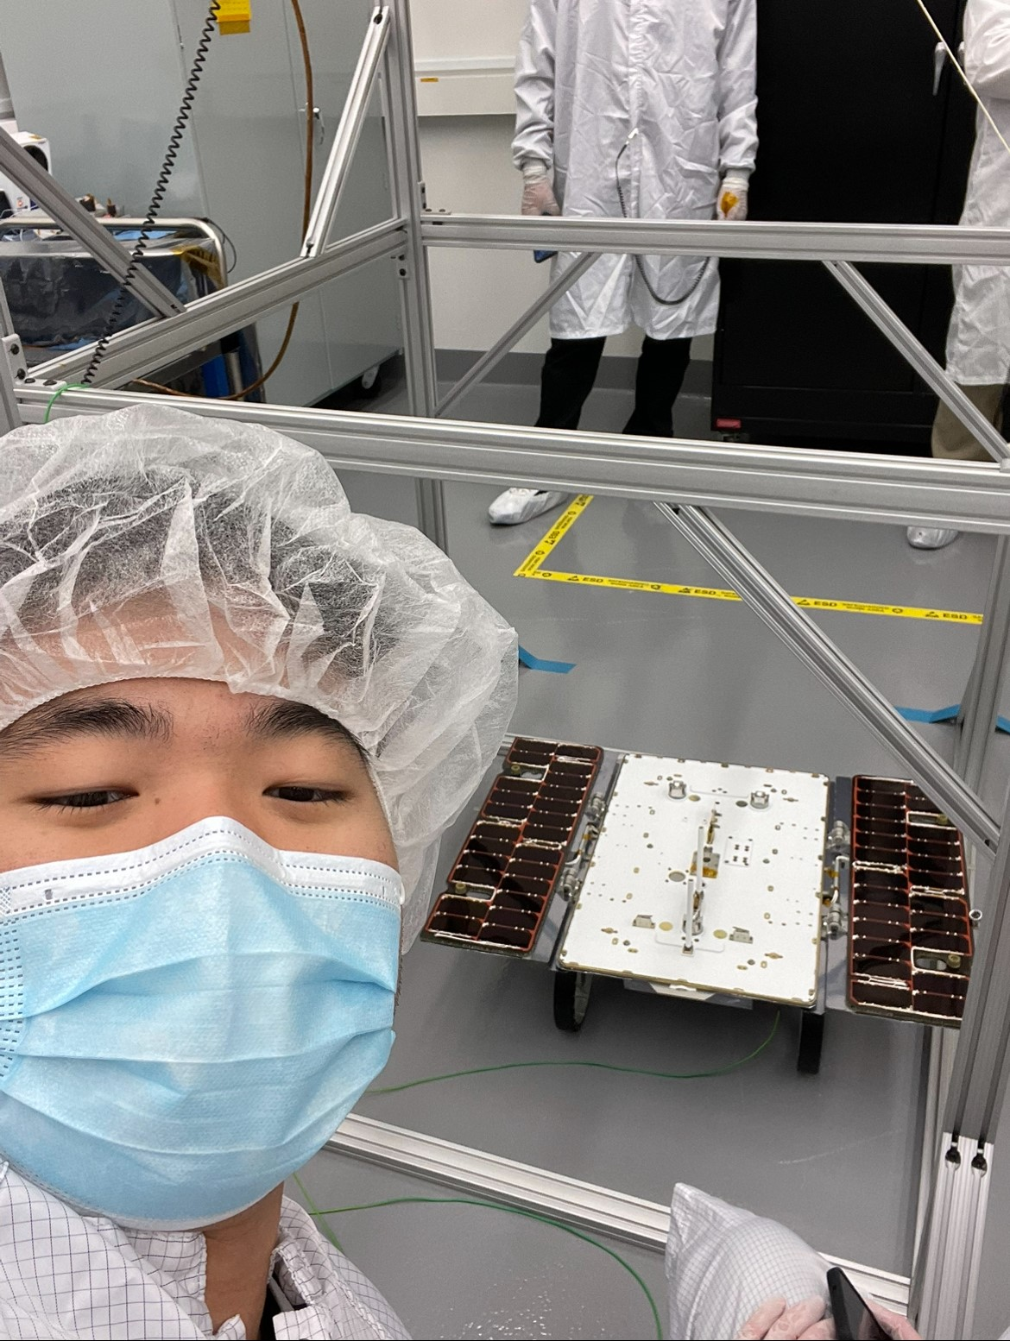
Additional Photos
CADRE (Cooperative Autonomous Distributed Robotic Exploration)

Slide 16
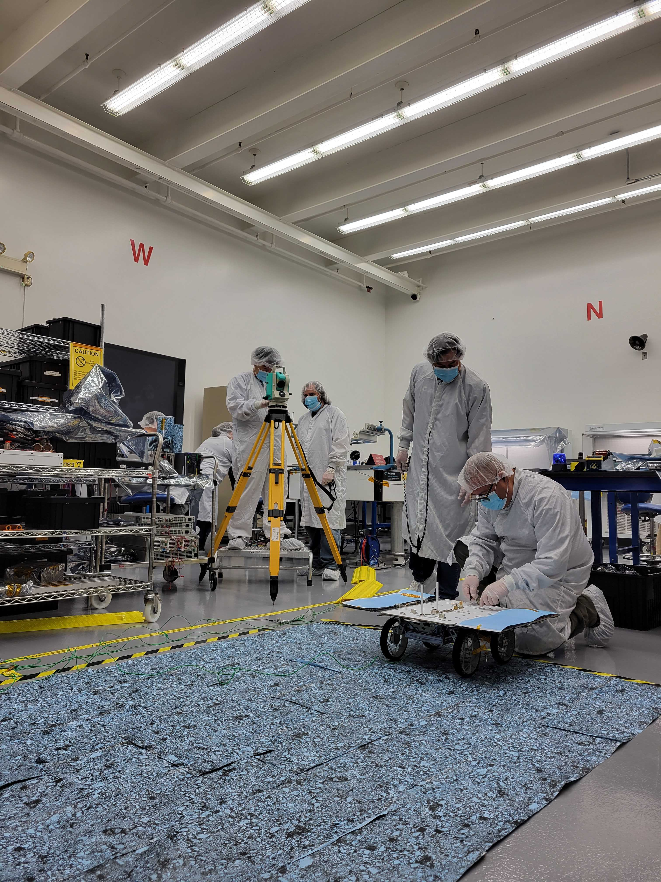
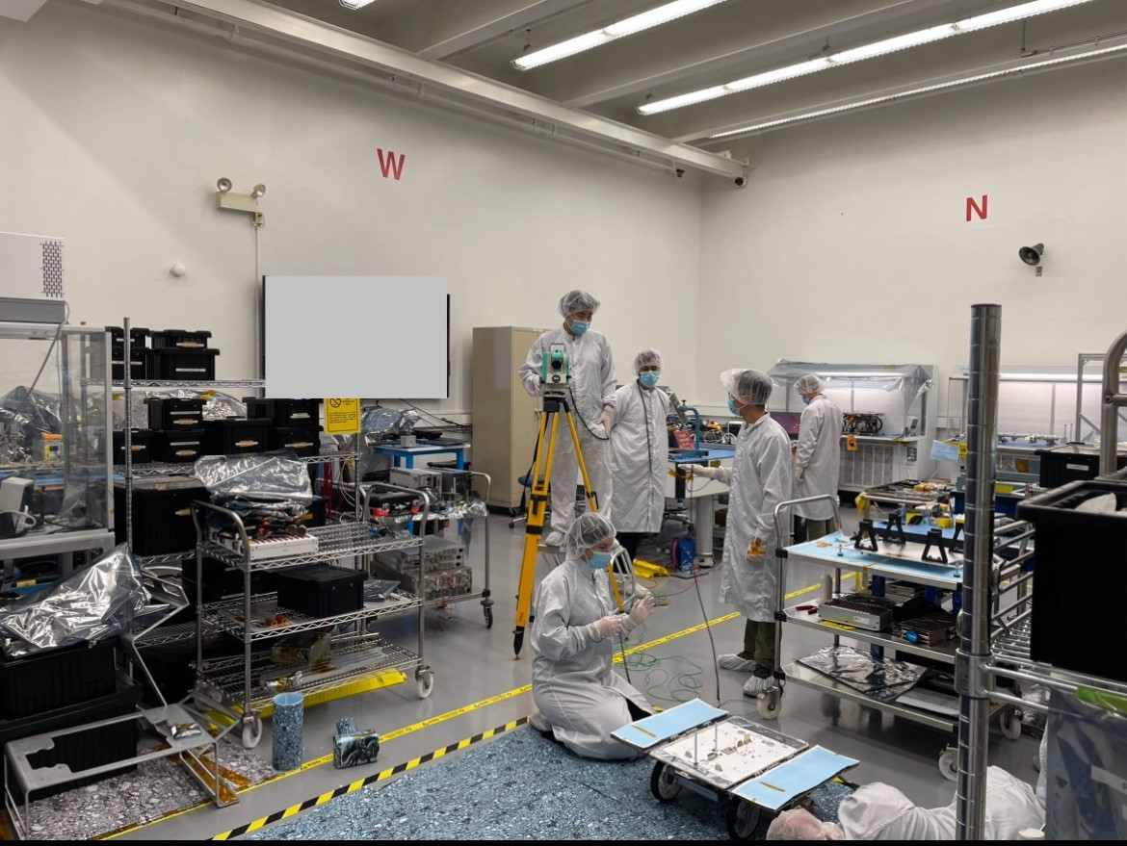
Additional Photos
CADRE (Cooperative Autonomous Distributed Robotic Exploration)

Slide 17
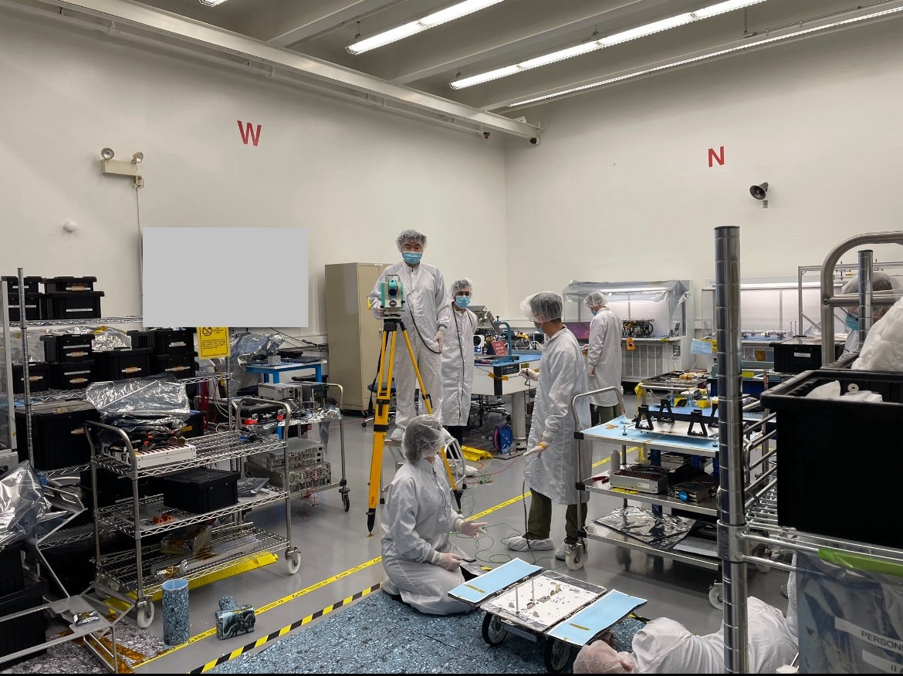
Additional Photos
CADRE (Cooperative Autonomous Distributed Robotic Exploration)

