Slide 1
Robotics Capabilities Development for Mars Sample Return Transfer Activities
Note: this presentation describes work from the circa 2023 MSR architecture that has since been changed.
© 2025 California Institute of Technology. Government sponsorship acknowledged.
Sample Transfer System
Marco Dolci, Joseph Bowkett, Philip Bailey, Anna Boettcher, Junggon Kim, Preston Rogers, Tu-Hoa Pham, Daniel Chavez Clemente, Jennifer Shatts, Julie Townsend, Philip Twu, and Curtis Collins
Jet Propulsion Laboratory, California Institute of Technology
The decision to implement Mars Sample Return will not be finalized until NASA’s completion of the National Environmental Policy Act (NEPA) process. This document is being made available for information purposes only.
03/05/2025
Notes:
Hi all I’m …
Presenting on behalf of the listed authors, as their travel clearance was revoked.
Today we’re presenting…
We need to stress that the content in this package relates to the circa 2023 MSR architecture which has since changed

Slide 2
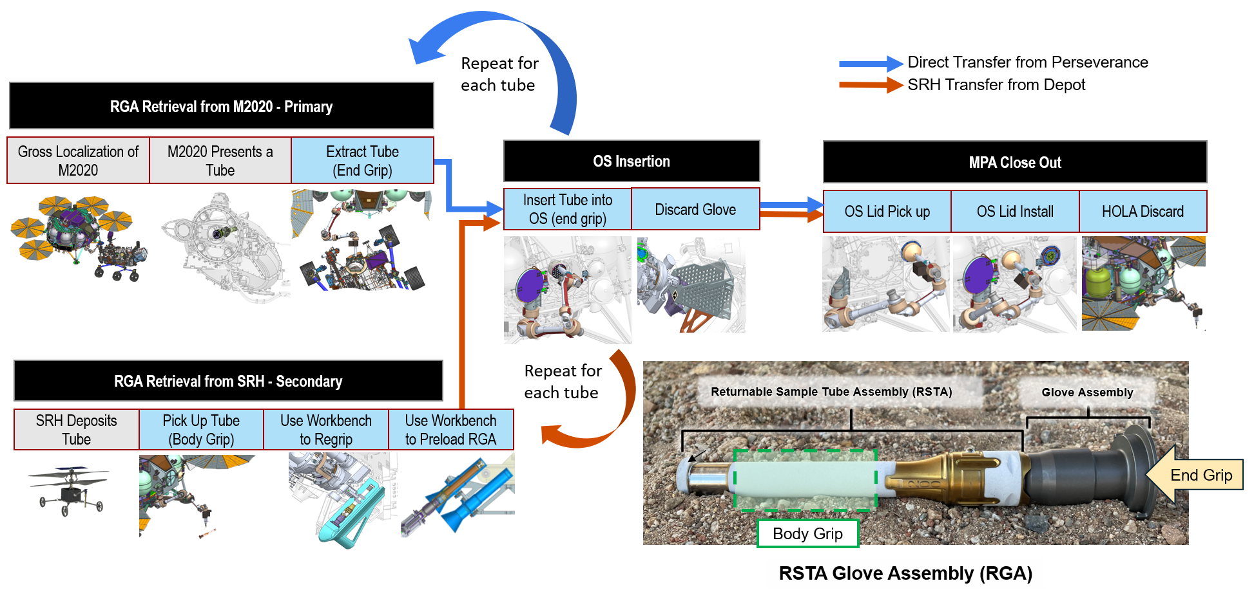
Overview: Sample Transfer System (circa 2023 architecture)
Pre-Decisional Information – For Planning and Discussion Purposes Only
Notes:
The mission revolves around the Returnable Sample Tube Assembly or RSTA
Each light blue box represents an interaction that involves the Sample Transfer System
RSTAs are presented by either the Perseverance rover, or by one the two (now deprecated) Sample Retrieval Helicopter platforms
Each of the tubes is inserted into the Orbiting Sample or OS, the OS lid is installed, then the HOLA tool used to hold it discarded
Each of these operations employs a set of what we call Robotics Capabilities broken down into sub categories

Slide 3
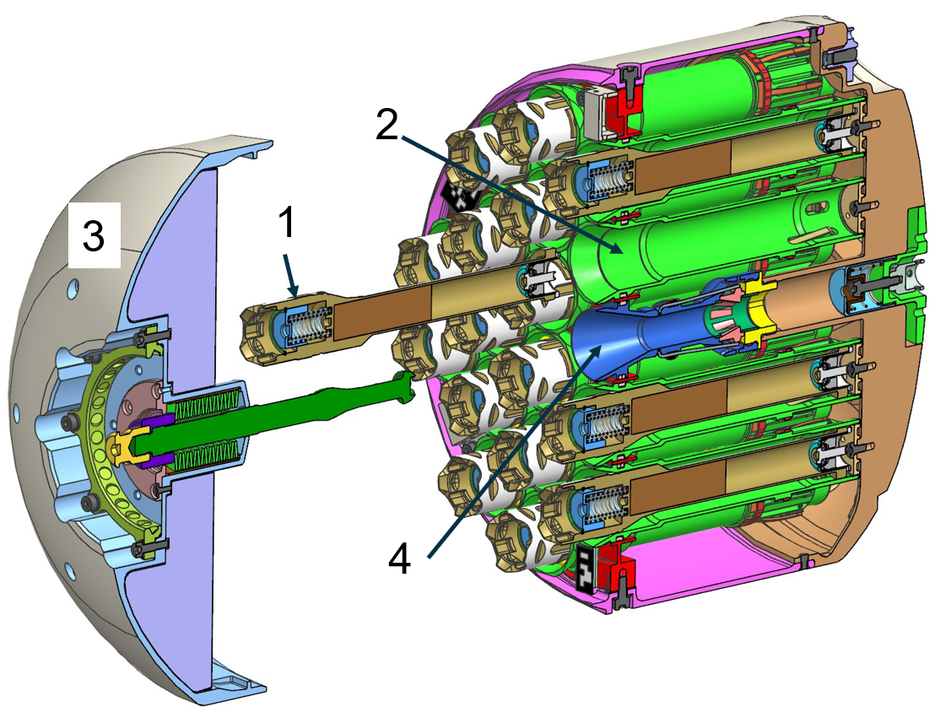
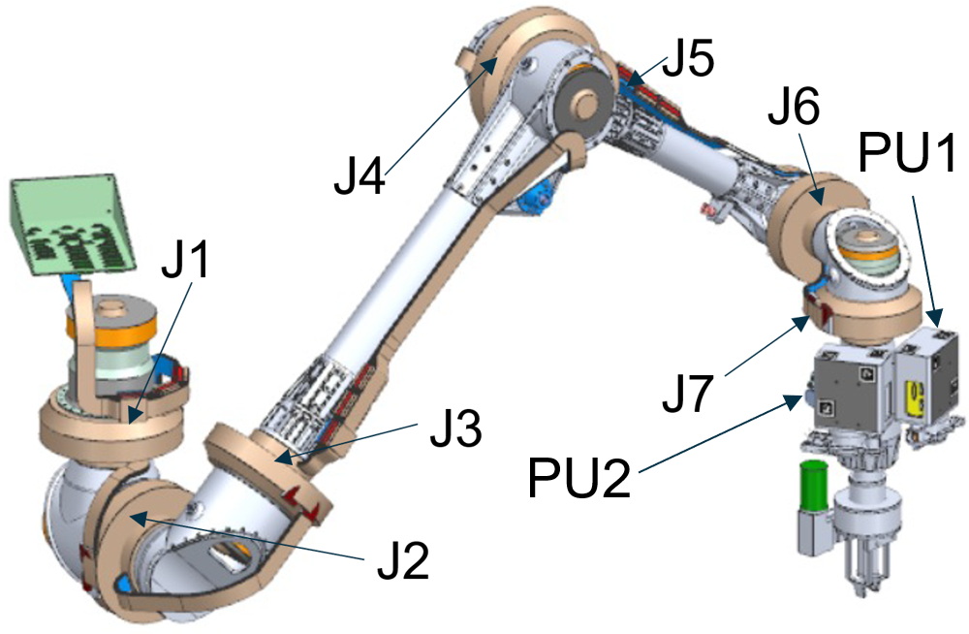
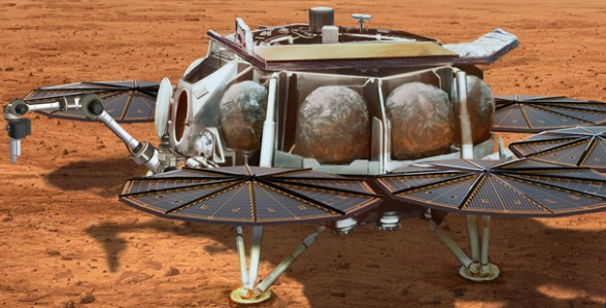
Relevant Hardware
End effector
7-DoF Sample Transfer Arm (STA)
Orbiting Sample (OS) & Lid
Cross section of a sample tube
An OS sleeve that houses a sample tube
The OS lid, installed after tubes are inserted
Chamfer that receives OS lid bullnose
STA Kinematic configuration
Notes:
Each of the robotic capabilities revolves around the operation of the Sample Transfer Arm or STA
This was planned to be provided by the European Space Agency and their contractor, Leonardo Robotics
It consists of 7 rotary joints in alternating Roll and Pitch configurations
Beyond the last joint there are two cameras termed Perception Unit 1 and 2, and an end effector that permits grasping either the side or end of a sample tube
Most interactions involve inserting objects into the Orbiting Sample or OS canister
Within the OS there are 30 sleeves for sample tubes, as well as a receptacle that receives the tip of the OS lid and pulls it onto the canister

Slide 4
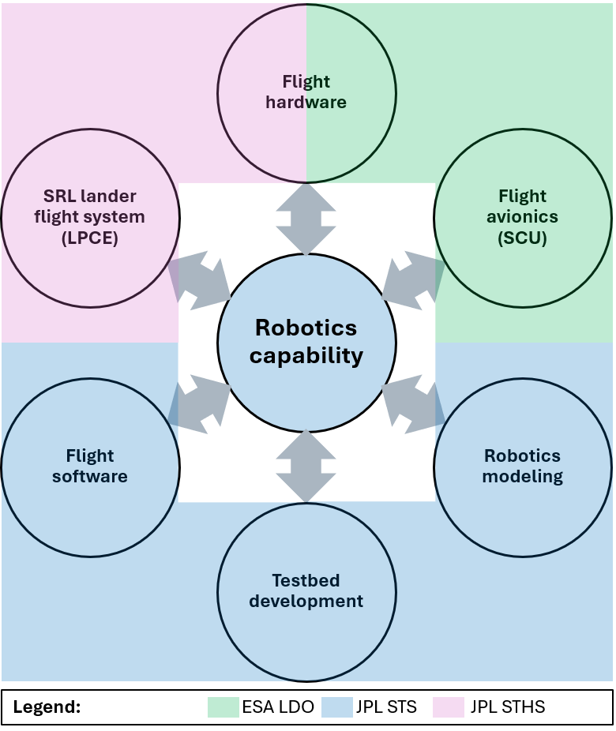
Robotic Capability Breakdown
7-DoF Sample Transfer Arm (STA)
STA Kinematic configuration
Notes:
With hardware and software coming from a variety of teams, there was a significant amount of coordination necessary
NASA JPL’s Sample Transfer System team provided the following Robotics Capabilities, as well as the flight software, modeling, and testbeds for their development
The flight hardware comes from both ESA LDO in the form of the arm, as well as the JPL Sample Retrieval Lander flight system
ESA LDO also provide the flight avionics or Servo Control Unit for the Sample Transfer Arm

Slide 5
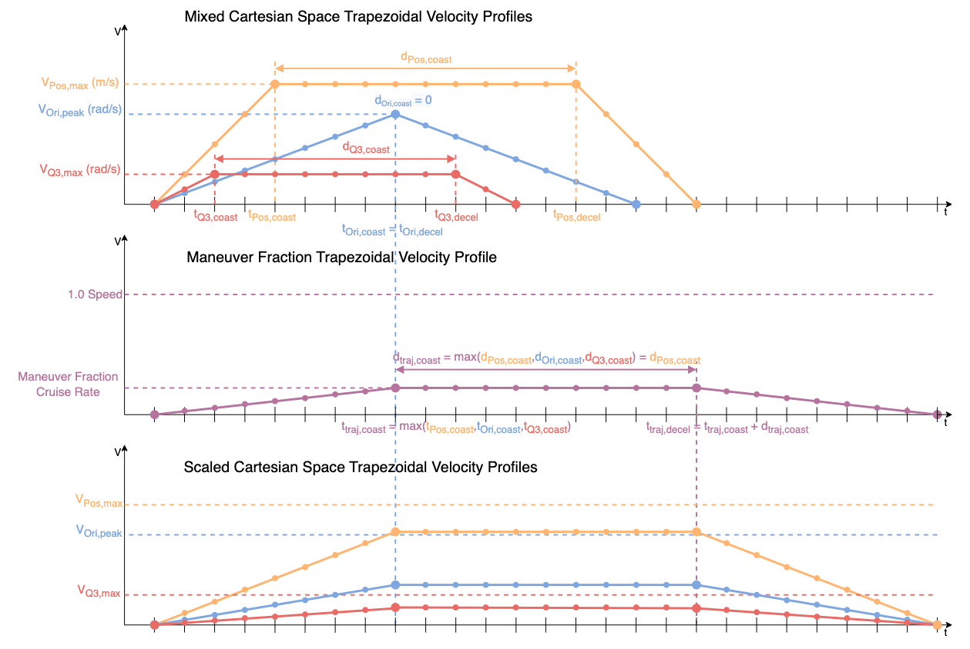
Capability Area: 7-DoF Manipulation
7-DoF (degree of freedom) Manipulation manages the forward and inverse kinematics of the Sample Transfer Arm
Right: an example Cartesian motion profile that is synchronized and aligned across joints
The input profile has a translation distance, dPos, rotation distance around the axis of motion, dOri, and a rotation distance in joint 3, dQ3
Notes:
The first of the robotic capabilities that was developed was termed 7-DoF Manipulation
This captures all the forward and inverse kinematics needed to compute the motion of the arm, including Jacobian and tool compliance matrices
One example of the deliverables from the capability is the ability to execute a linear Cartesian motion with a tool, such as when approaching a station
This is achieved using a trapezoidal profile, where after a period of acceleration, the Cartesian velocity reaches a cruise phase, before decelerating back to stop. These velocities are fed through Jacobian matrices to achieve the needed joint velocities to track the profile in the tool frame

Slide 6
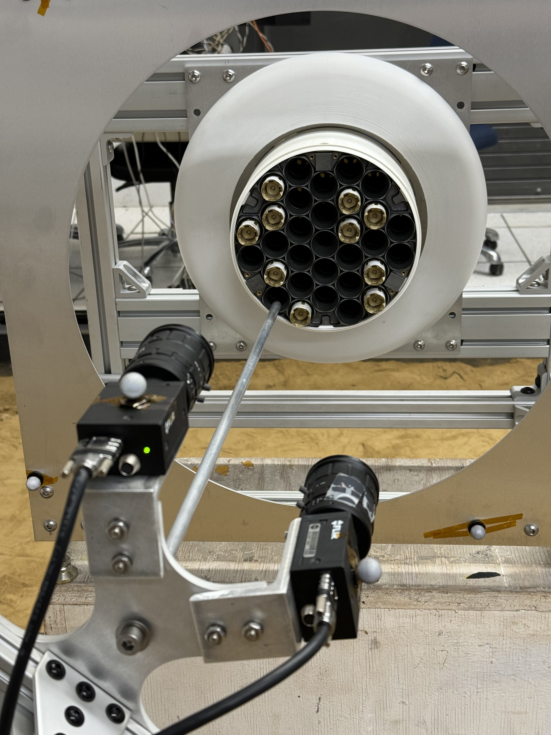
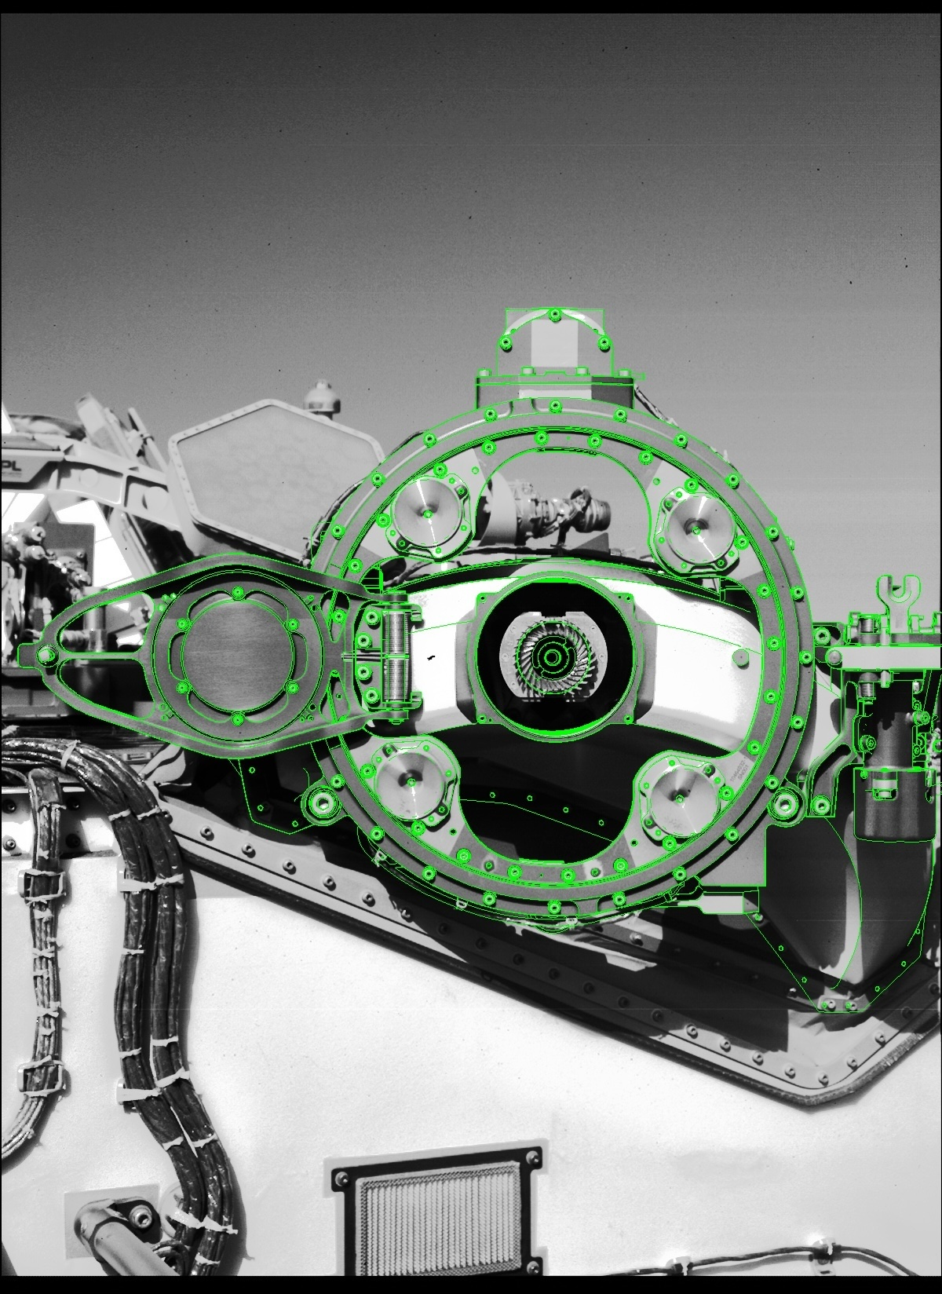
Capability Area: Robotic Vision
Robotic Vision affords the means to refine tool pose via the two end effector perception units
OS testbed with representative cameras and stand-in end-effector
Image captured of the M2020 dock by M2020’s WATSON camera, with the TSM-based localization overlaid on edges
Notes:
Next comes Robotic Vision, which allows us to refine the positioning of the STA relative to both SRL and any external systems it interacts with
It does this by using the two cameras on the end of the STA to perform stereo disparity mapping, and then identify expected geometries in the station we’re interacting with
On the left we have a testbed experimenting with localizing a partially filled OS, and on the right is an example stereo localization of the Perseverance dock as though the STA were about to extract a sample tube

Slide 7
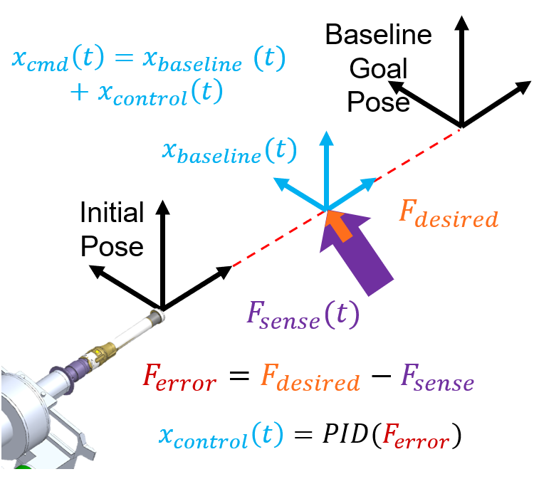
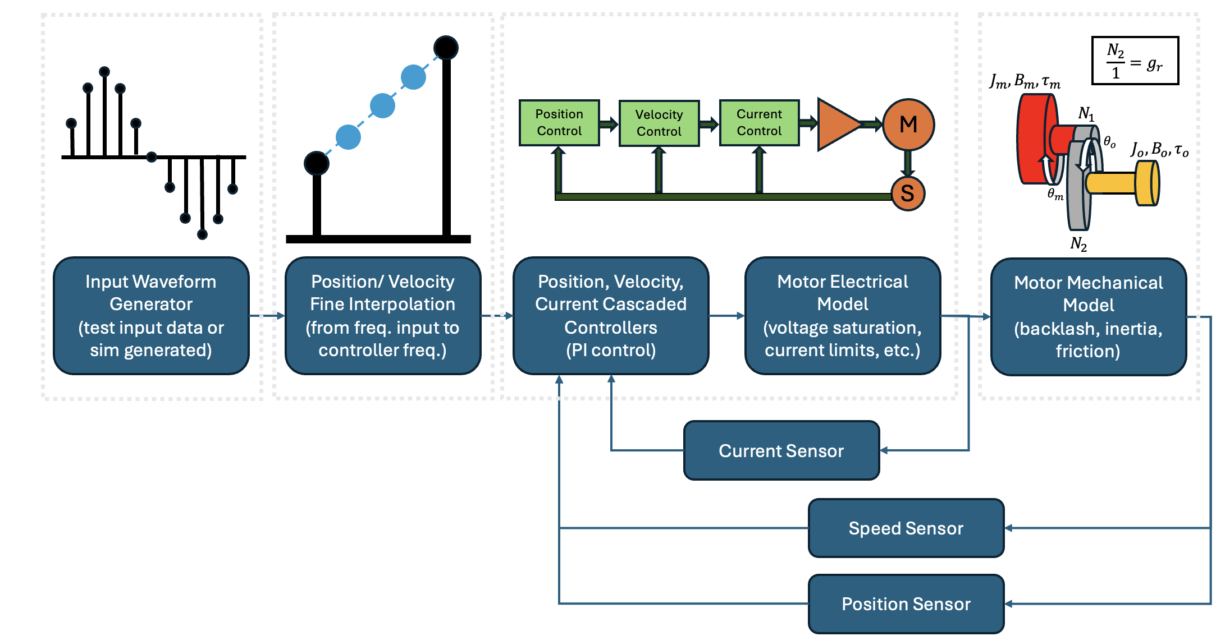
Capability Area: In-Contact Manipulation
In-Contact Manipulation dictates the response of the Sample Transfer Arm during all forceful station interactions, such as inserting sample tubes into the OS
A depiction of the elements of the simulation for
each of the 7 actuators within the Sample Transfer Arm
The force regulation algorithm is applied on top of either static or changing baseline arm joint angles
Notes:
Once the tool pose has been refined by vision localization, we turn on what is called In-Contact Manipulation in order to react to forces measured during station interactions, otherwise known as dexterous mnanipunlation
On the left is a diagram on an insertion operation, where a tube is inserted axially while forces are measured laterally and a control response tries to reduce those forces via PID
On the bottom right is a depiction of some of the simulations that go into predicting the performance of this closed loop control approach to tube insertion, with cascaded control loops, actuator dynamics, and discretization effects

Slide 8
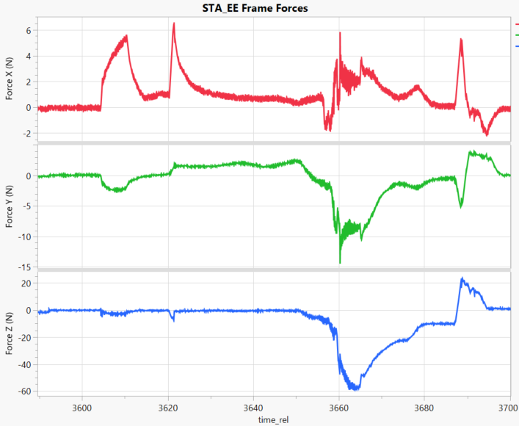
Example Station Interaction: Sample Tube into OS
4x speed
Duration 60 seconds, vs 390 second req (550% margin)
Forces in glove tip (requirement) frame:
1 pt contact
2 pt contact
Insertion
Preload
Unload
Axis | Req.ment | Actual | Margin
Force XY | 15 N | 6.4 N | 134%
Force Z | 157 N | 60 N | 162%
Torque XY | 4.25 Nm | 1.26 Nm | 237%
Torque Z | 0.2 Nm | 0.02 Nm | 900%
Insertion Requirements:
Notes:
Here we have an example of inserting an RSTA into an OS sleeve under worst case conditions on a development testbed, save for a lack of alumina coating on the outside of the tube
We can see that both the duration and force requirements have significant margin against their requirements, of which those key are keeping side forces below 15N and torque below 4.25Nm
In the force plots you can see where force one point of the tube contacts the sleeve, then a second point, before getting fully seated
There is then a preload applied to allow the end effector to change grip, and an unload before the glove on the RSTA is extracted

Slide 9
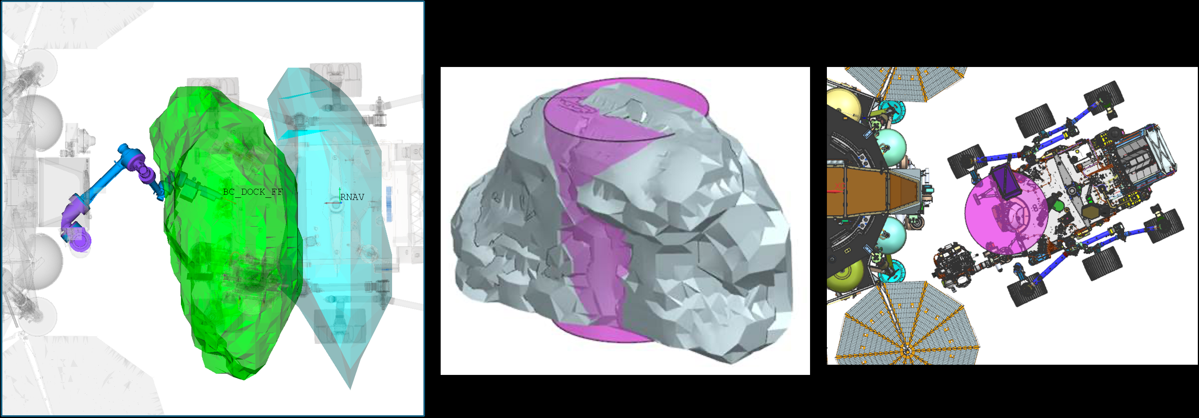
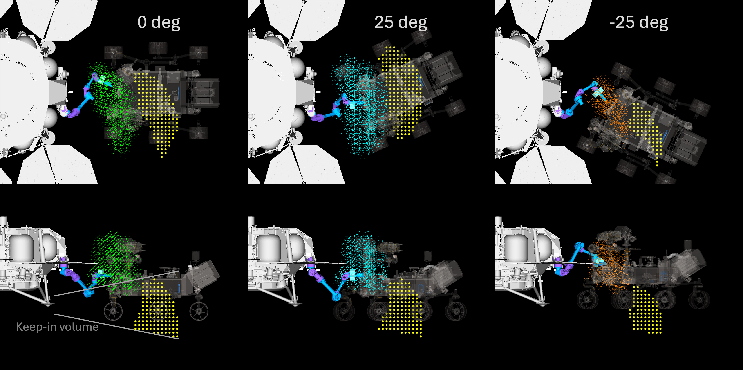
Capability Area: Robotics Analysis
Robotics Analysis ensures all relevant locations within the workspace can be reached, and adequate force applied there
STA workspace for tube exchange with M2020
STA workspace for tube pickup from the ground
M2020 rover parking volumes. The rover parking volumes for three different heading angles (0 and ±25◦) are shown
Notes:
Lastly, the Robotics Analysis capability focused on evaluating the reachable workspace of the Sample Transfer Arm, as well as ensuring that there was sufficient joint strength at each pose to applied the forces for each interaction
On the left we have an assessment of the two possible parking locations for the Sample Retrieval Helicopters, along with possible ground angles for dropping off the tubes
Top right shows the range of positions that the Perseverance rover may have parked, then requiring the STA to preload into the dock to receive an RSTA
Bottom right expands that parking analysis over the range of possible ground angles the rover may have approached from

Slide 10
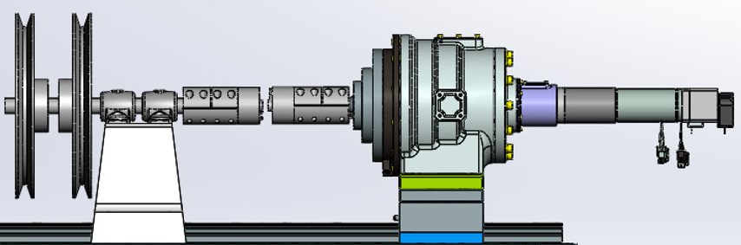
Test Venues
Asimov: used for early station interaction exploration with simplified geometries
Bradbury: higher fidelity whole arm testing with representative station hardware
Bradbury 7 DoF Testbed
Douglas: vision testbed for capturing example localization images
Clark: 1-DoF abstraction of Bradbury actuator to mimic simplified passive dynamics
Clark Testbed
Notes:
To wrap up, there are a variety of test and development environments that were stood up to prove out the robotic capabilities
First is Asimov, a 6-DoF arm inherited from a previous mission that was used to understand forceful station interactions with a sample tube and simplified chamfer geometries
Top right is Bradbury, a 7-DoF arm that was an approximation of the STA kinematics and joint capabilities before the final design was known. That was used to do end-to-end qualifying tests and refine edge cases of each operation
Bottom left is Clark, which employed one of three spare Bradbury actuators at a time to validate dynamics models of the joints and passive oscillation dynamics
For more details on how these capabilities were developed and tested, please have a read of the paper!
Lastly bottom right is Douglass, which was used exclusively for developing and training the vision localization algorithms relative to the Orbiting Sample as tubes were slowly added

