Slide 1
Lunar Vistas:
CADRE’s Earth-Moon-Sun Geometry
Richard Rieber
9 January 2024

Slide 2
Agenda
Lunar Phases, periods, tidal locking, and more!
Librations (not libations)
Earth Phases
Reiner Gamma – where and…when?
Implications for Operations
Imagination time

Slide 3
Lunar Phases - Explained
Sunset
Full moon rises at sunset
Midnight
Noon
Full moon sets at sunrise
Last Quarter moon rises at midnight
Sunrise
Last Quarter moon sets at noon
Knowledge check
Identify noon, midnight, and sunset on the Earth
What time does a Full Moon rise and set?
What time does a Last Quarter moon rise and set?
https://cdn.creatureandcoagency.com/uploads/2018/05/Phases-of-the-Moon-Orbit.jpg
New Scrabble Word
Syzygy: a conjunction or opposition, especially of the moon with the sun.

Slide 4
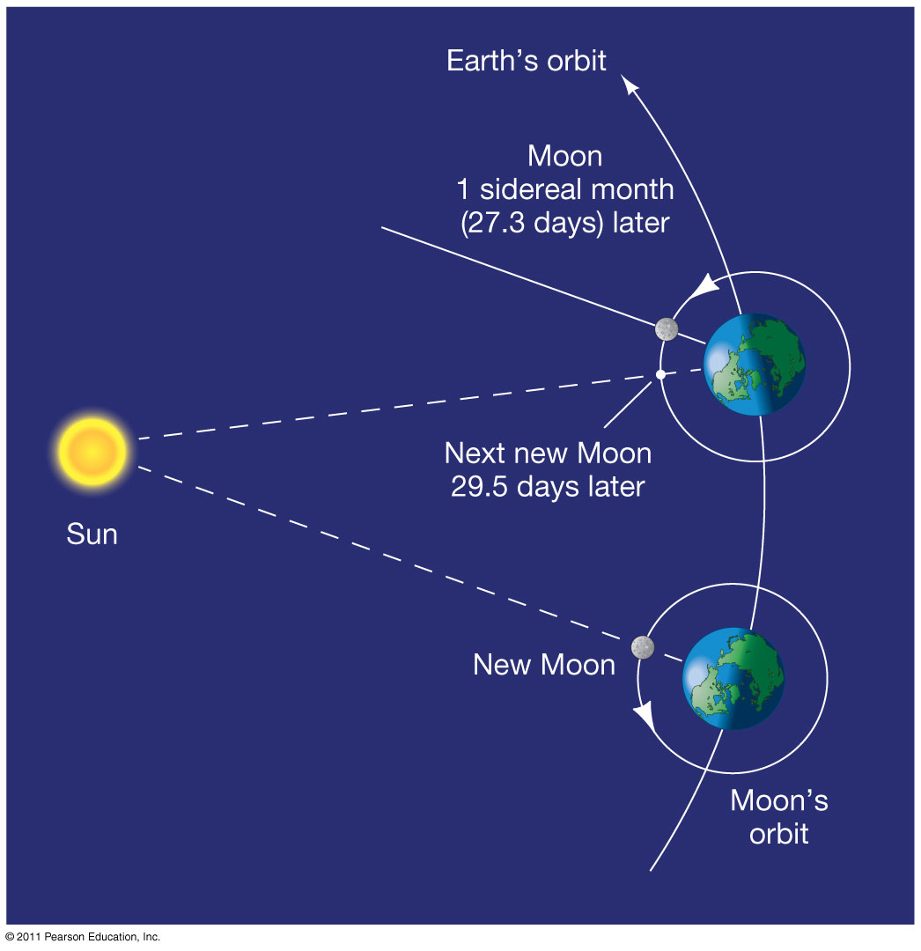
Sidereal vs. Synodic periods
Sidereal Period:
Moon Orbital Sidereal Period = 27.321 days
Moon Rotational Sideral Period = 27.321 days
This is how long it takes the moon to ORBIT a full 360°
Synodic Period:
Moon Orbital Synodic Period = 29.530 days
Moon Rotational Synodic Period 29.530 days
This is how long it takes the moon to return to the same location relative to celestial objects (e.g. the sun)
This is the period we care about.
KNOWLEDGE CHECK: Is a common Earth day (24hr) a sidereal day or a synodic day?
Answer: A common Earth day is a Synodic day. A sidereal day is 23:56:04.0905

Slide 5
Solar Motion on the moon
The sun moves at:
360°/T_{synodic} = 12.19°/day = 0.507°/hr
Compare to Earth: 360°/24hr = 15°/hr
Sunrise to Sunset = 180°/12.19°/day = 14.766 days
The sun moves 30x slower on the moon compared to Earth.

Slide 6
Tidal Locking
Tidal Locking synchronizes the orbital period to the rotational period
This is why we can only see one face of the moon from Earth

Slide 7
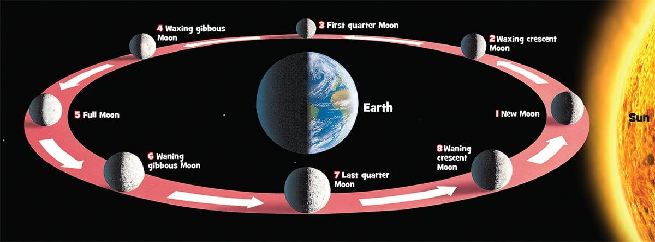
Lunar Phases - durations
7.4 days
7.4 days
https://cdn.creatureandcoagency.com/uploads/2018/05/Phases-of-the-Moon-Orbit.jpg
7.4 days
7.4 days

Slide 8
Effect of synodic period on Antenna Schedule
How long does it take for the moon to return to the same part of Earth’s sky?
Earth rotational period + Lunar orbital motion during that time
Lunar orbits 360° in 27.321 days = 13.177°/day
Earth rotates 15deg/hr., ergo
13.177°/15°/hr = 00:52:42.
What does this mean for us?
The earth rises over a given antenna 53-minutes later every day.
If we lock our shift schedule to antenna passes, it shifts by ~1-hr every day.
Example:
Mission Day-1, shift-1 starts at 8:00, ends at 18:00
Mission Day-6, shift-1 starts at 13:00, ends at 23:00
Mission Day-12, shift-1 starts at 19:00, ends at 05:00

Slide 9
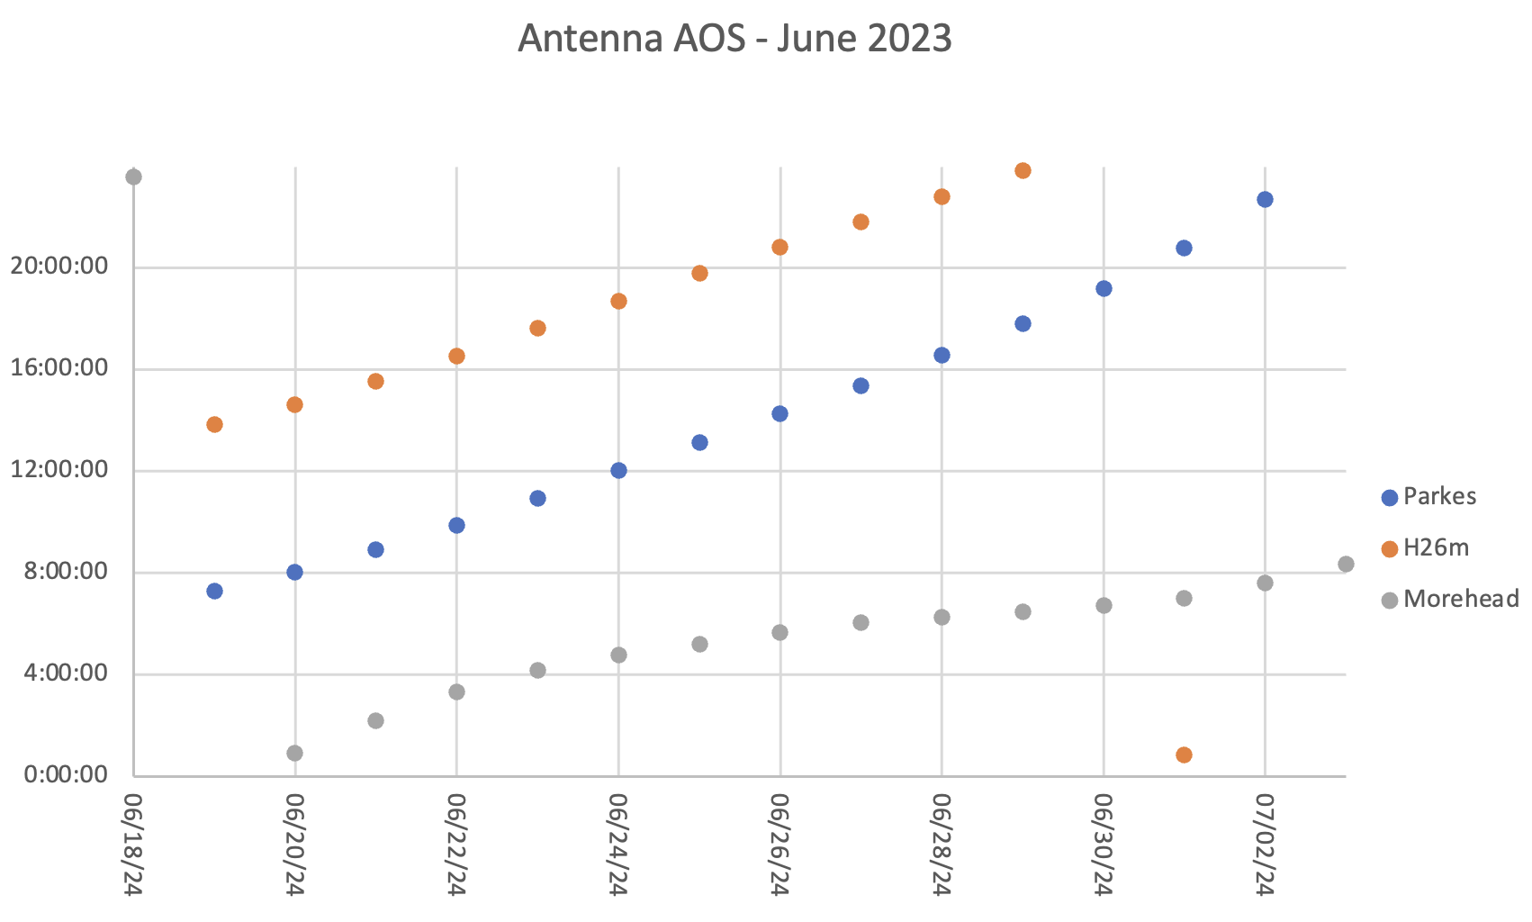
June 2023 Antenna AOS times
AOS = Acquisition of Signal
DSS-49 in Australia
Hartebeesthoek 26m, South Africa
DSS-17, Morehead State, Kentucky
** Note: usage of Morehead is minimized as it is the slowest antenna. AOS times are less reflective of orbital geometry

Slide 10
Lunar Orbit Inclination
https://en.wikipedia.org/wiki/Orbit_of_the_Moon#/media/File:Lunar_Orbit_and_Orientation_with_respect_to_the_Ecliptic.svg

Slide 11
Lunar visibility
Width of this region at ground station latitude defines track duration
Areas of the Earth that can see the moon roughly at October landing
https://www.timeanddate.com/worldclock/sunearth.html

Slide 12
1-day of moon views
https://www.timeanddate.com/worldclock/sunearth.html

Slide 13
Mission life of moon views
https://www.timeanddate.com/worldclock/sunearth.html

Slide 14
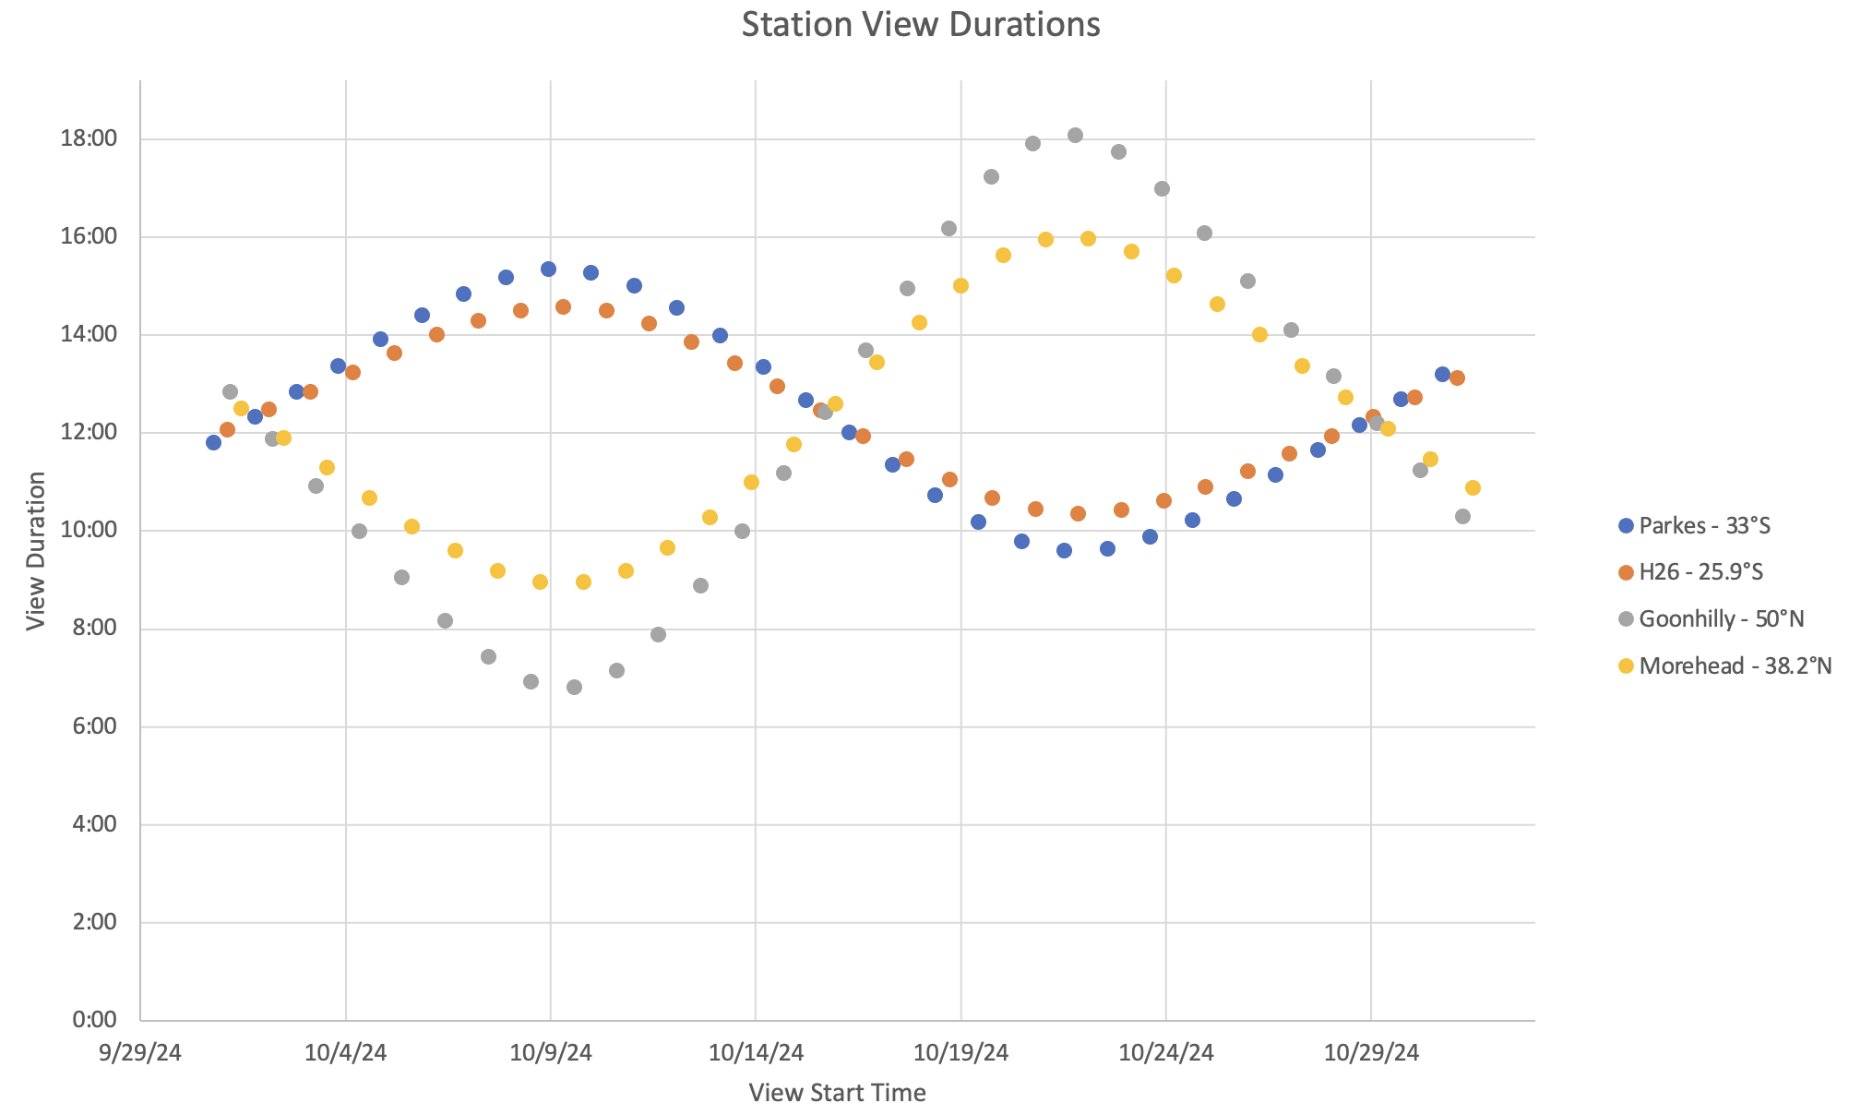
View durations
Northern Hemisphere stations
Southern Hemisphere stations
IM-3 Mission

Slide 15
Rise/Set Times
Parkes view periods shorten as moon spends less time in the southern hemisphere
Morehead-only view periods
Goonhilly view periods increase to 18h as moon spends more time in the northern hemisphere
IM-3 mission

Slide 16
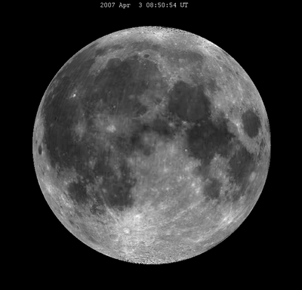
Lunar Libration
Longitude Libration:
Caused by varying speeds of the moon due to its eccentric orbit
Causes the moon to wiggle +/‑7.5deg East/West
Latitude Libration:
Caused by a 6.7° misalignment of the Moon’s rotation axis to its orbital plane
Causes a 6.7° wiggle North/South
Allows for 59% of the lunar surface to be visible from Earth
https://en.wikipedia.org/wiki/Tidal_locking#/media/File:Lunation_animation_April_2007.gif

Slide 17
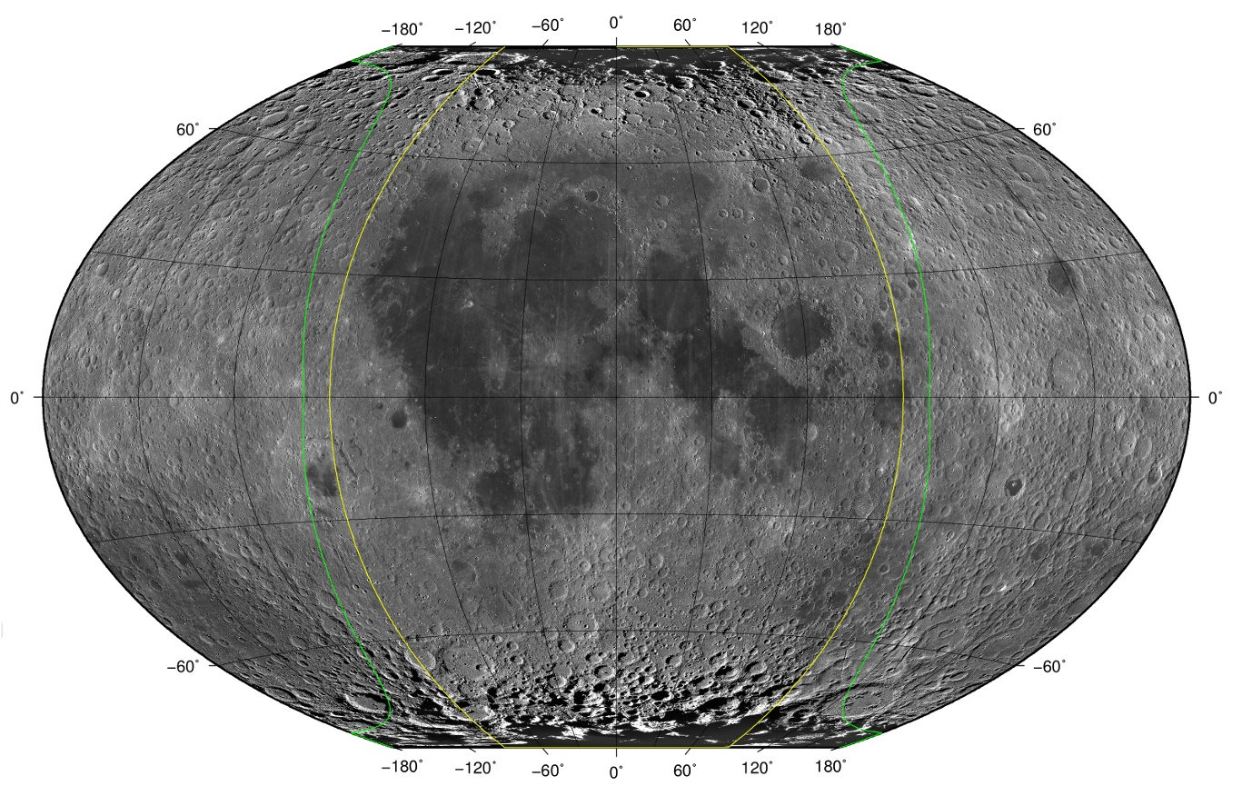
Libration effect on visible area
GREEN: Theoretical extent of visible lunar surface (in green) due to libration
YELLOW: extent of the visible lunar surface without libration
https://en.wikipedia.org/wiki/Libration#/media/File:MoonVisibleLibration.jpg

Slide 18
Put it together
https://en.wikipedia.org/wiki/Lunar_phase#/media/File:Lunar_libration_with_phase_Oct_2007_(continuous_loop).gif

Slide 19
Selenographic Coordinate System
Comparable to Earth’s Latitude and Longitude
(0°, 0°) is roughly at the center of the moon disk as seen from Earth
https://en.wikipedia.org/wiki/Selenographic_coordinate_system

Slide 20
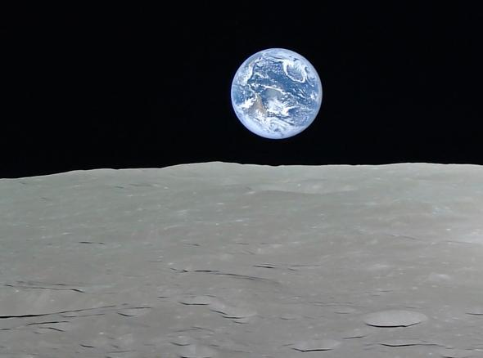
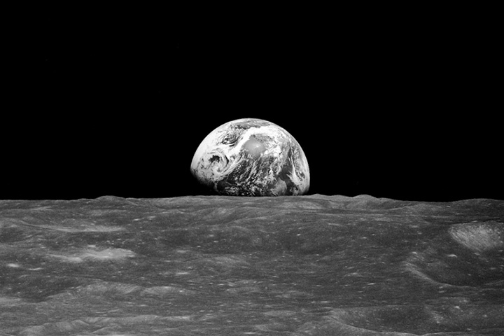
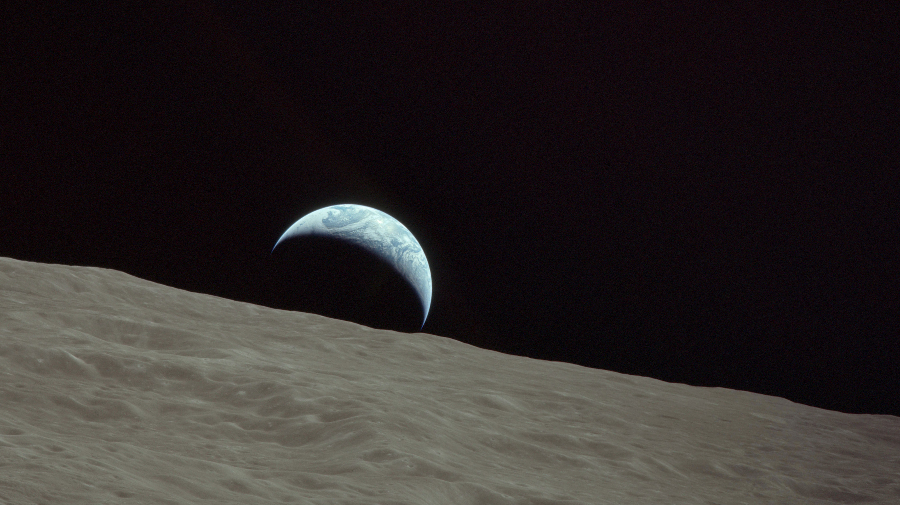
Earth Phases
What does the Earth look like from the moon?
Full-Earth seen by Kaguya spacecraft
Apollo 8 “Earthrise” taken by Frank Borman
Apollo 17 “Crescent Earthrise”

Slide 21
Earth Phase and Lunar Phase
The Earth Phase is the exact opposite of the lunar phase
A full-moon as seen from Earth means a New-Earth as seen from the Moon.
A new-moon as seen from Earth means a Full-Earth as seen from the Moon.
https://cdn.creatureandcoagency.com/uploads/2018/05/Phases-of-the-Moon-Orbit.jpg

Slide 22
Reiner Gamma – Our destination
Reiner Gamma located at 7.5°N, 59°W
https://eyes.nasa.gov/apps/solar-system/#/earth/moons/moon

Slide 23
Reiner Gamma
https://en.wikipedia.org/wiki/Libration#/media/File:MoonVisibleLibration.jpg

Slide 24
POP QIUZ
What part of the lunar orbit will we be operating during?
https://cdn.creatureandcoagency.com/uploads/2018/05/Phases-of-the-Moon-Orbit.jpg

Slide 25
Lunar phases and Reiner Gamma
Reiner Gamma is at 59°W, this places it 4.84-days behind the the prime meridian (the sub-earth point).
Reiner Gamma Sunrise
Reiner Gamma Sunset
https://cdn.creatureandcoagency.com/uploads/2018/05/Phases-of-the-Moon-Orbit.jpg

Slide 26
Lunar phases and Reiner Gamma
What Lunar Phases are we operating during?
Waxing Gibbous through a Waning Crescent
Reiner Gamma Sunrise
Reiner Gamma Sunset
https://cdn.creatureandcoagency.com/uploads/2018/05/Phases-of-the-Moon-Orbit.jpg

Slide 27
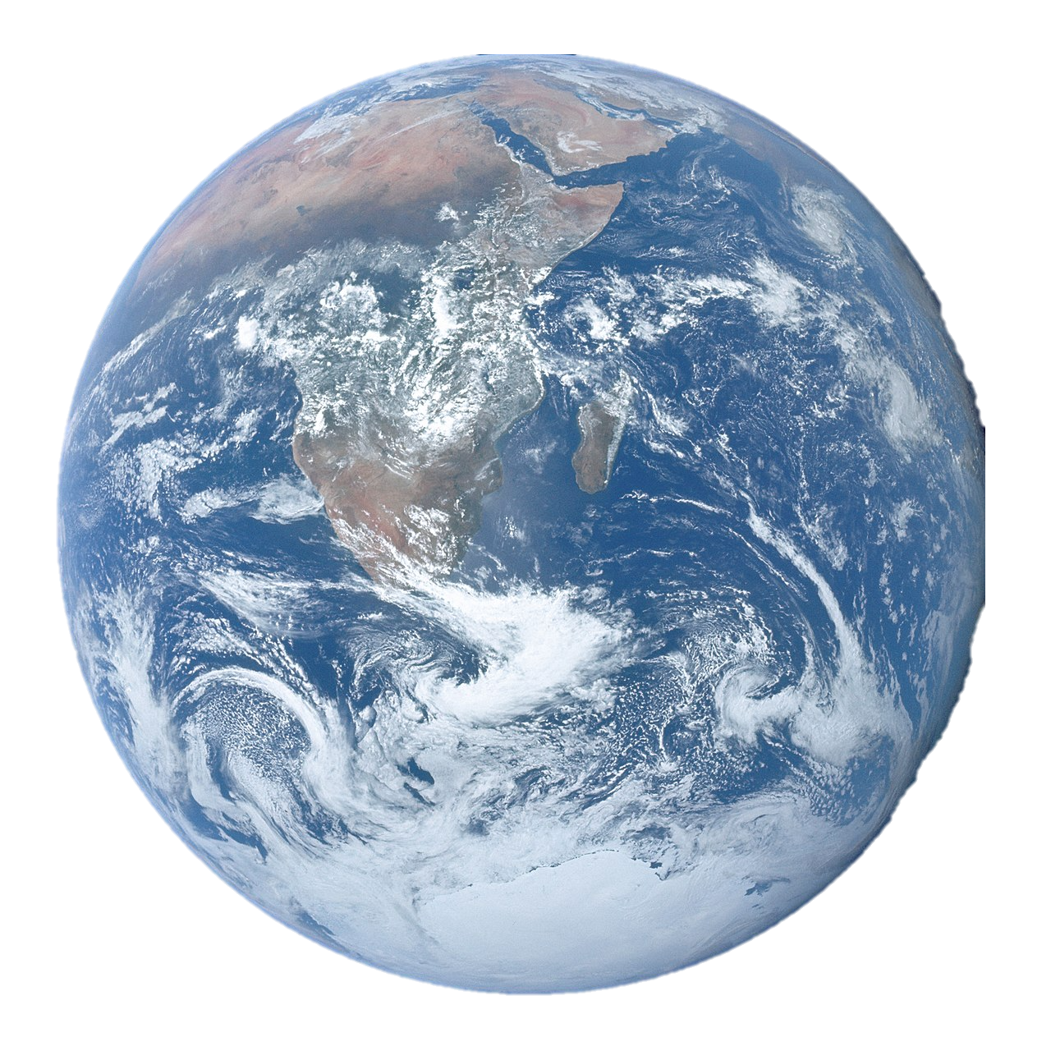
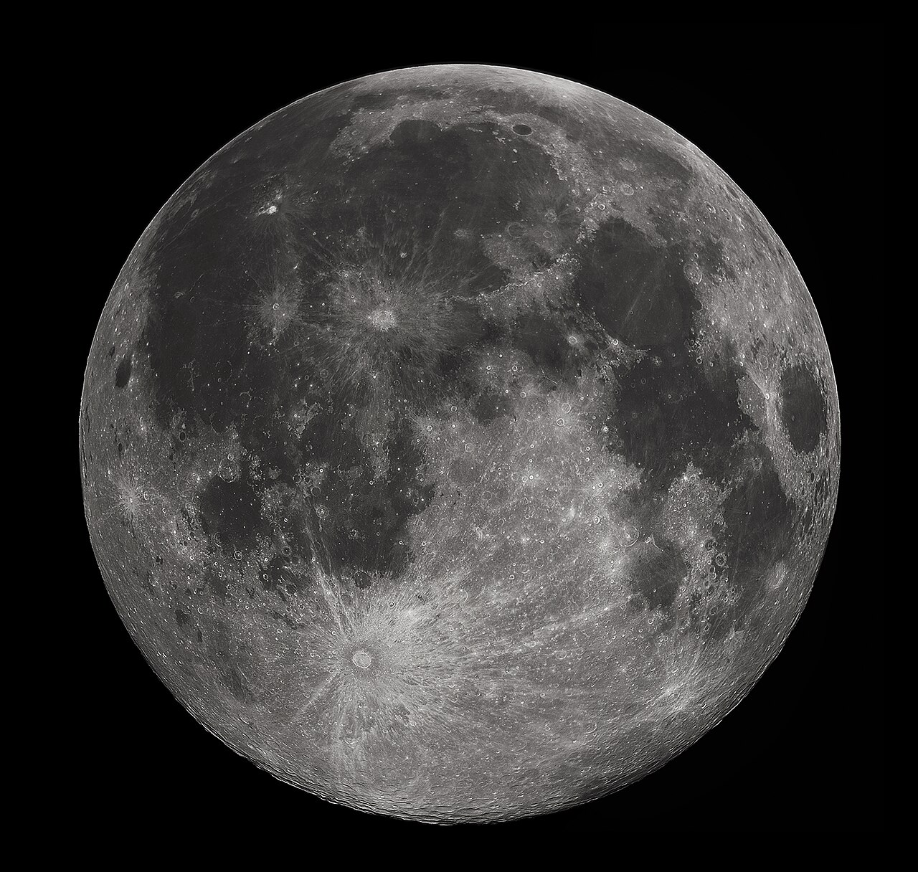
Lunar phases and Reiner Gamma
What Earth Phases are we operating during?
Waning Crescent through a Waxing Gibbous
3. First Quarter Earth
Reiner Gamma Sunset
4. Waxing Gibbous Earth
3. First Quarter Earth
2. Waxing Crescent Earth
5. Full Earth
Moon
1. New Earth
8. Waning Crescent Earth
6. Waning Gibbous Earth
7. Last Quarter Earth
Reiner Gamma Sunrise
https://cdn.creatureandcoagency.com/uploads/2018/05/Phases-of-the-Moon-Orbit.jpg

Slide 28
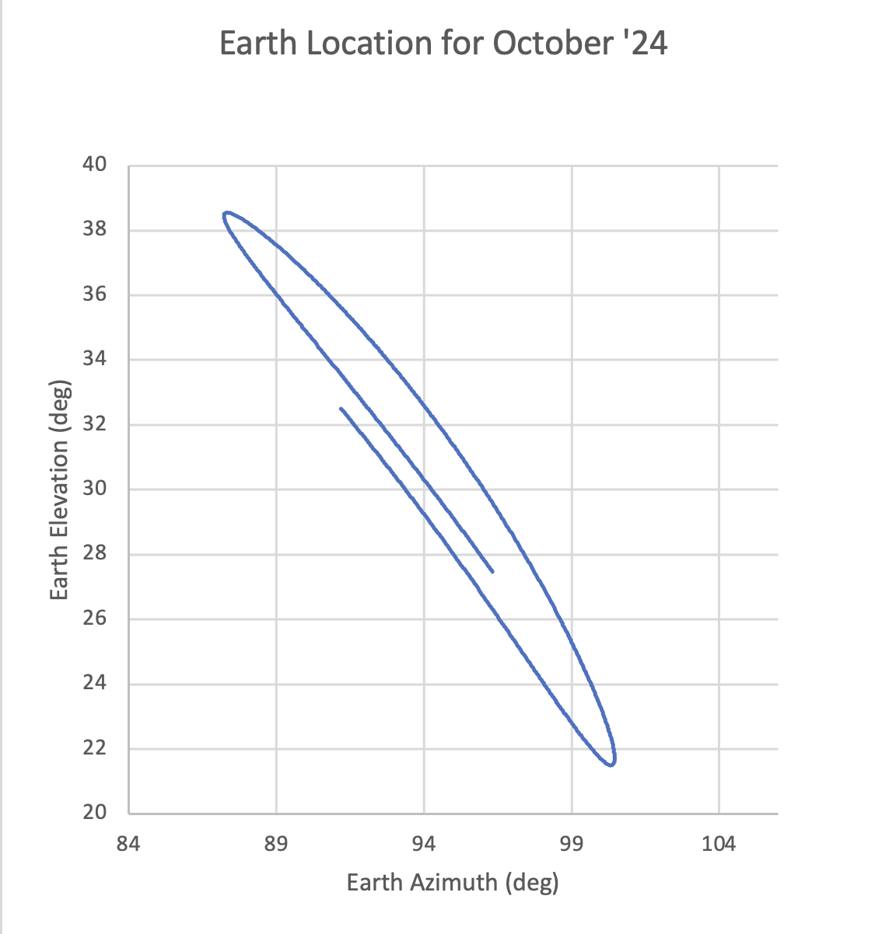
Earth location in the Sky at Reiner Gamma
Tidal locking keeps Earth roughly in the same part of the sky
Earth moves ~20°
Why 20°?
Longitude Libration = +/-7.4°
Latitude Libration = +/-6.7°
10/10/24 13:30
10/23/24 01:30

Slide 29
Earth Location – Day vs. Night

Slide 30
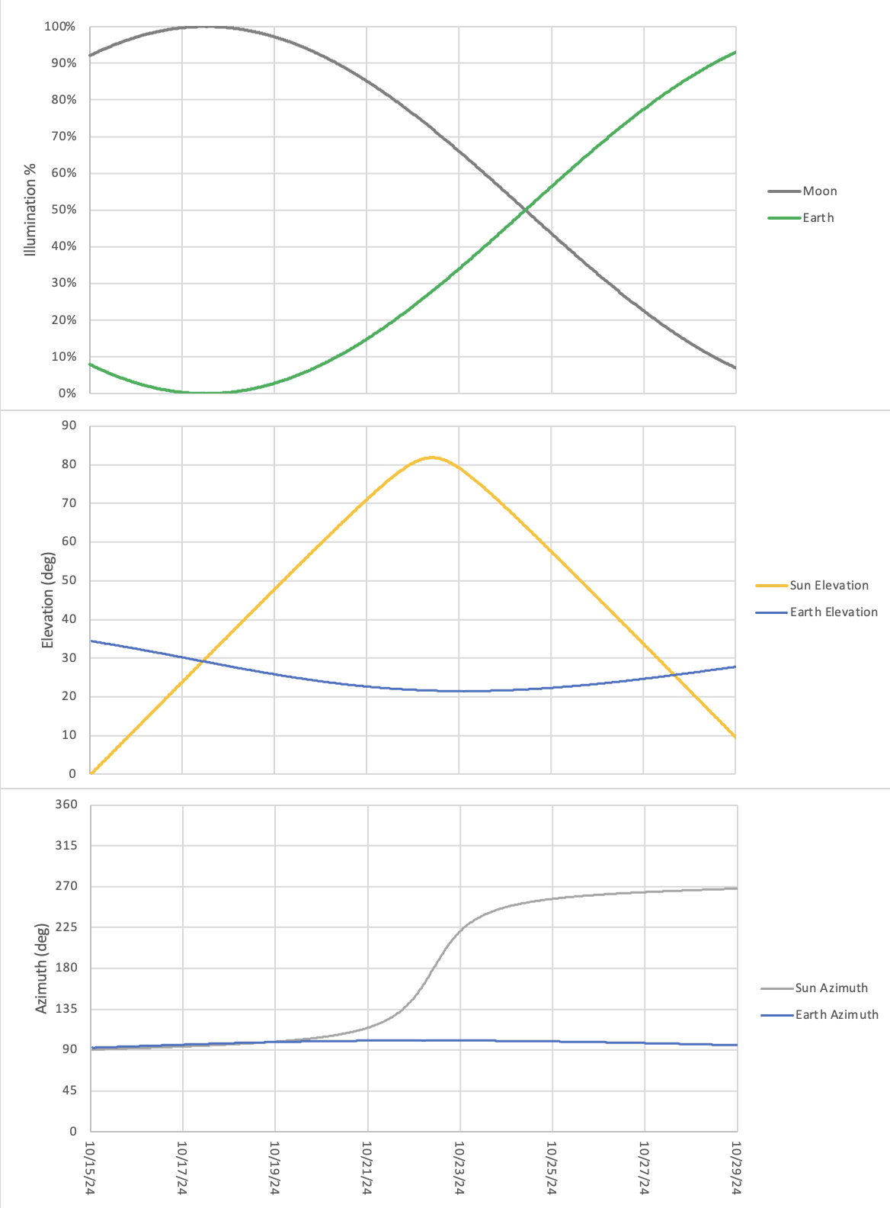
Putting it all together
Full Moon
Full Earth (off chart)
Lander shadow length (m) and heading
Last Quarter
New Earth
New Moon (off chart)
North
West
South
East
North

Slide 31
Implications for Ops – Earth Shine
Full Moon
Full Earth (off chart)
Lander shadow length (m) and heading
Last Quarter
New Earth
New Moon (off chart)
Minimal Earth Shine at beginning of mission
North
West
South
East
North

Slide 32
Implications for Ops – Lander Shadow
Full Moon
Full Earth (off chart)
Lander shadow length (m) and heading
Last Quarter
New Earth
New Moon (off chart)
Lander shadow moves slowly
Sun passing directly overhead creates minimal southward shadow at noon
North
West
South
East
North

Slide 33
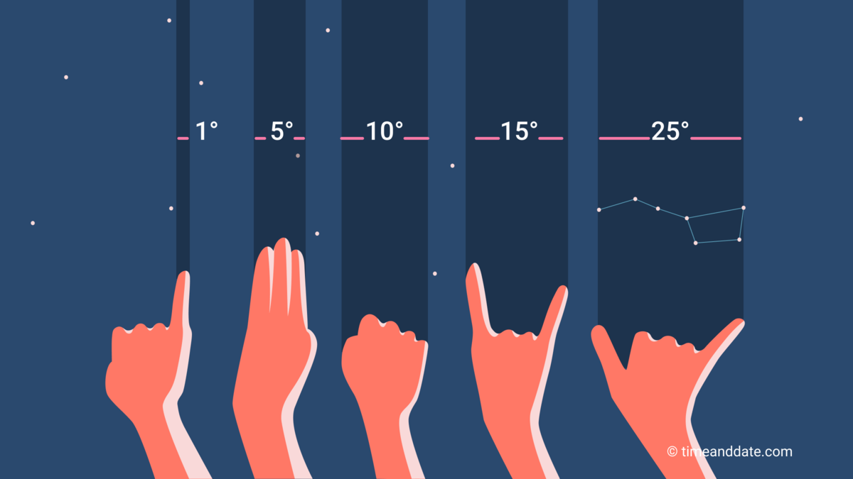
Angular size of Earth vs. Moon
Moon’s orbit is eccentric
e = 0.0549
Apogee = 405,504km
Perigee = 363,396km
OK, so the angular size of Earth is 4x larger than the moon is here on Earth
From the SACA Context Cam, the Earth would be 112 - 125 pixels across.
That represents 3% of the FOV, so it’ll be pretty small.
 | Moon | Earth
Diameter | 3474.8km | 12,742.0km
Angular size at Apogee | 0.49° | 1.80°
Angular size at Perigee | 0.55° | 2.01°
https://www.timeanddate.com/astronomy/measuring-the-sky-by-hand.html

Slide 34
A picture of Earth
Will we have something like Apollo 8’s iconic Earthrise photo?
Probably not. It’ll look something more like this

Slide 35
Magnitude of Earthshine
We can calculate the ratio of Earthshine to direct sunlight
Assume the solar flux hitting the moon is the same as the solar flux hitting Earth
Earth has an albedo of 30%
The Earth has a radius of 6371km
The semimajor axis of the lunar orbit is 384,450km
Earthshine is 25,000 times dimmer than direct sunlight if the Earth is full
Earthshine is 50,000 times dimmer than direct sunlight if the Earth is 50% illuminated
Why do we care? Earthshine probably won’t fill in shadows in our images.

Slide 36
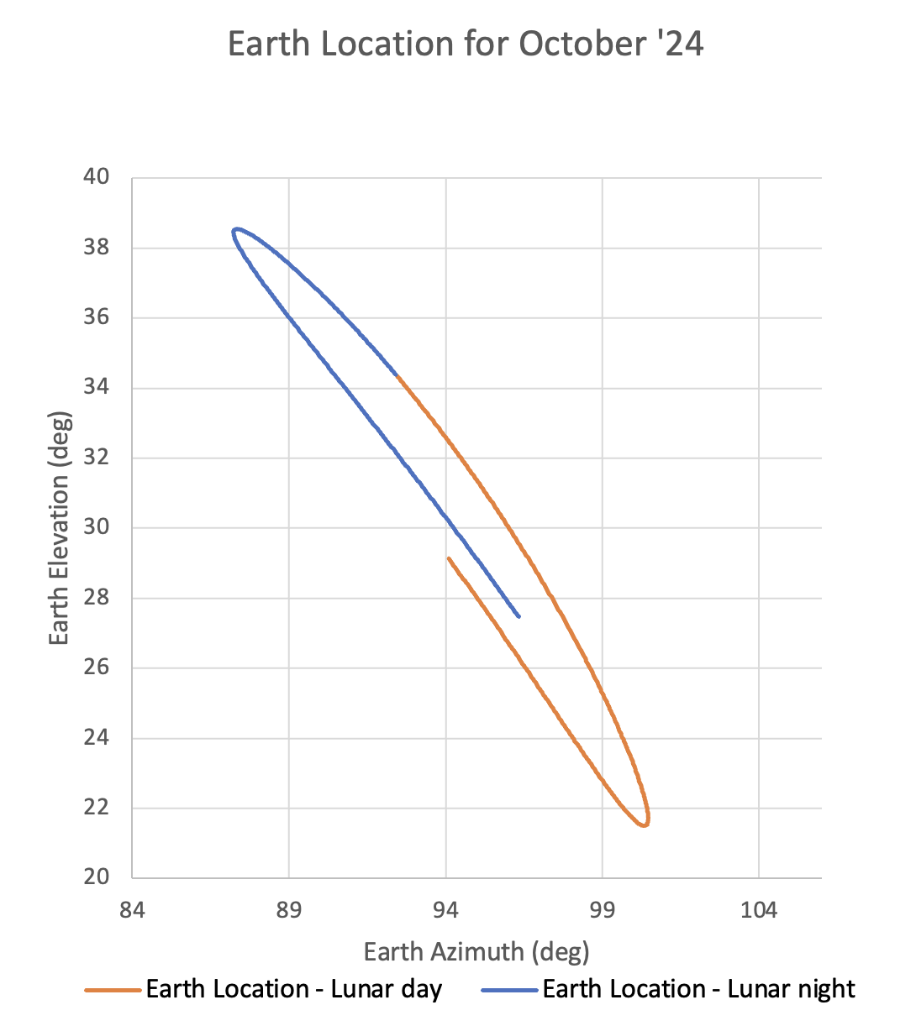
Implications for Ops – Earth Location
Earth is nearly always in the same part of the sky:
Nearly due east
22° - 35° elevation
That is pretty high in the sky

Slide 37
Imagination time
10/27/24, Mission day-10:
Sun location: 30deg elevation, 264deg azimuth (west)
Earth location: 25deg elevation, 97deg azimuth (east)
Lander shadow: 7.3m long, pointing 84deg (east)
Earth illumination: 80%
What does this scene look like?

