Slide 1

STA Camera Alignment Registration Frame (SCARF)
Mars Sample Return – Sample Retrieval Lander – Sample Transfer Arm
Hariet Yousefi (347R) – JPL: Jet Propulsion Laboratory, California Institute of Technology
Mentor: Philip Bailey
Pre-Decisional Information – For Planning and Discussion Purposes Only
Reviewed and determined not to contain CUI

Slide 2


Hariet Yousefi
California State University, Northridge
  B.S. Mechanical Engineering, May 20254
  M.S. Mechanical Engineering (Starting Fall 2024)
Research
  Autonomy Research Center for STEAHM (ARCS)
  Campus Autonomy Robot Tour (CART)
  Smart Morphing Wing (Senior Design Project)
  LSAMP (Carbon Fiber Composite)

Slide 3
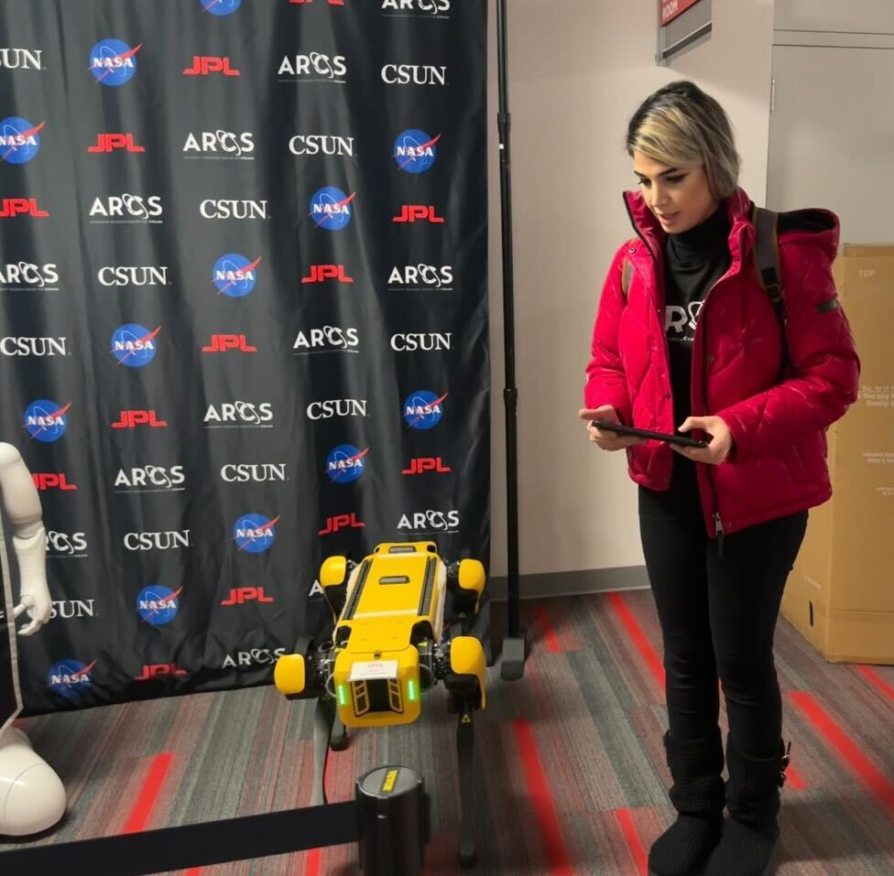
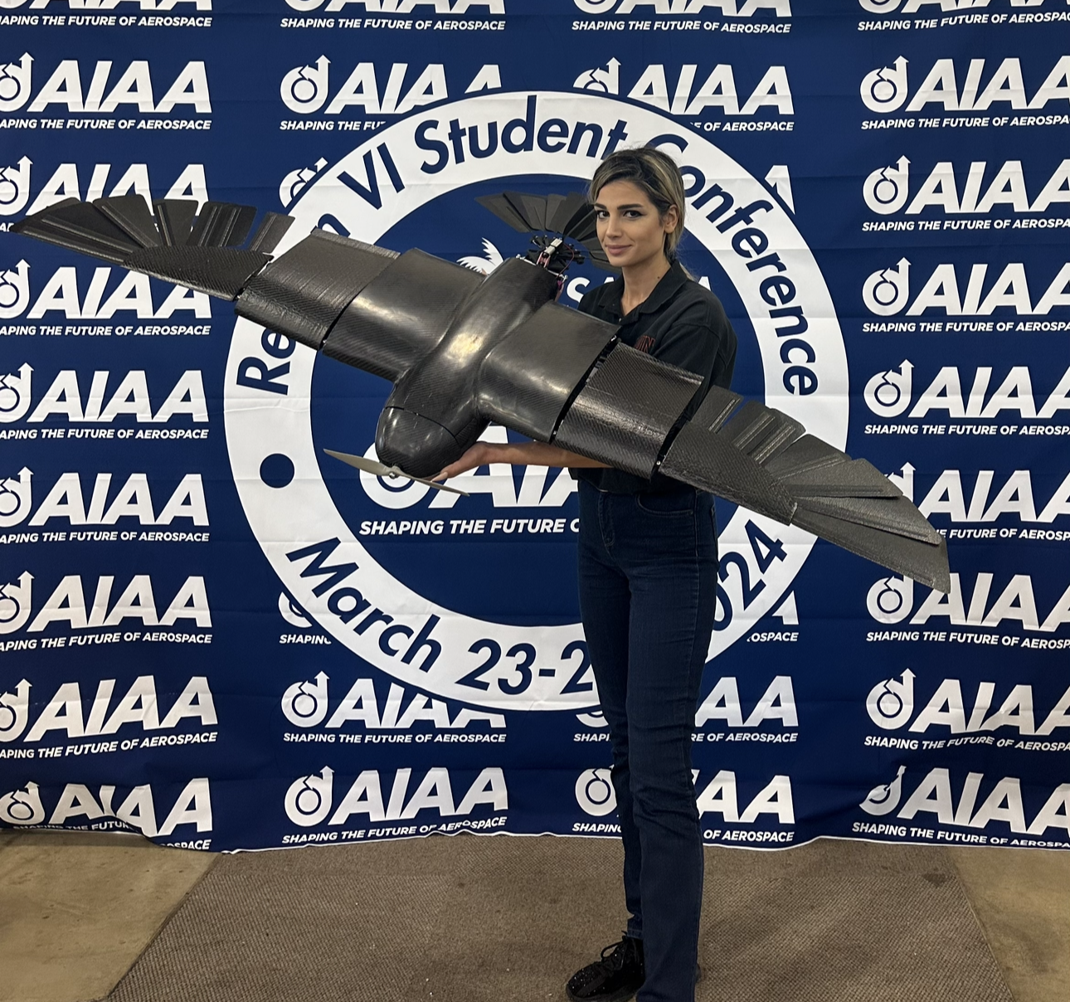
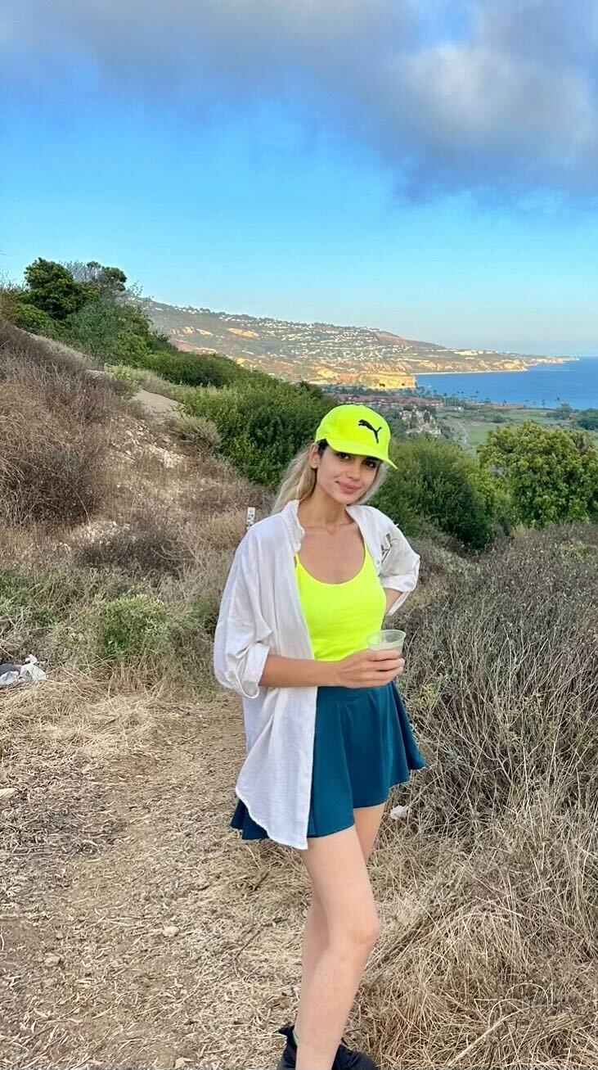
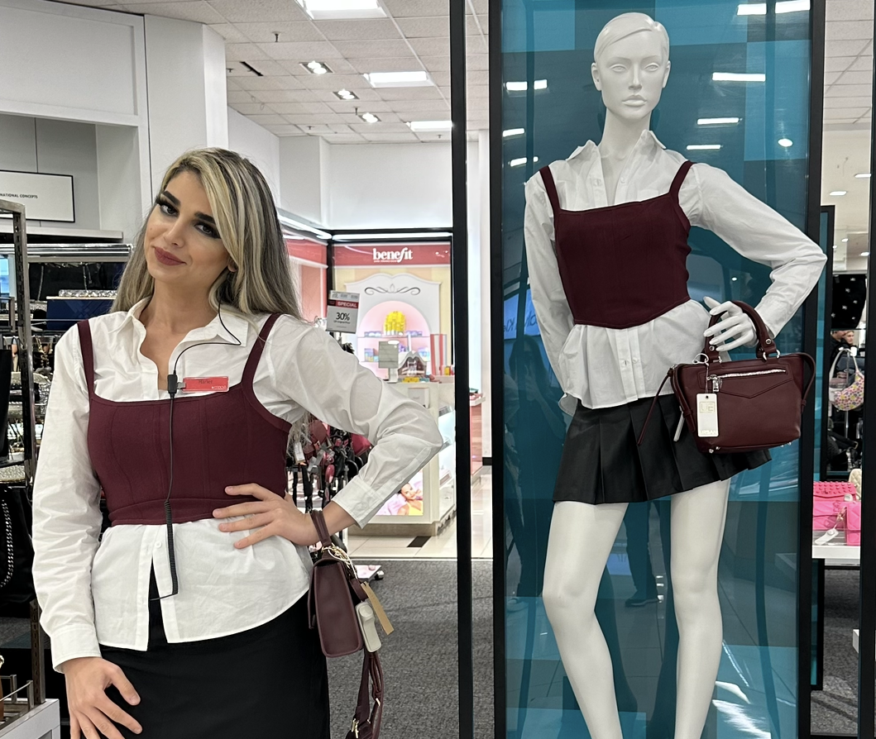
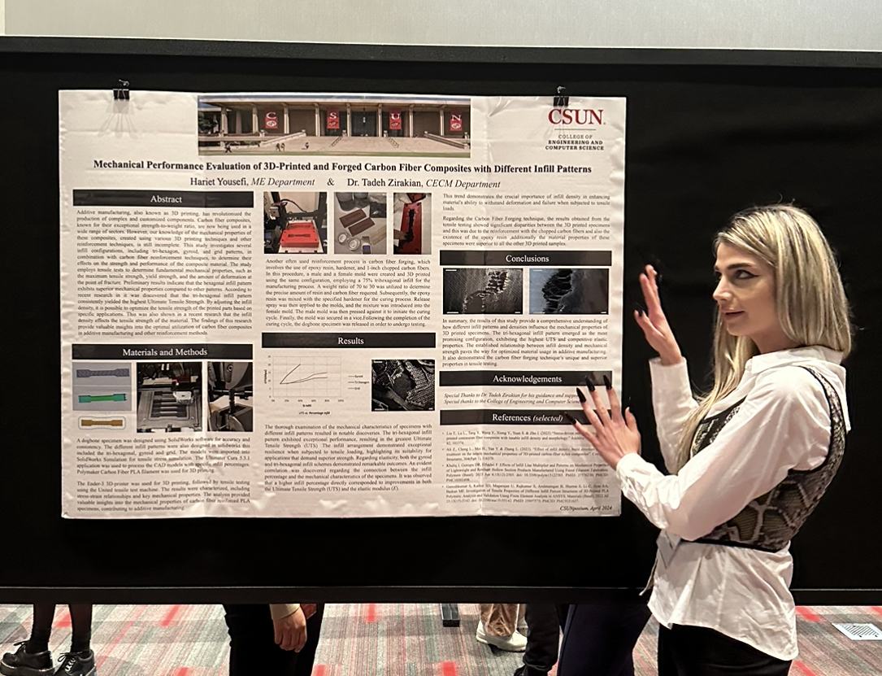
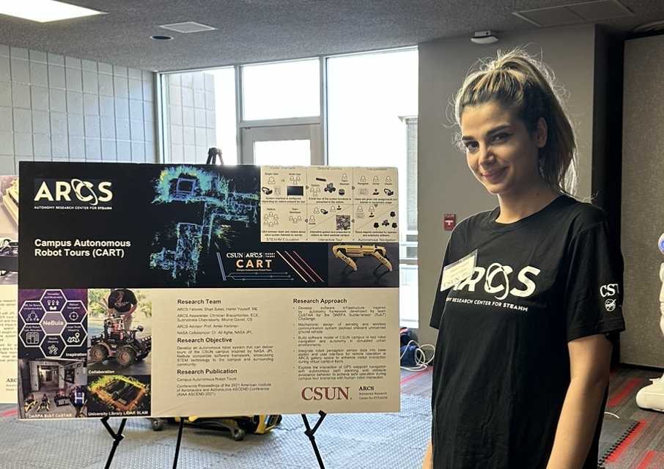
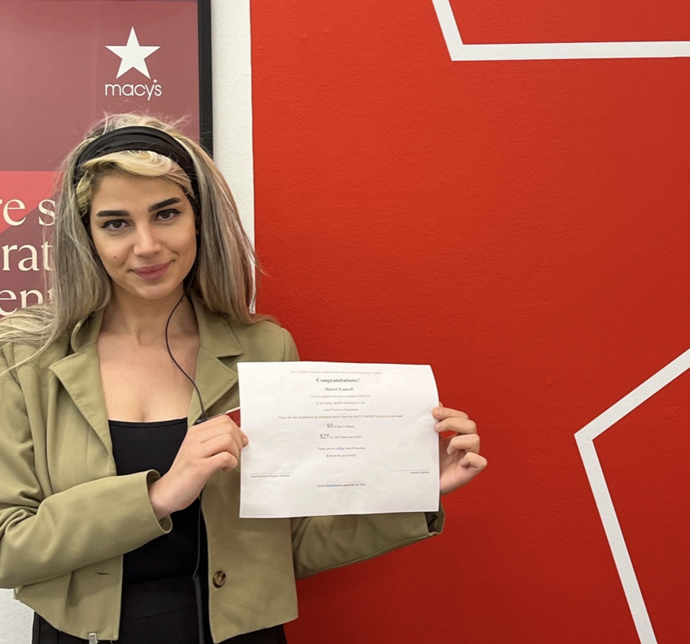
Photos

Slide 4

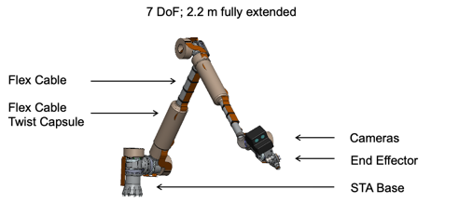
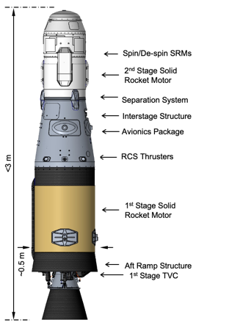

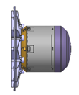

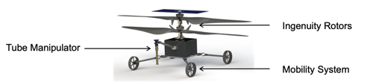
SRL Payloads - (December 2023 Baseline)
MLS office
STHS office
STHS office
OS lid – mounted within OSCAR before install
OS lid handling tool (HOLA)
Orbital Sample (OS)
Assembly to hold & Eject the OS (ADEOS)
Sample Transfer System (STS)/Sample Transfer Arm (STA)
JPL/ESA/Leonardo
OS + ADEOS = MPA (MLS Payload Assembly)
Orbiting Sample Subsystem (OSS)
JPL
SRH office
STHS office
Sample Recovery Helicopters (SRH)
JPL
Mars Launch System (MLS)/
Mars Ascent Vehicle (MAV)
JPL/MSFC/Lockheed
Engineering Cameras (EECAMs) x6
JPL
The decision to implement Mars Sample Return will not be finalized until NASA’s completion of the National Environmental Policy Act (NEPA) process. This document is being made available for information purposes only.

Slide 5
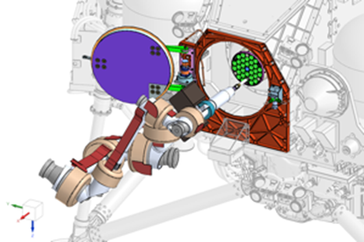
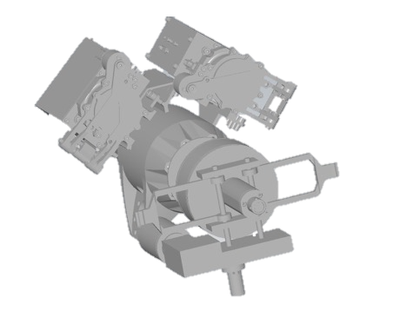
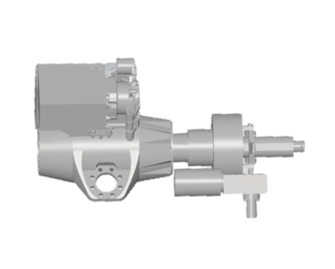
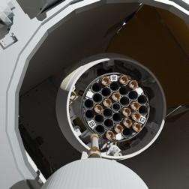
STA Perception Unit Overview
The STA has two identical fully redundant and dual strapped grayscale cameras
The cameras are located 26 cm back, and 10.1 cm offset from the tip of the end effector and ~82 degrees apart about the end effector axis
  Note when operating with a tube gripped, the tool point is an additional 18 cm forward
Camera Property | Value
Resolution (S x L) | 2048 x 2048
Bit Depth | 10 or 12
Field of View (FOV) | 57 x 57 deg
Pixel Size | 5.5 µm x 5.5 µm
Spectral Bandpass | 400 - 675 nm (TBC)
Focal Length | 11.2 mm
f/number | 13.3
Depth of Field | 0.3 m to 0.9 m
Best Focus | 0.45 m
Color | Grayscale
STA PUs
STA End Effector Tool Tip
26 cm
10.1 cm
STA Camera
Covers

Slide 6
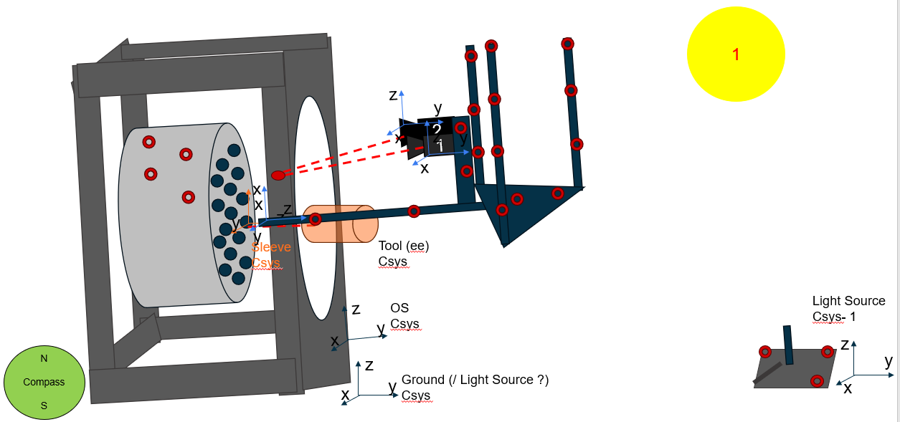
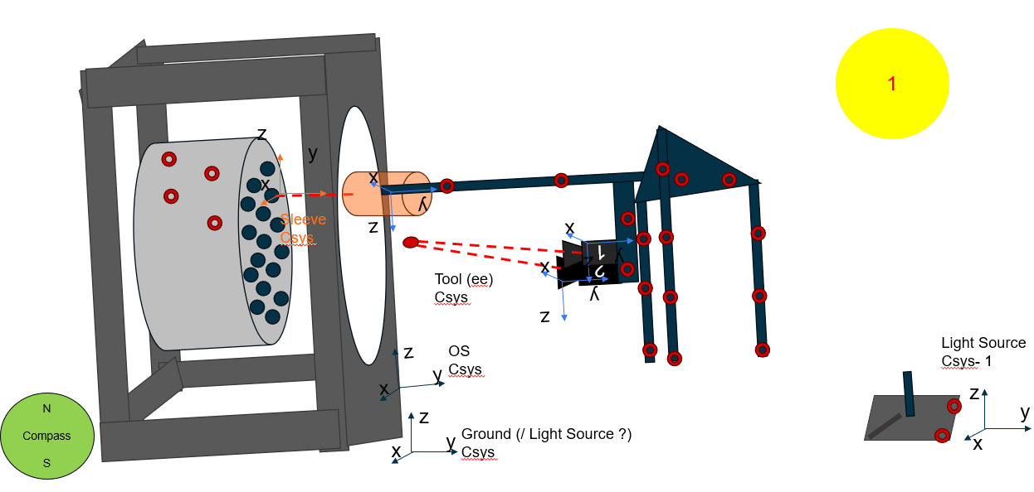
Objective & Design Factors:
Design a visually representative OS station that can extract ground truth information of the STA camera pose relative to the station.(OS Structure, Camera Fixture)
The camera must be easily posable to a validate OS-relative location
Images from this testbed will be used for the following purposes
  Verifying the effect of directional lighting / shadowing into the OS bay
  Verify error allocations for STS vision with respect to the OS scenario
  Ground truth of the STA Camera pose W.R.T the OS will be verified to 0.2 mm accuracy
Identify issues in OS detection with respect to real cameras or hardware
Verify performance of STS Vision simulation w.r.t to a real camera / hardware with specified error margins

Slide 7
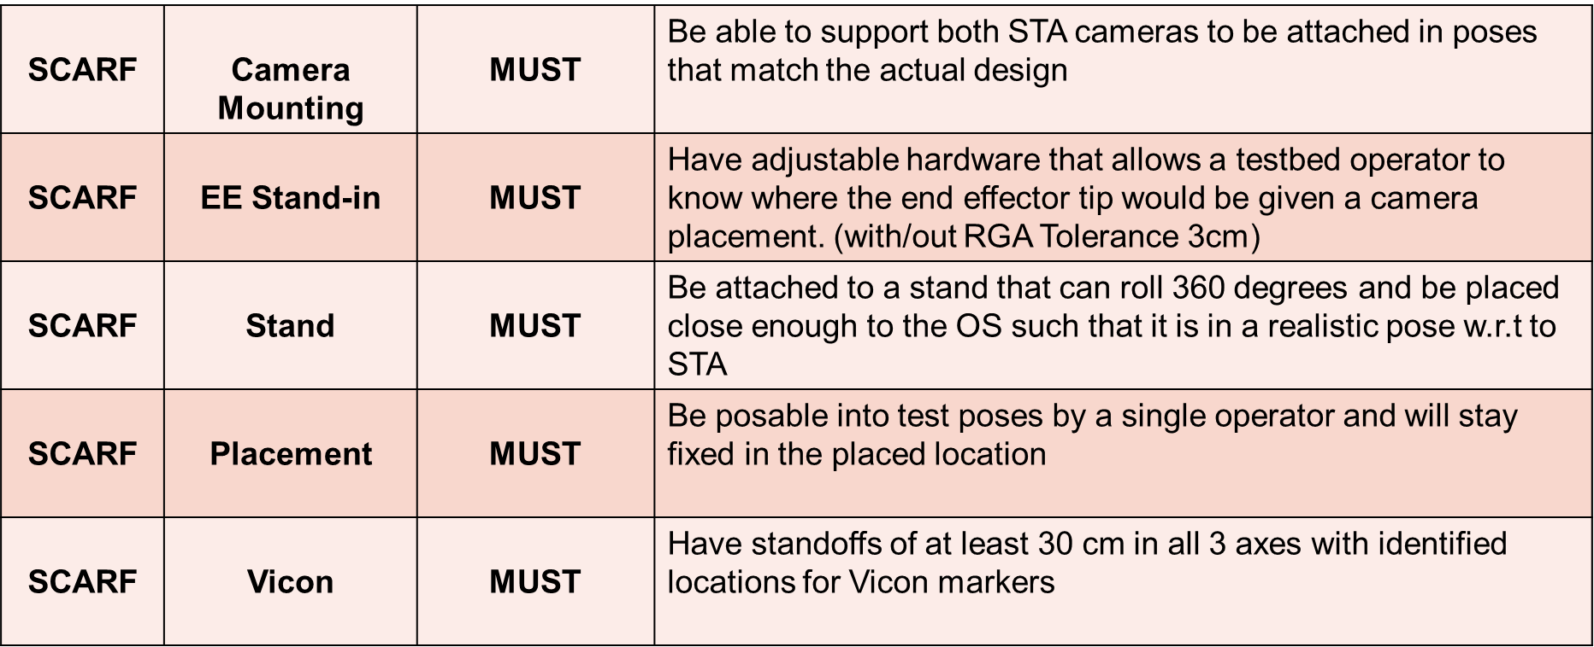
SCARF STA Camera Alignment Registration Frame Requirements

Slide 8
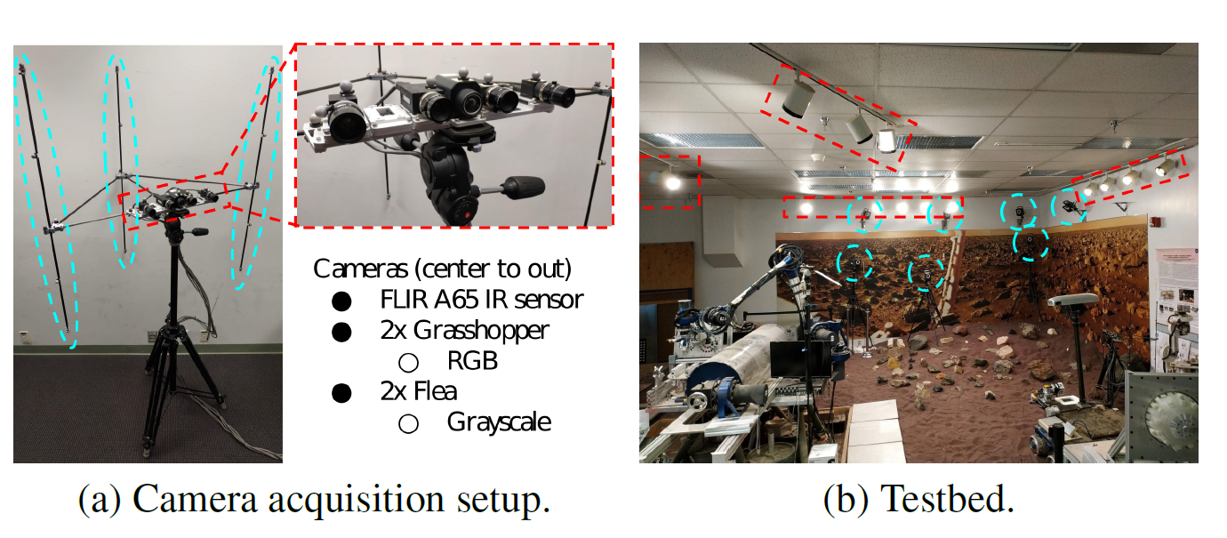
Inspiration from Hoa’s Rover Localization Tube Pick-Up
Inspiration Key Points
360 rotation
Use of carbon fiber tubes
Usage of a 3ripod
Weight consideration requirement
T. -H. Pham et al., "Rover Localization for Tube Pickup: Dataset, Methods and Validation for Mars Sample Return Planning," 2020 IEEE Aerospace Conference, Big Sky, MT, USA, 2020, pp. 1-11, doi: 10.1109/AERO47225.2020.9172300.

Slide 9
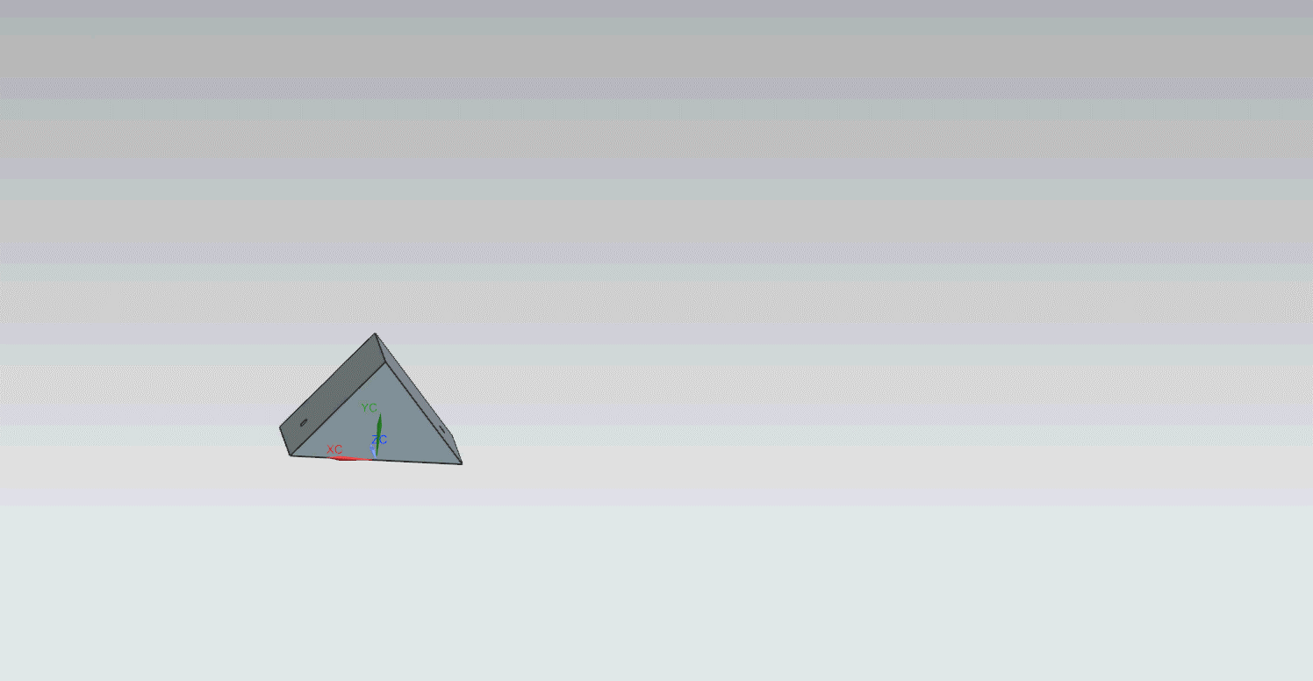
1st Iteration
Triangular mount (fixed angle)
Carbon fiber horizontal and vertical arms
Coupled adjustable EE
Challenging manufacturing

Slide 10
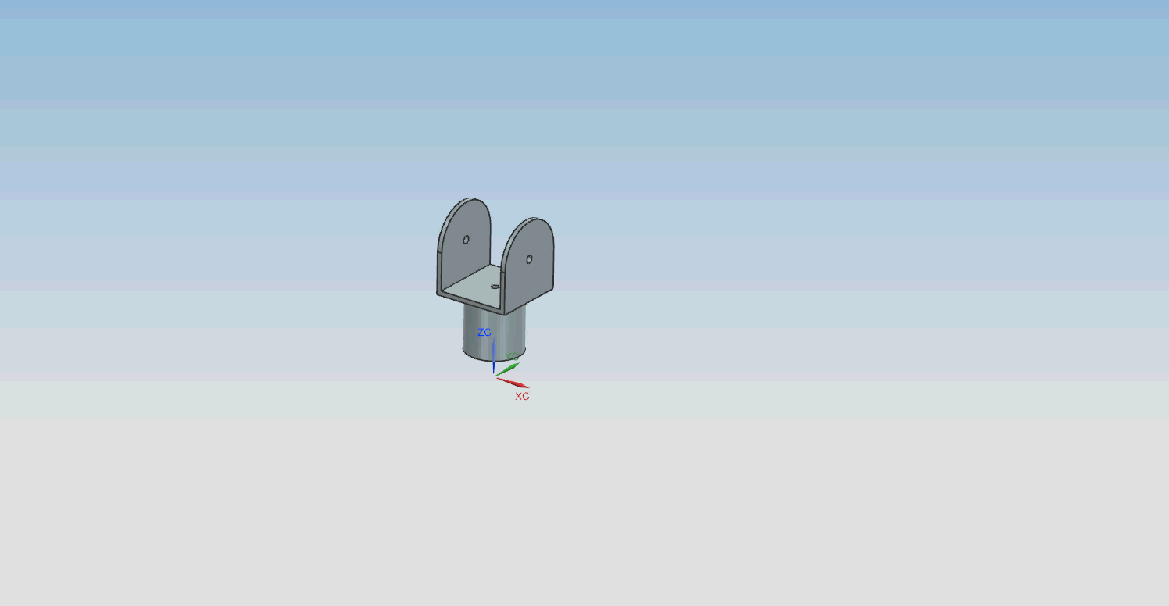
2nd Iteration
Linkage mount
(adjustable angle)
Carbon fiber horizontal and vertical arms
(structural base)
Coupled adjustable EE
Preferred fixed angle
Multiple components
Notes:
Preferred a fixed rather than adjustable

Slide 11
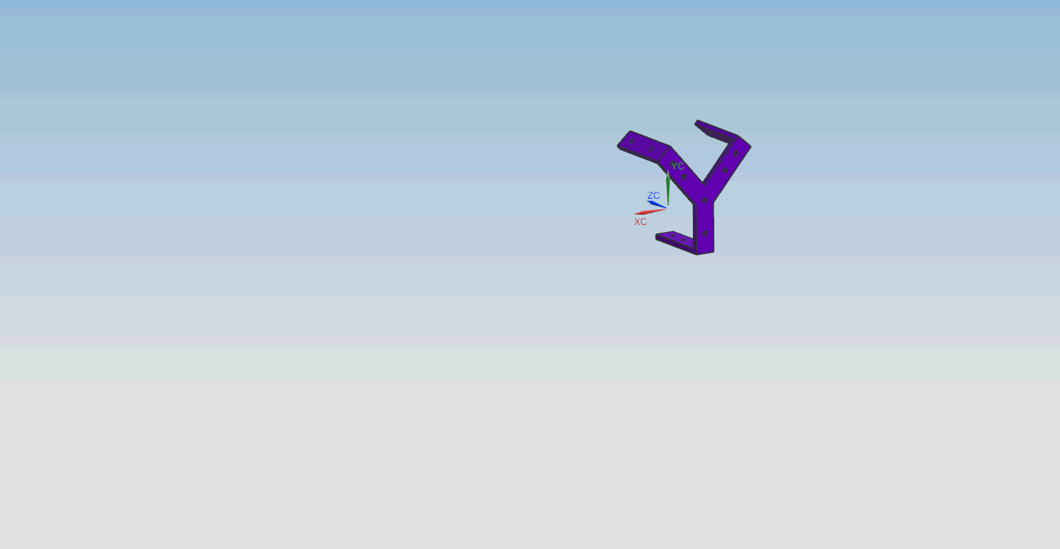
3rd Iteration
Y shaped 90 angle mount
(fixed angle)
1 inch T slots as horizontal arms
1 inch OD carbon fiber tubes as vertical arms
Lighter assembly is preferred (360 rotation)

Slide 12
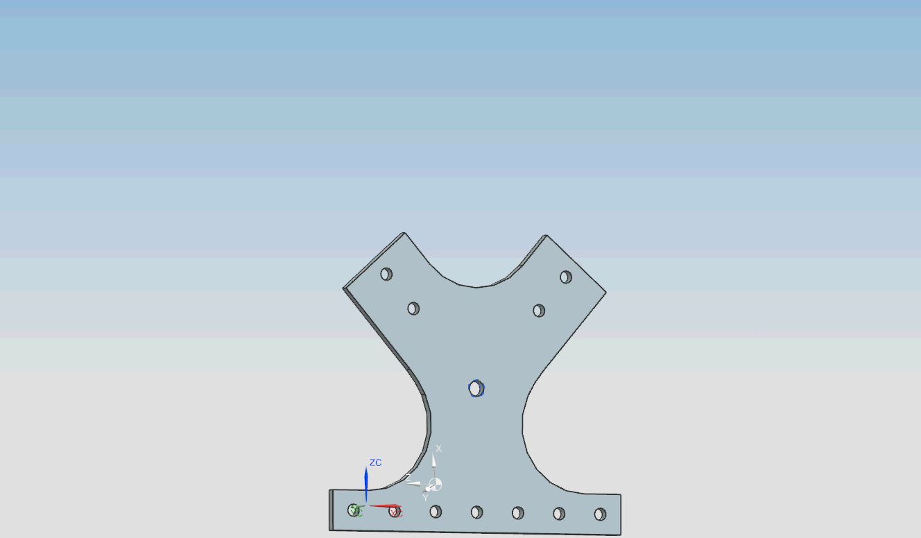
Final Design
Y Shaped ¼ inch
Plate manufactured by
water jet
Structural support
2 (2”by 3” with ¼ inch
Wall thickness
angle brackets
8020 components
Comparable
Light weight
Fixed angle
Match STA design
Adjustable EE

Slide 13
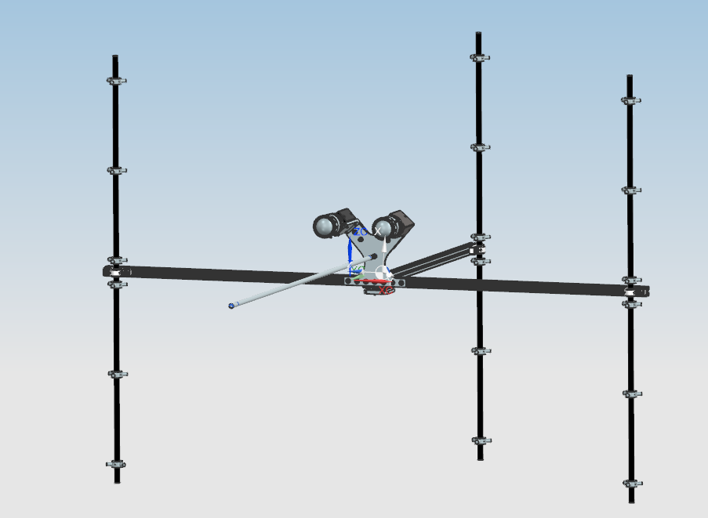
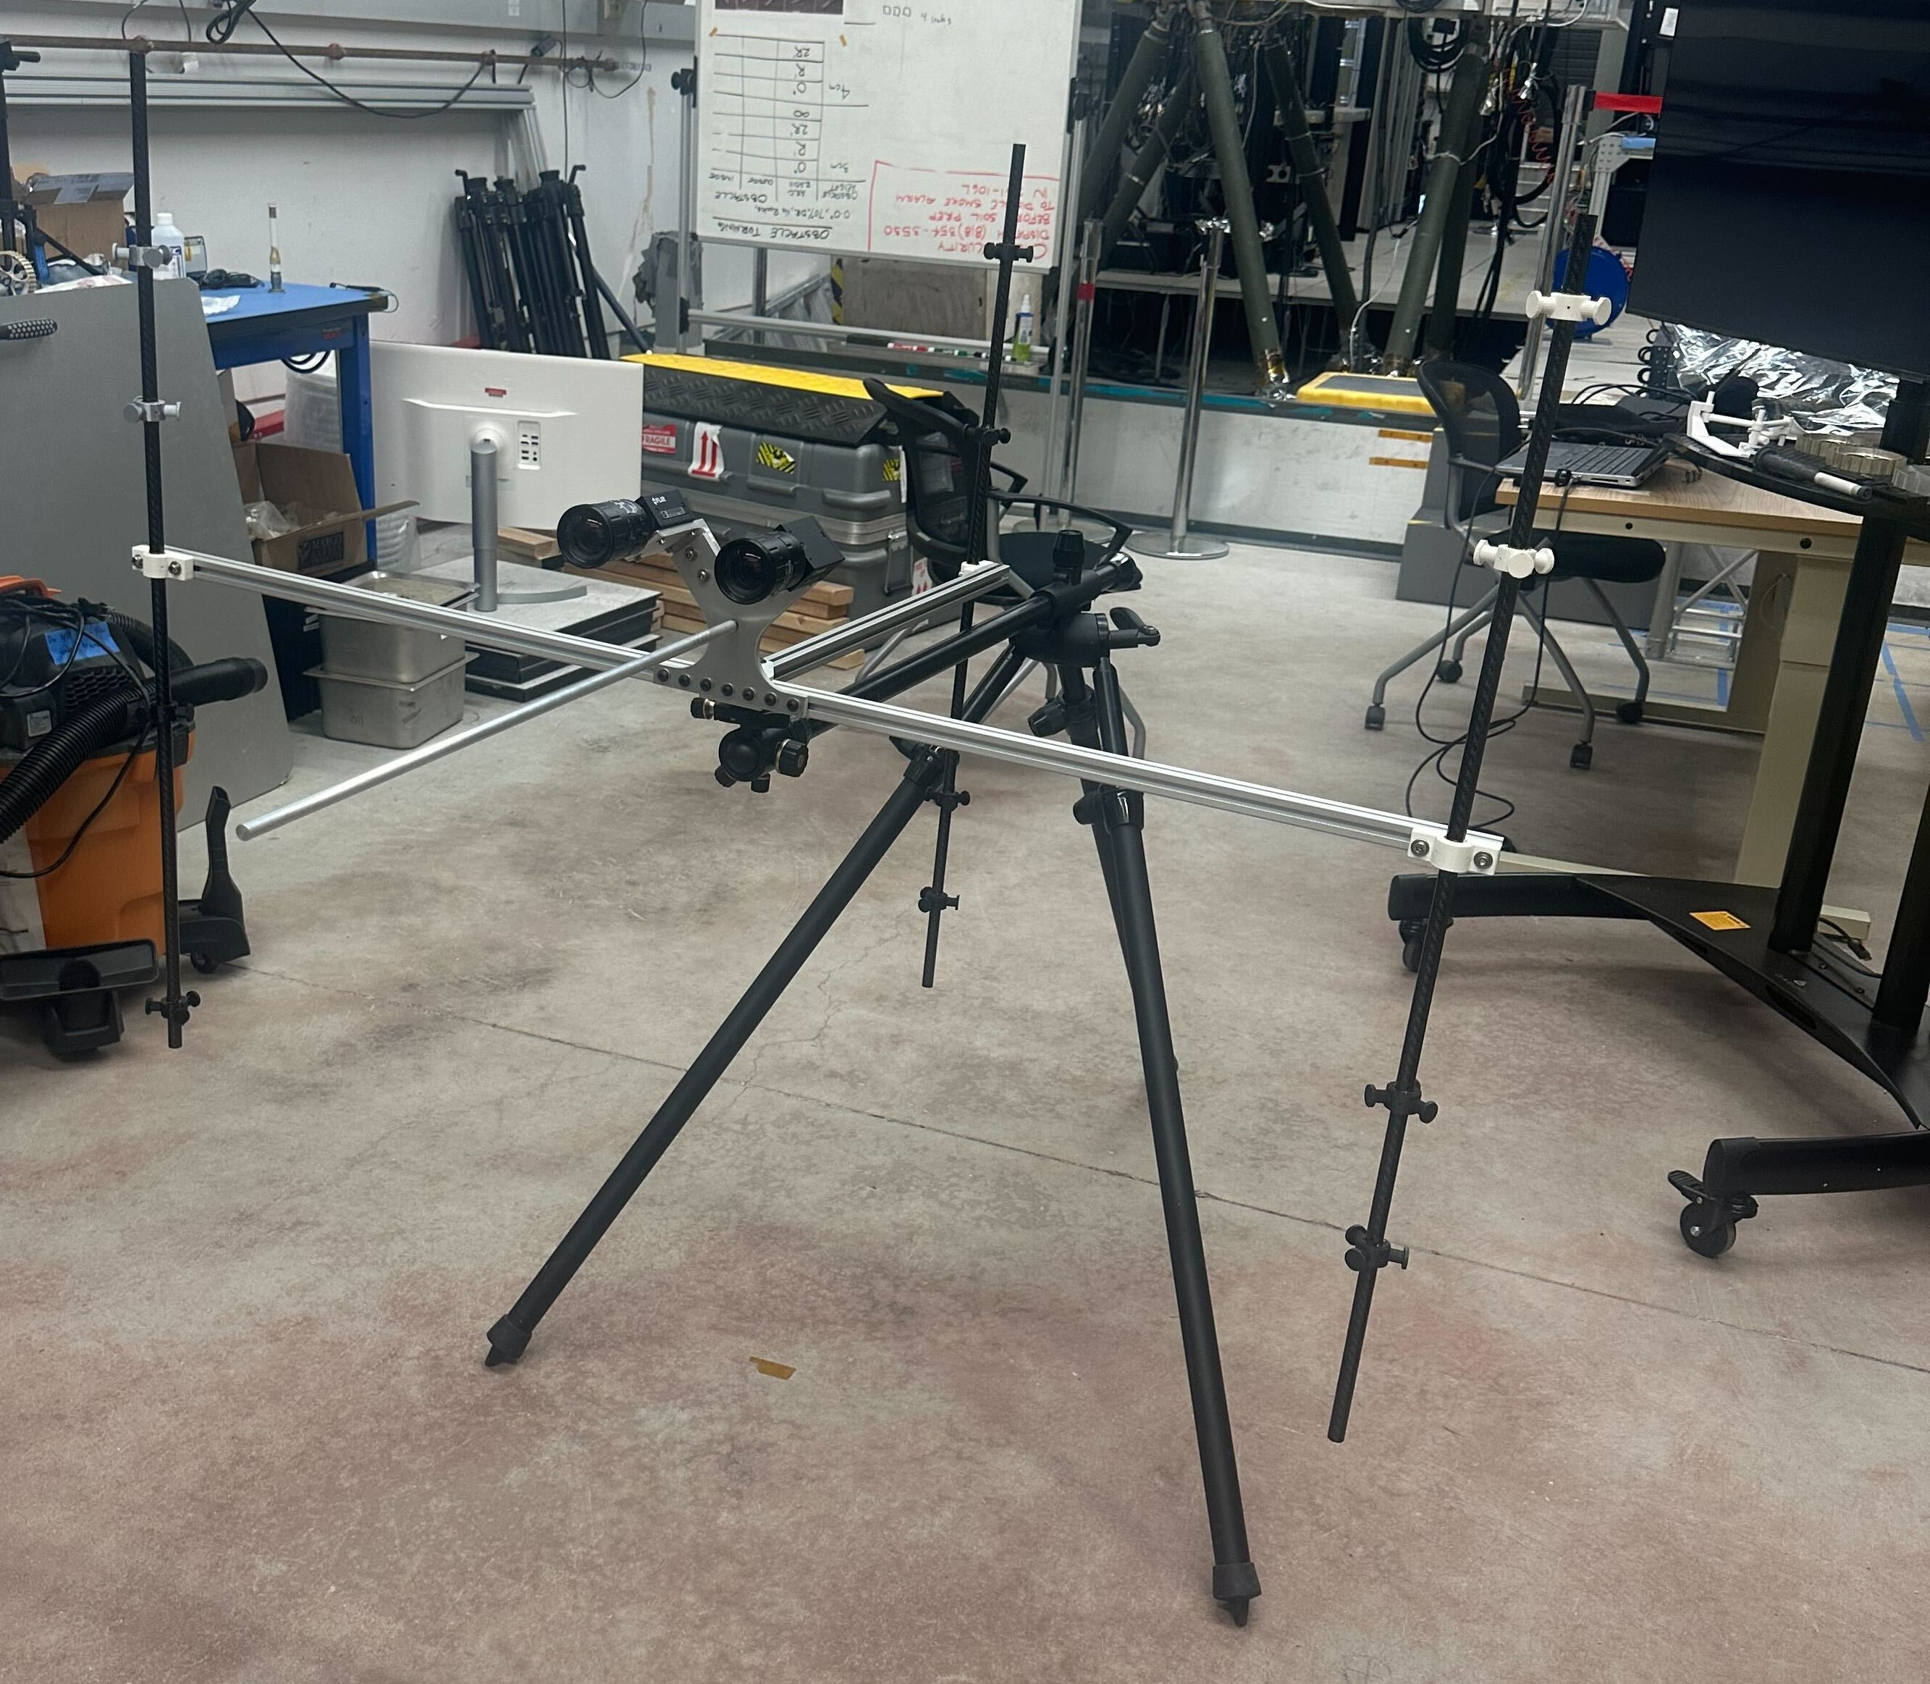
Drawing and Order+ Manufacture

Slide 14
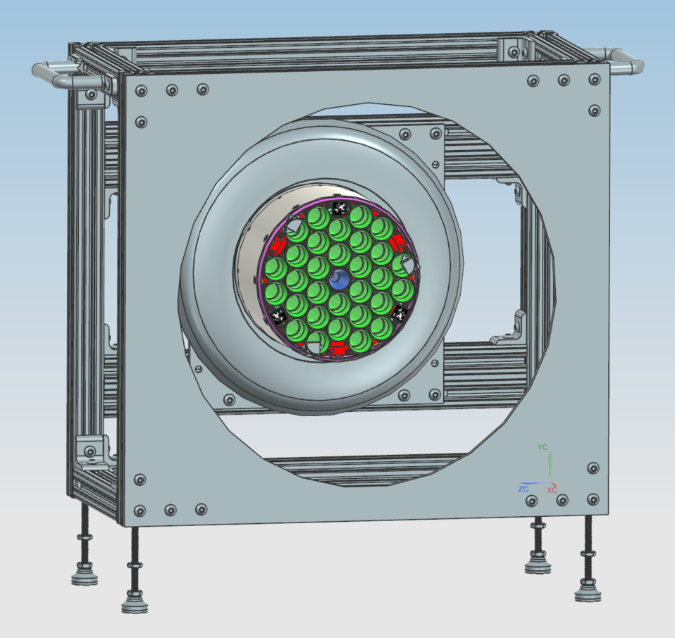
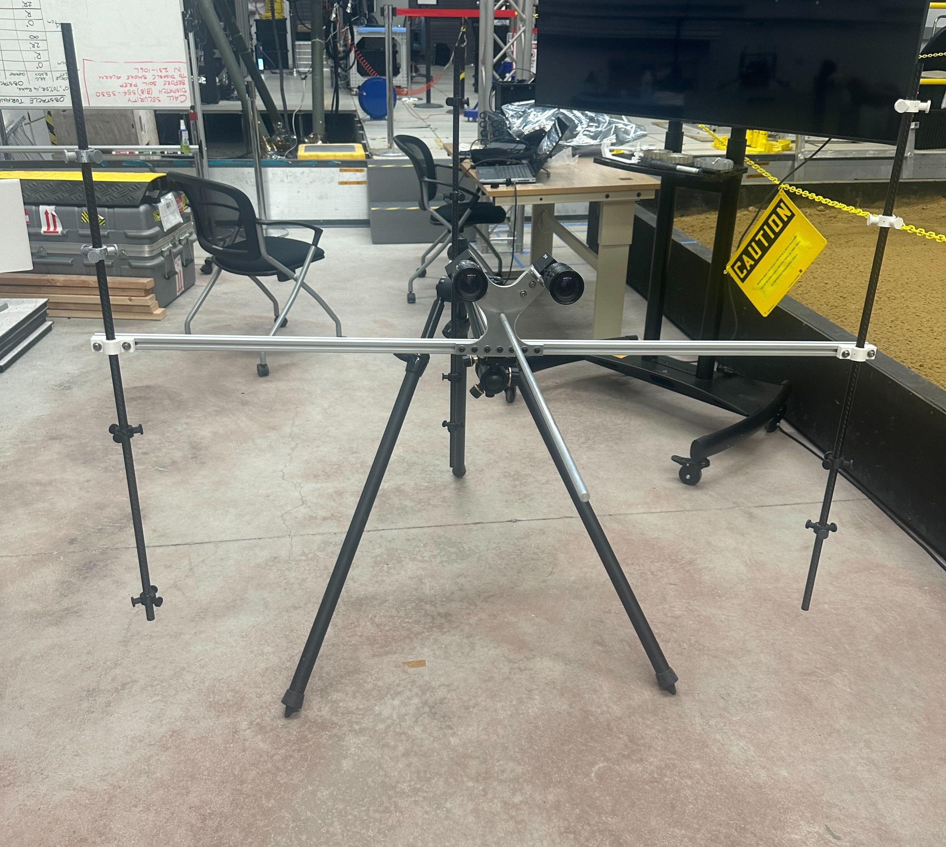
Future Work – Calibration/Ground Truth Capture Strategy
Calibration: By utilizing Vicon balls
When the location of the cameras are known
  Measure the location of the OS by utilizing Vicon balls
Capture images of the icon balls with various test matrix ,then get the ground truth information of the SCARF relative to the station
Notes:
TO BE CHANGED

Slide 15
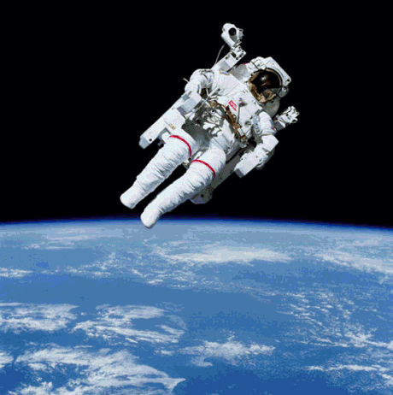
Lessons Learned
Iterative Design Process:
  Importance of continuous refinement to align with project objectives and manufacturing capabilities.
Effective Communication:
  Incorporating feedback from senior engineers in design iterations.
Proficiency in Advanced Software:
  Gained expertise in NX software for design and Adams software.
Regular Team Engagement:
  Importance of teamwork and collaboration in achieving project goals

Slide 16
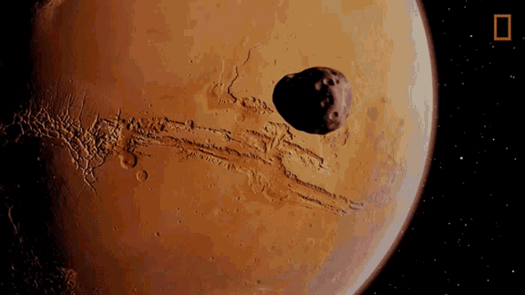
Future Plans
Contributing to NASA:
  Seek opportunities to rejoin NASA JPL
  Utilize skills to advance space exploration
Future Education:
  Pursue Masters Degree this Fall
Career Developments:
  Secure a full-time position in aerospace or technology
  Gain experience in project management and leadership
Innovation and Research:
  Participate in cutting-edge engineering projects
Go to MARS
Notes:
Add inspirations from Hoa’s

Slide 17
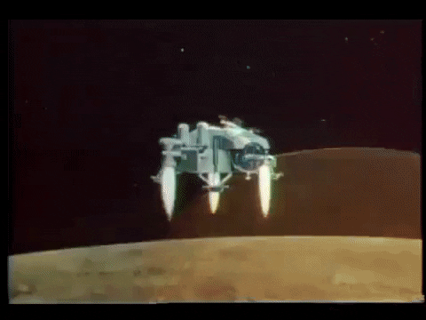
Acknowledgmentd
In Alphabetic order
Alireza Chatrzarrin
Anna E Boettcher
Danny Green
Jenny Tieu
Joseph J Bowkett
Keiana M Samoy
Kenneth J Glazebrook
Katie Ortiz
Lupe M Dominguez
Philip Bailey
Philip Y Twu
Phoebe Rhodes-Wickett
Sawyer Brooks

Slide 18


Questions and Contact Information

