Slide 1
Tube or not Tube: Manipulation and Sampling Operations on Mars 2020

Slide 2
Introduction
First part of a two-part series discussing Mars 2020 Robotic Operations based on this paper, which was selected as the Best Paper overall from the 2025 IEEE Aerospace conference:
V. Verma, M. Maimone, K. Kaplan, E. Thiel, N. Rothenberger, J. Carsten, A. Rankin, E. Schaler, E. Graser, N. Balabanska, S. Kuhn, and H. Dor, "Robotic Operations During Perseverance’s First Extended Mission," 2025 IEEE Aerospace Conference, Big Sky, MT, USA, Winner of M. Charles Fogg Best Conference Paper Award, 02 March 2025.
Today’s talk will focus on robotic arm and sampling challenges and operational improvements
Robotic Operations Overview (Mark Maimone)
Abraded Science Optimizations (Joseph Carsten)
Sampling and Caching Updates (Kyle Kaplan)
Robotic Arm Force-Torque Sensor Recalibration (Ethan Schaler)

Slide 3
Mars 2020 Robotic Operations
Mark Maimone

Slide 4
What does RO do?
The Mars 2020 Robotic Operations (RO) team is responsible for the development, planning and Mars execution of robotics aspects of the mission.
This includes the Perseverance rover’s:
mobility,
manipulation,
Mechanisms,
sampling operations,
Ingenuity helicopter’s flights.
A lesson learned from MER and MSL missions is that these Robotic Operations require a unique approach compared to non-surface deep space missions. Every drive results in a new effective landing site, and issues and ISAs can arise every day, hence the response time needs to be faster. So M2020 created RO as a top-level project organization to support rapid deployment of operations tools and strategies to improve overall mission safety.

Slide 5
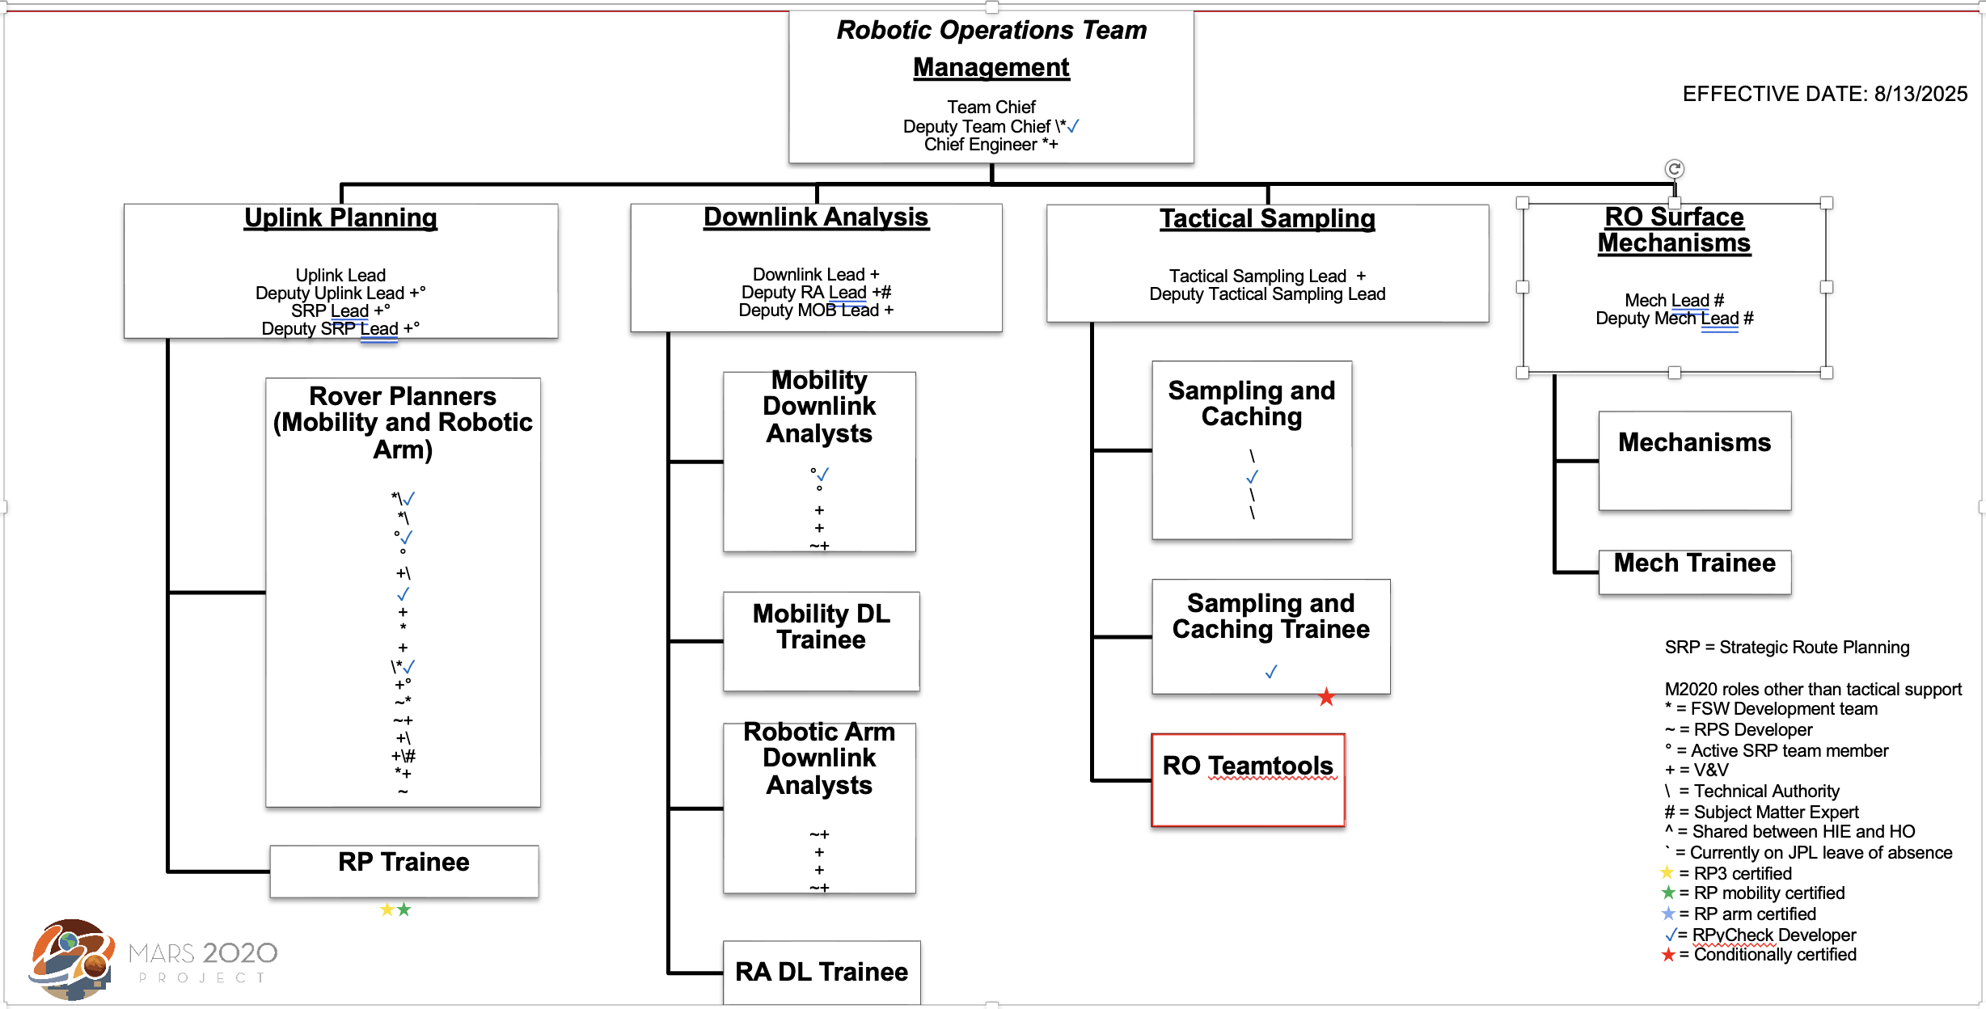
Robotic Operations Org Chart

Slide 6
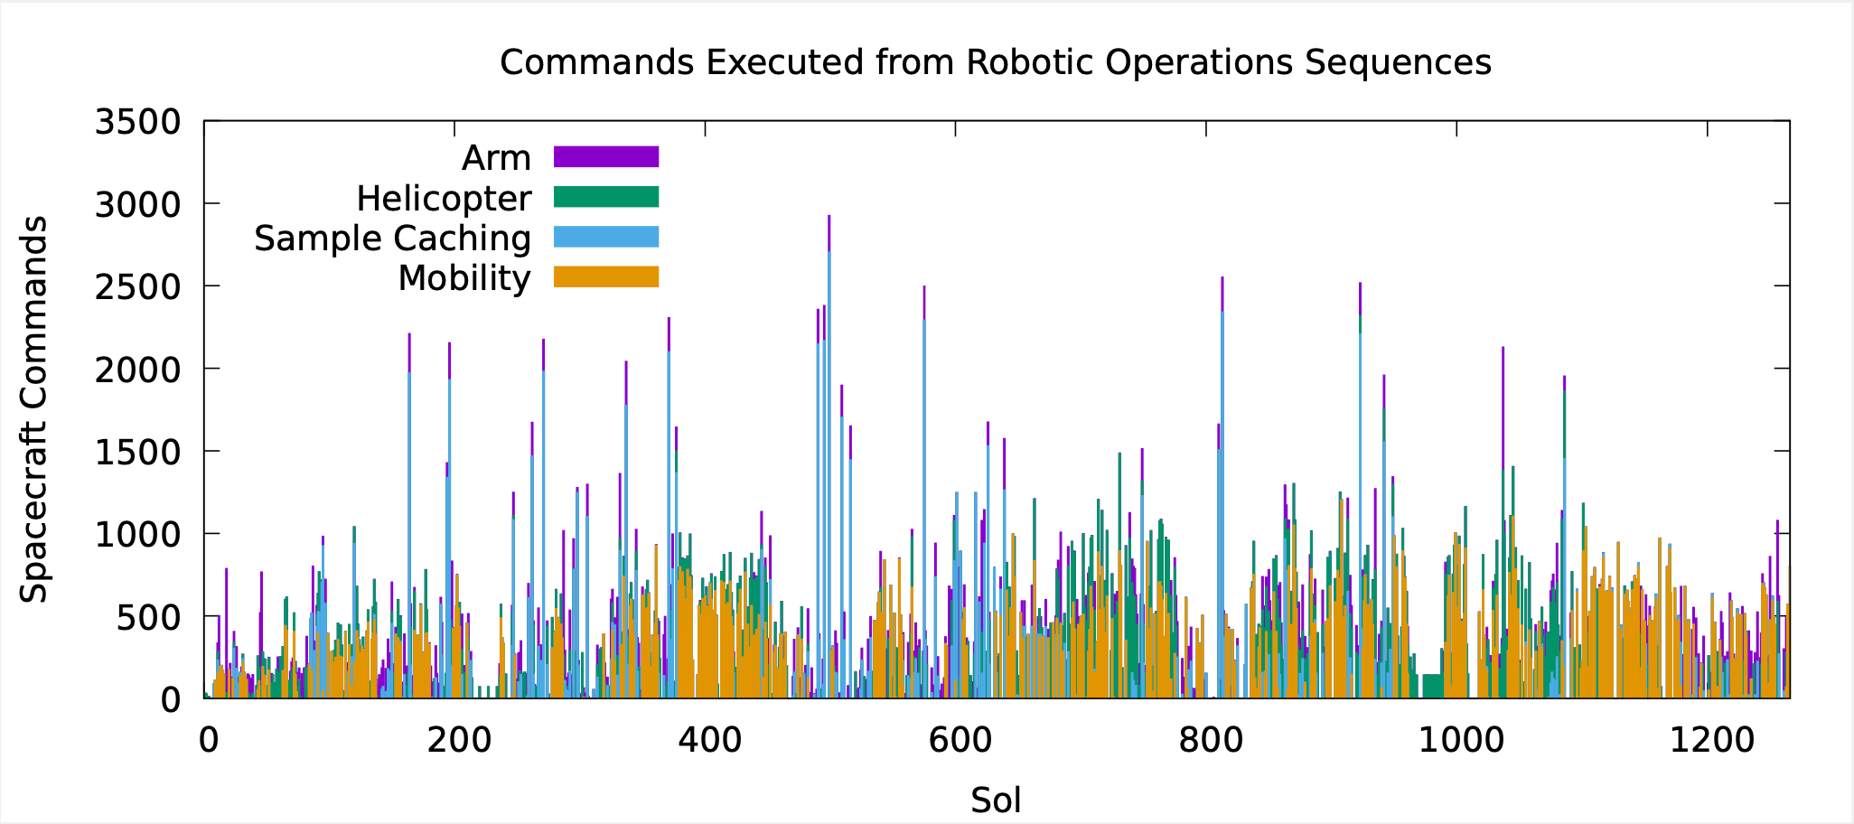
RO Impact on Operations
Commands from the Robotic Operations (RO) team execute nearly every day

Slide 7
Abrasion Sol Path Optimization
Joseph Carsten

Slide 8
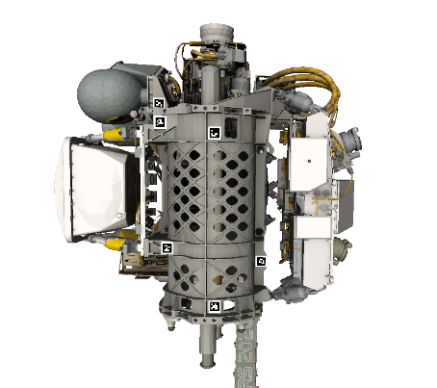
Turret Overview
Facility Contact Sensor (FCS)
Gas Dust Removal Tool (gDRT)
Wide Angle Topographic Sensor for Operations and eNgineering (WATSON)
Proximity Science instruments are PIXL, SHERLOC, and WATSON
Planetary Instrument for X-ray Lithochemistry (PIXL)
Scanning Habitable Environments with Raman & Luminescence for Organics and Chemicals (SHERLOC)
Drill

Slide 9
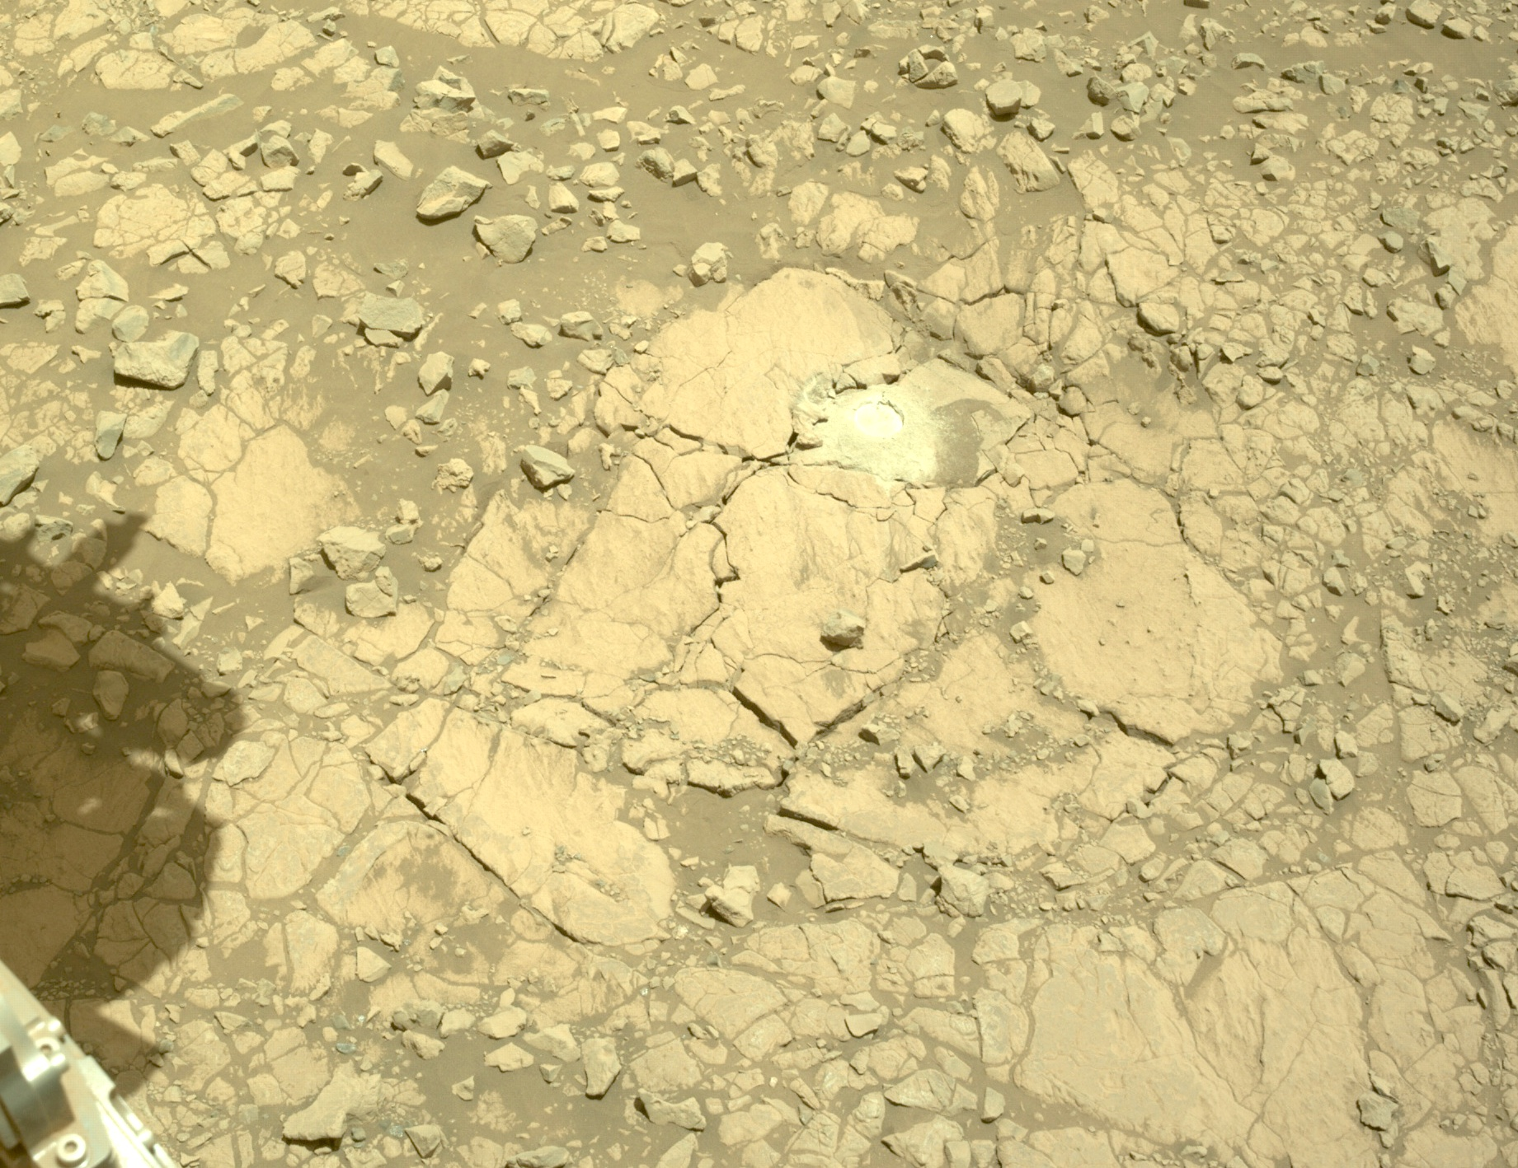
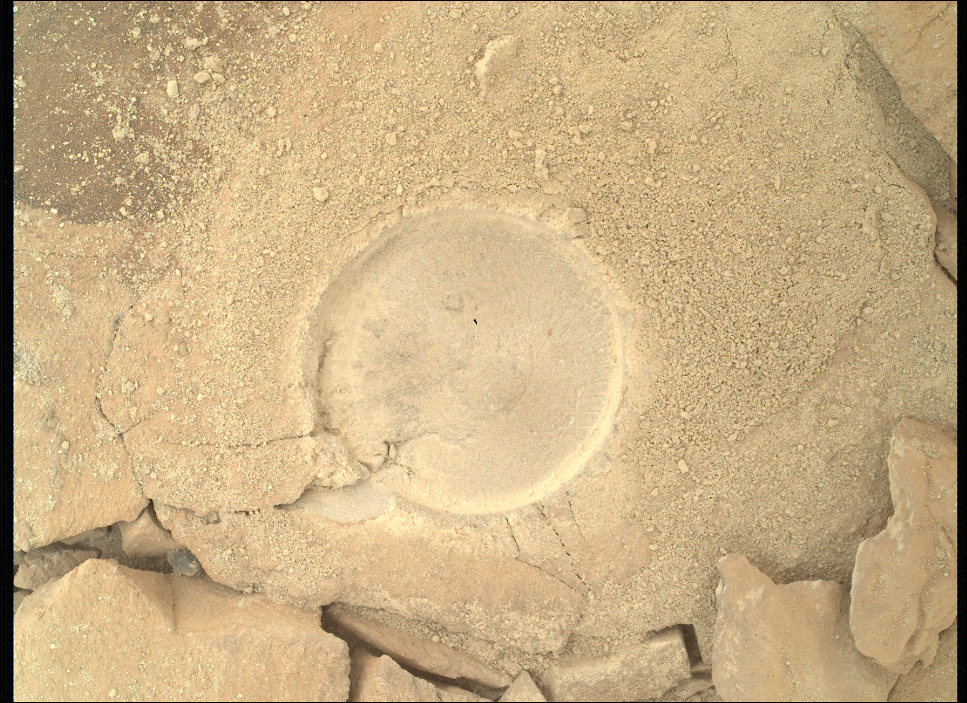
Proximity Science
Vast majority of proximity science observations have been performed on abraded surfaces
Abraded surfaces are strongly preferred by the science team
Removes the outer weathering rind
Creates a smoother surface for observation
NASA/CalTech-JPL/MSSS

Slide 10
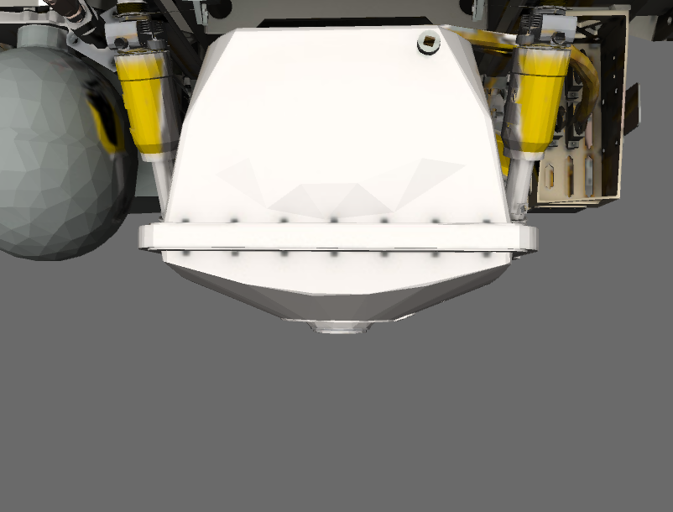
Placement Challenges
PIXL and SHERLOC must be placed at very small standoffs while maintaining adequate margin to inadvertent terrain contact
PIXL standoff is 25.5 mm
SHERLOC context imager is in focus at a 41.3 mm standoff
Abrading makes achieving terrain clearance more difficult
Need to place the instruments relative to the bottom of a hole (abrasion depths are generally around 7 – 10 mm)
Abrading creates cuttings piles around the outside of the abraded patch further reducing clearances
Very roughly to scale

Slide 11
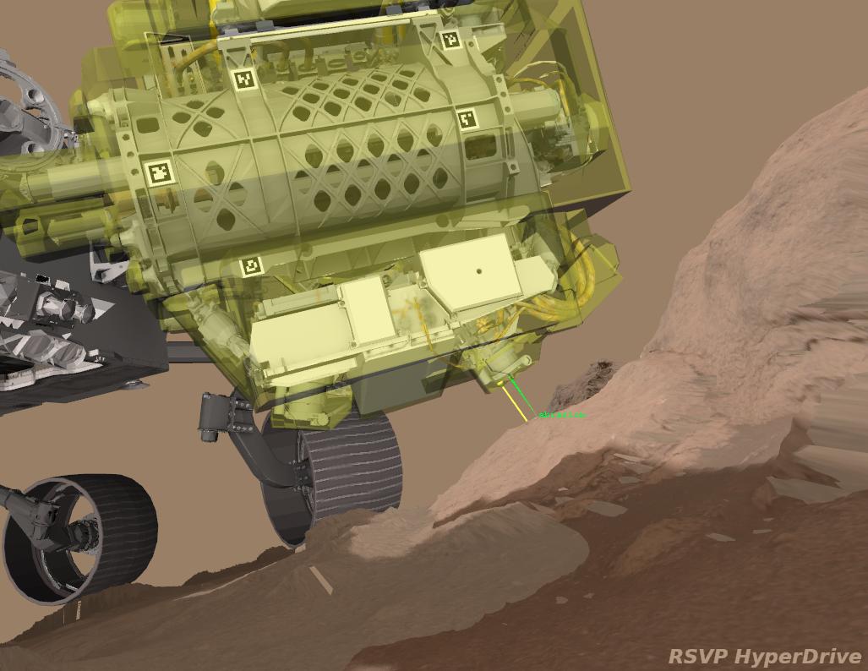
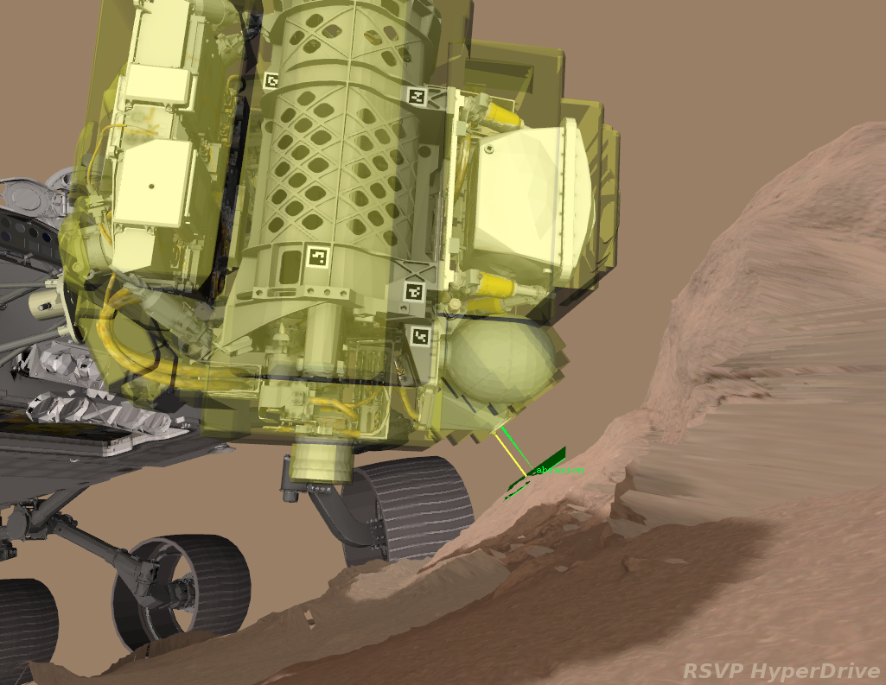
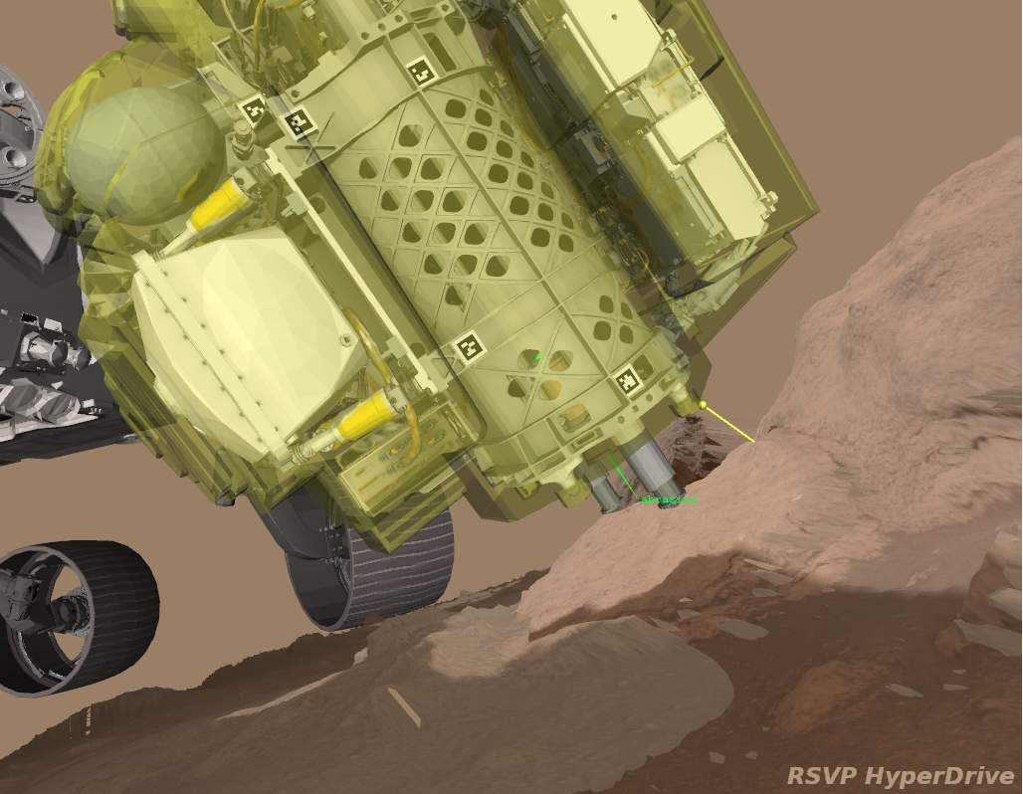
Abrasion Target Analysis
Involves placement of every single tool on the turret
Need to perform clearance analysis for all tool placements (including four different gDRT placements)
Need to evaluate the suitability of the drill placement (surface roughness, debris under the stabilizers, anticipated stabilizer articulation)
Need to verify arm preload is safe to apply
Need to perform a predictive analysis to evaluate the likelihood of being able to perform proximity observations post abrasion

Slide 12
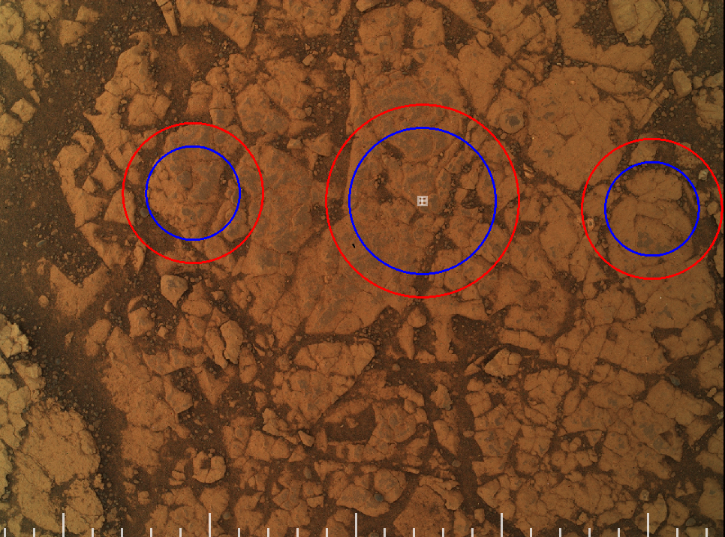
Abrasion Target Analysis (cont)
Complex abrasion target evaluation could not reliably be performed during the couple hours available on the tactical timeline
Moved to a strategic evaluation requiring augmented staffing
Tactical team captures WATSON target refinement images of candidate targets
Higher resolution imaging makes it easier to identify small pebbles and other debris
Reduces uncertainty in the placement of the abraded patch
Reduced uncertainty makes target evaluation more likely to pass
NASA/CalTech-JPL/MSSS

Slide 13
Original Abrasion Sol Path
Sols on Mars
Drive to Approach Target
Capture WATSON Target Refinement Images
Abrade, Dust Clearing, Workspace Imaging
PIXL, SHERLOC, WATSON Observations
Navcam and Hazcam Stereo Images
Navcam and Hazcam Stereo Images, WATSON Images
WATSON Images
Abrasion Target Evaluation,
Sequence WATSON Imaging
Finalize Abrasion Target, Sequence Abrasion Activities
Evaluate Science Targets, Sequence Proximity Science
Planning Cycles on Earth

Slide 14
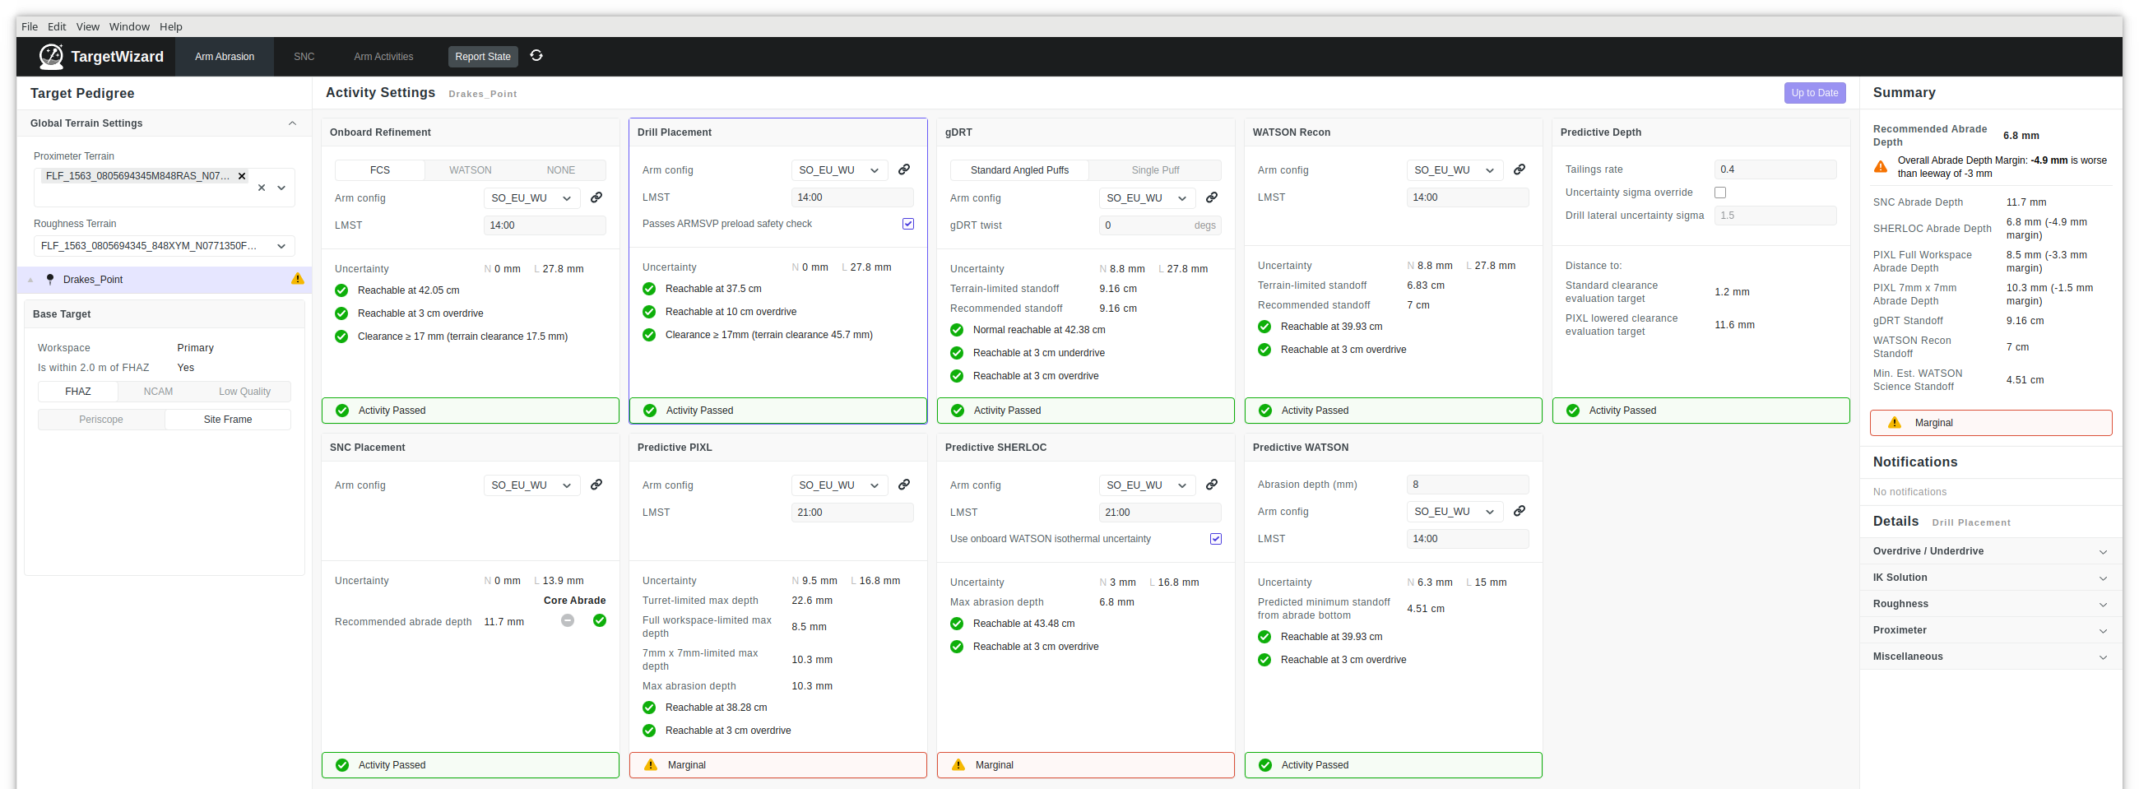
Target Wizard
Undertook an effort to automate much of the target evaluation process
Evaluations that used to take tens of minutes for a given target can now be done in a few seconds

Slide 15
Predictive Analysis Risk Posture
Foregoing WATSON refinement images increases placement uncertainty, making it harder to locate a target with high confidence of being able to place proximity science instruments
Instead of using 3 sigma uncertainty (99.7% confidence) for the predictive analysis, use 1.5 sigma (87% confidence)
Makes finding an abradable target without WATSON refinement images only slightly harder than it is with those images
Still use 3 sigma uncertainty for all hardware safety checks
 | Predictive Analysis Lateral Uncertainty
With WATSON refinement, 3 sigma | 11.0 mm
No WATSON refinement, 1.5 sigma | 16.8 mm
No WATSON refinement, 3 sigma | 29.4 mm

Slide 16
New Abrasion Sol Path
Sols on Mars
Drive to Approach Target
Capture WATSON Target Refinement Images
Abrade, Dust Clearing, Workspace Imaging
PIXL, SHERLOC, WATSON Observations
Navcam and Hazcam Stereo Images
Navcam and Hazcam Stereo Images, WATSON Images
Abrasion Target Evaluation,
Sequence WATSON Imaging
Finalize Abrasion Target, Sequence Abrasion Activities
Evaluate Science Targets, Sequence Proximity Science
Planning Cycles on Earth

Slide 17
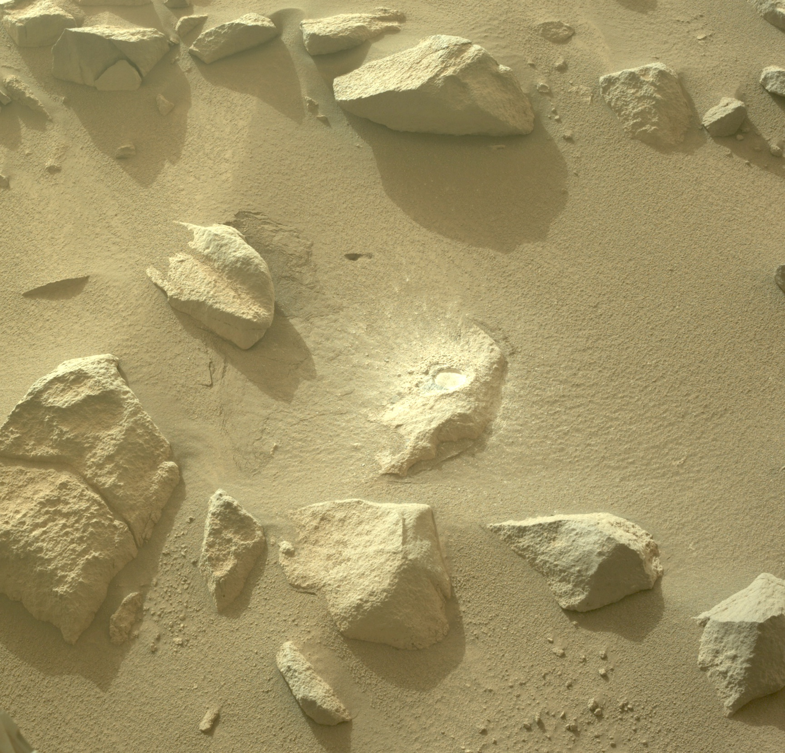
Results
24 abrasions performed between rollout on sol 1079 and sol 1565
Never needed to spend an additional sol to capture WATSON refinement images
Saved 21 planning cycles and completed one abrasion we would not have done without the optimization

Slide 18
Sampling and Caching Updates
Kyle Kaplan

Slide 19
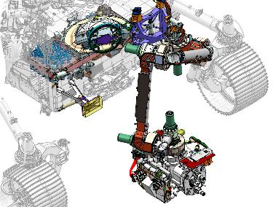
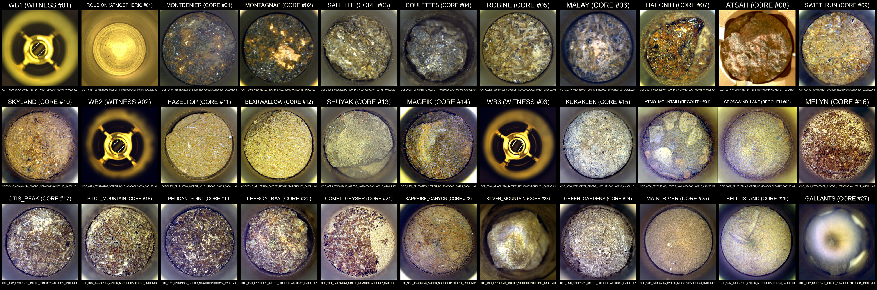
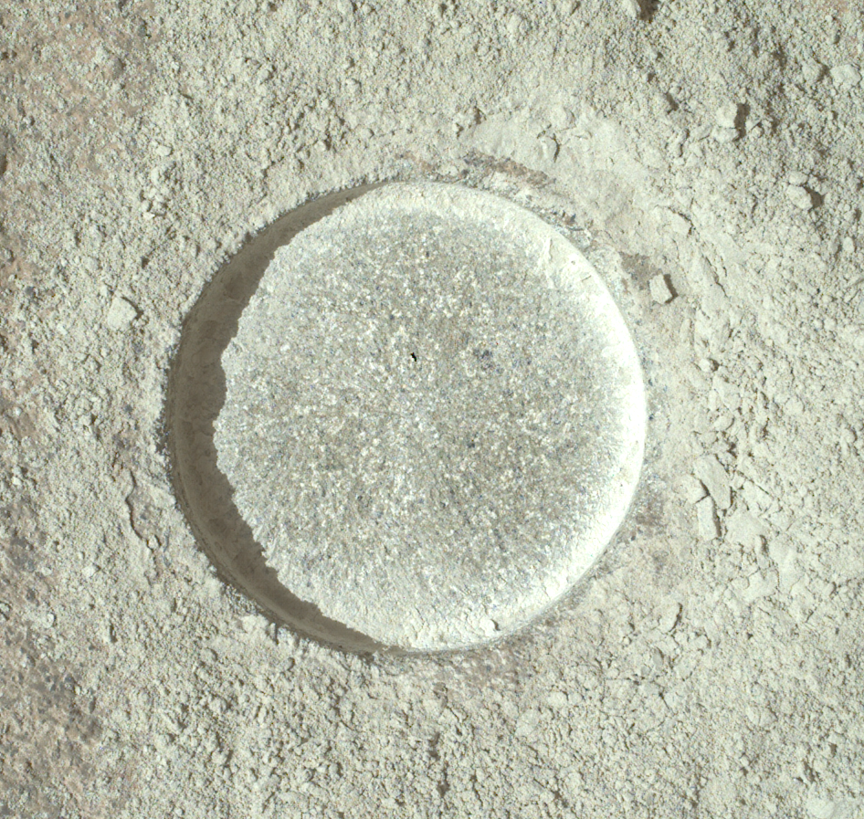
Sampling and Caching Subsystem (SCS)
Sampling Stats
Abrasions Attempted | 50
gDRT Puffs | 259
Tubes Sealed | 31 (2 filled, but unsealed)
- Rock Cores | 25
- Regolith | 2
- Witness | 3
- Atmospheric | 1
Bit Exchanges | 98
All samples sealed or in storage. Credit: J. Maki
Marmen Abrasion, Sol 1513.
Notes:
1-2 min
Overview of hardware and capabilities
Emphasize progress of mission (e.g. 31 of 41 tubes sealed)

Slide 20
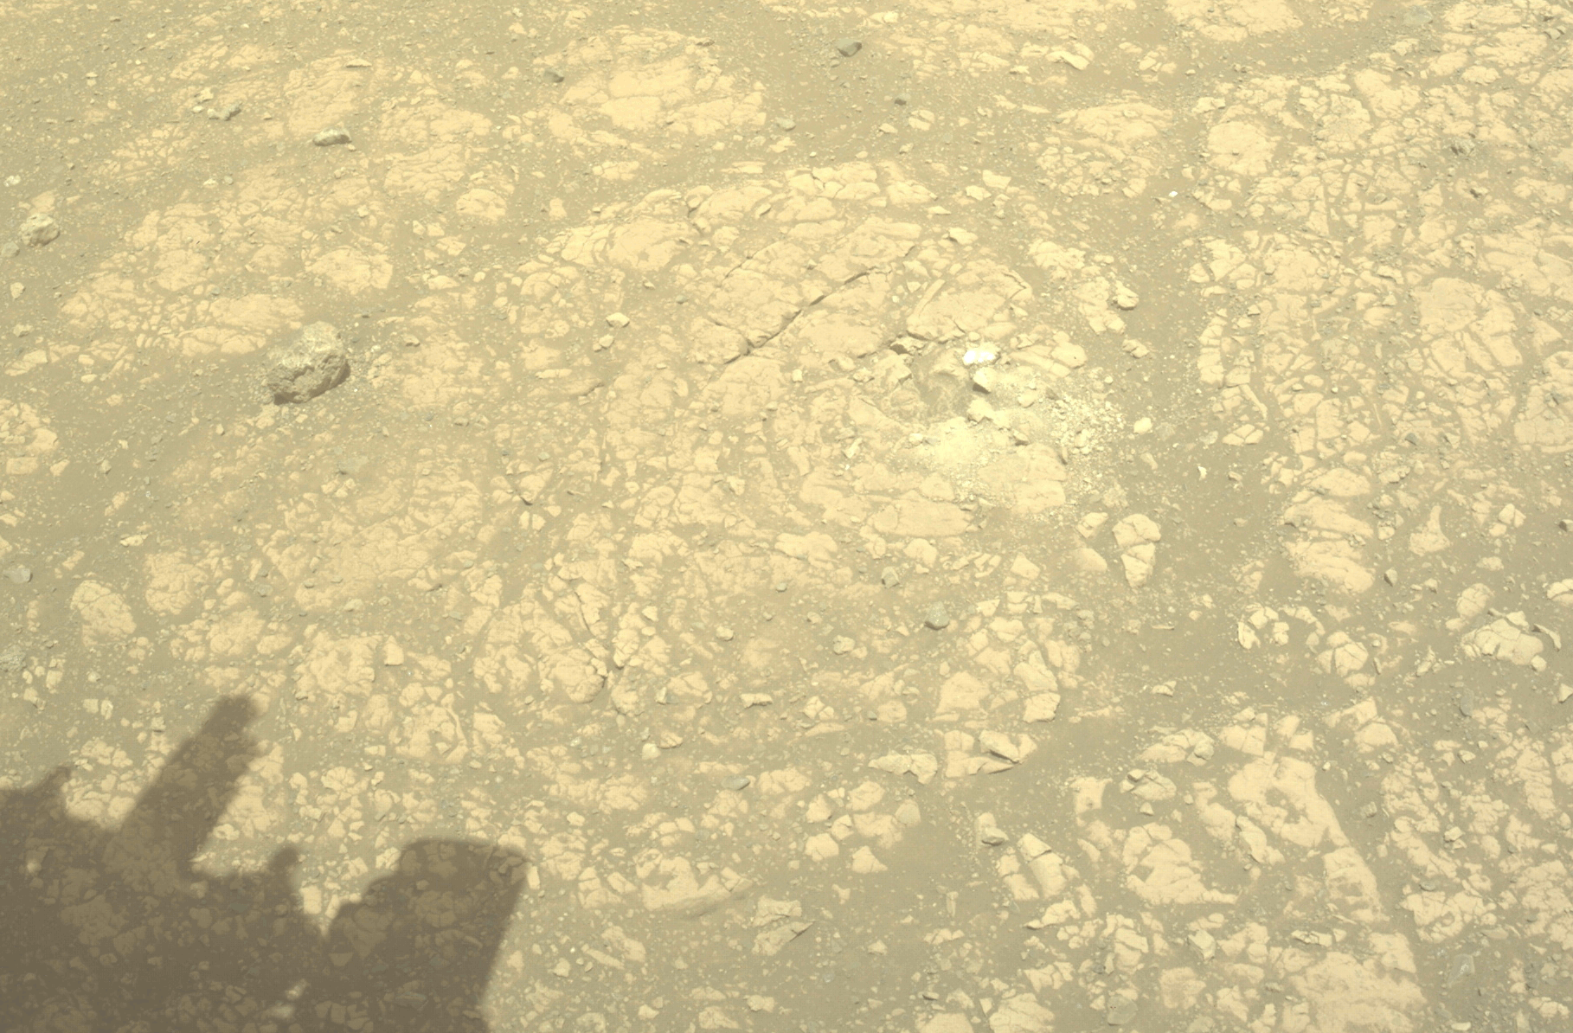
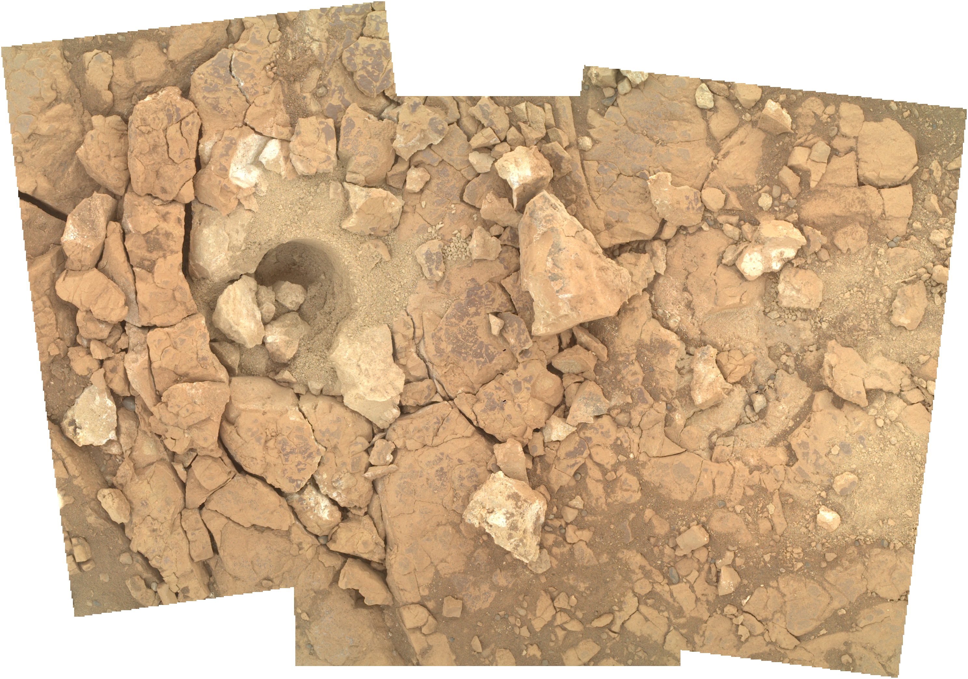
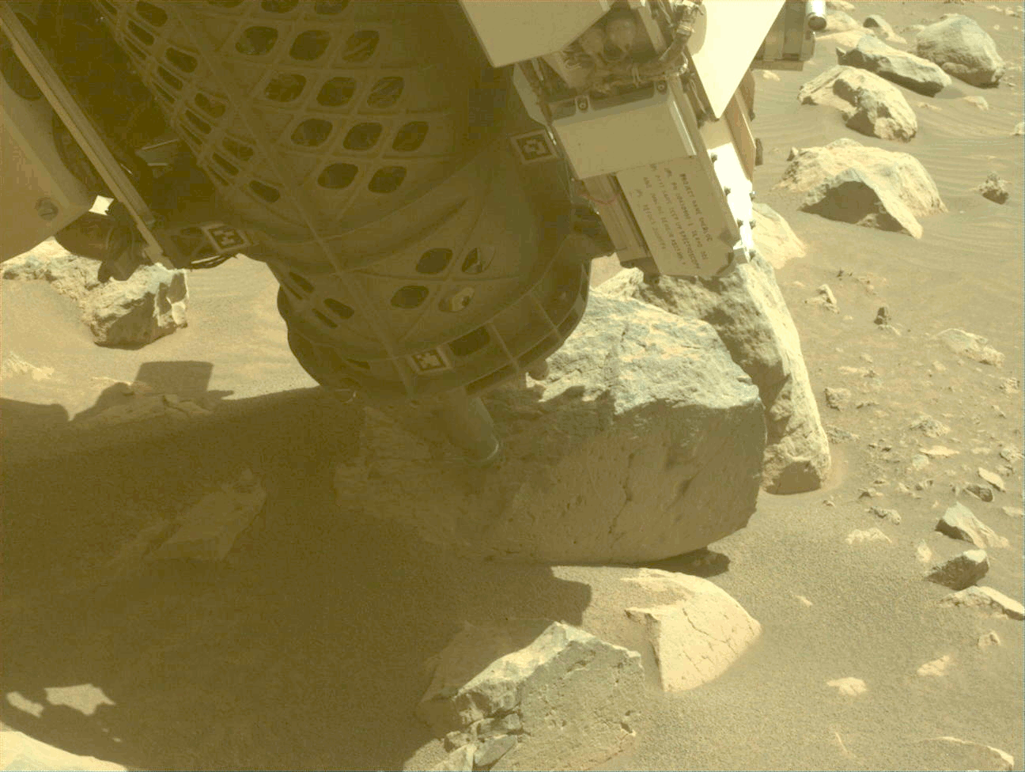
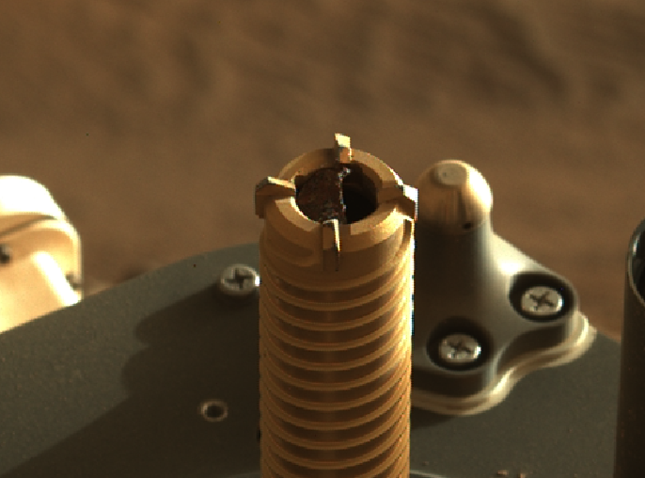
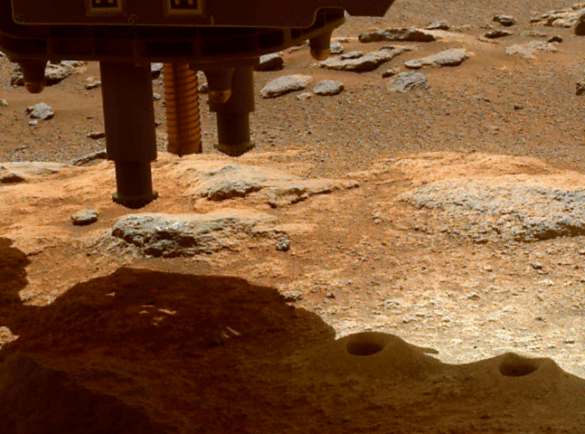
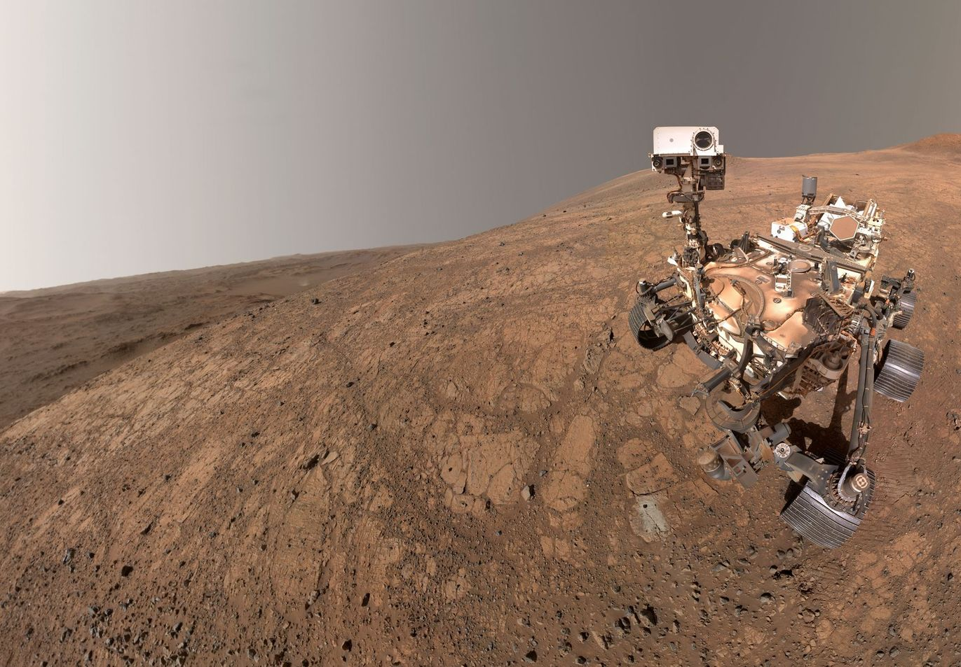
Extended Mission Sampling Operations
Learning how to drill rocks at the edge of our performance limits.
Gallants coring attempt, Sols 1551-1552.
Gallants post-coring, Sol 1555.
Abrading Drakes Point, Sol 1565.
Releasing new capabilities to enable increased science return.
CORING_3 Mushroom, Sol 371.
Pauls sample dump, Sol 325.
Rover selfie, Sol 1500.
Notes:
2 min
Challenges of attempting to keep up with Science’s requests
Using the system in ways that have not necessarily been tested on Earth and seeing varying degrees of success
Want to get the most out of the hardware and maximize Science return
Using the hardware in ways that were considered before ops but not fully exercised (e.g. sample dump)

Slide 21
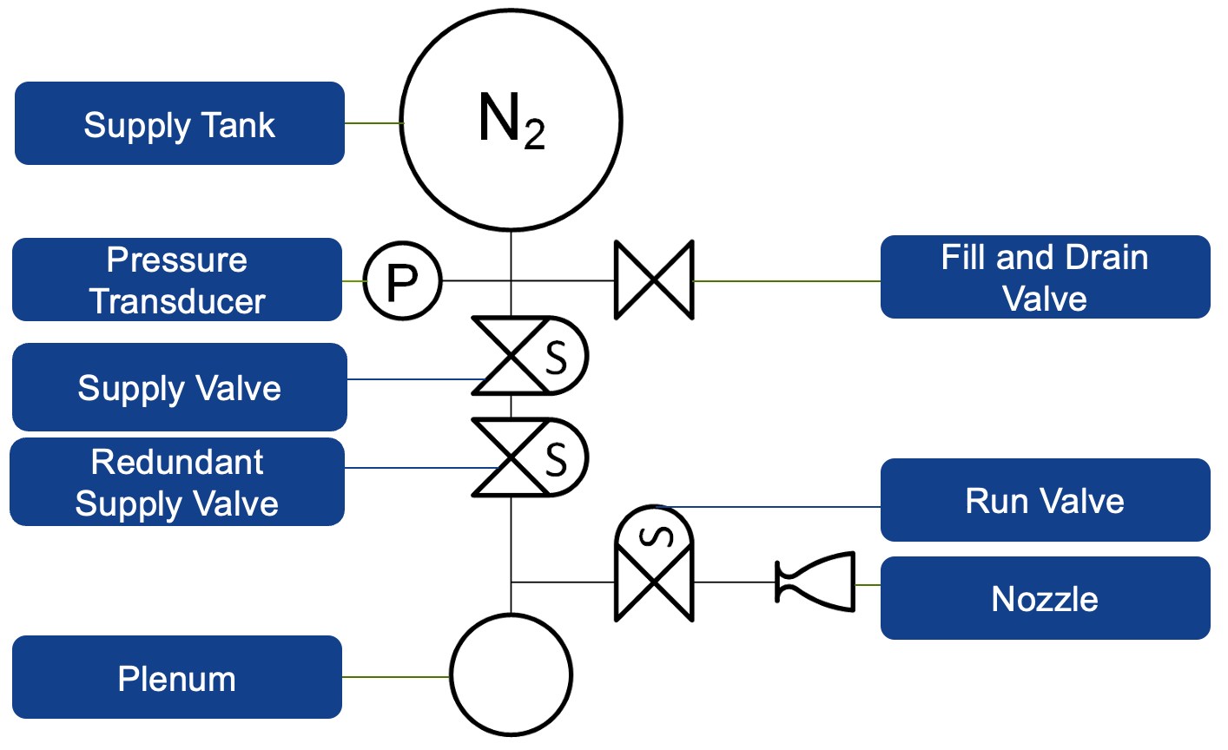
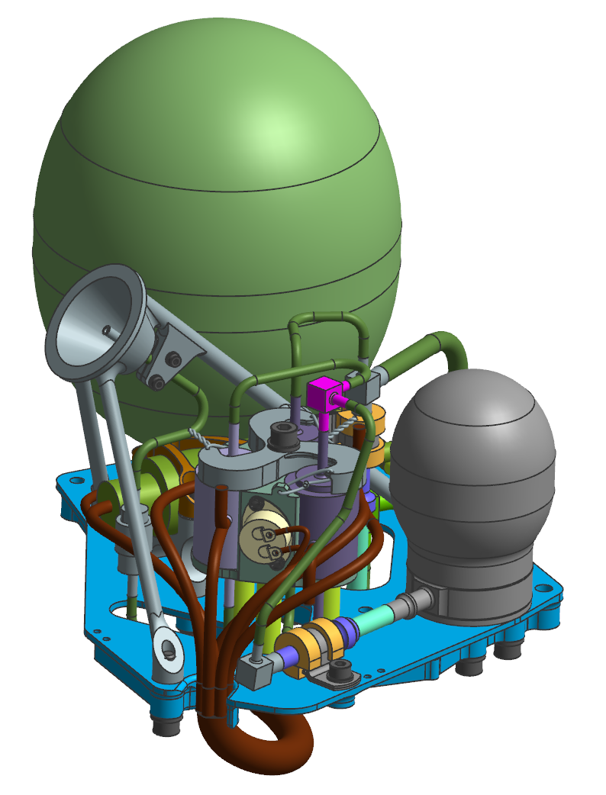
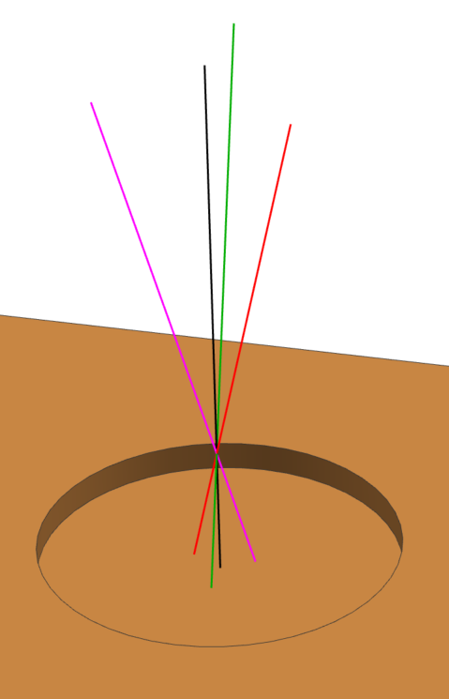
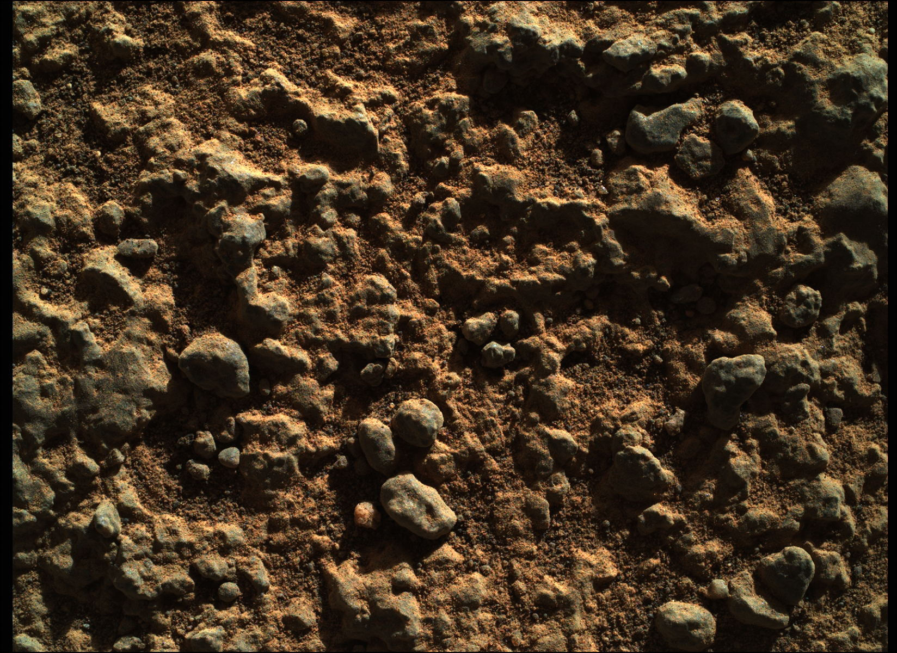
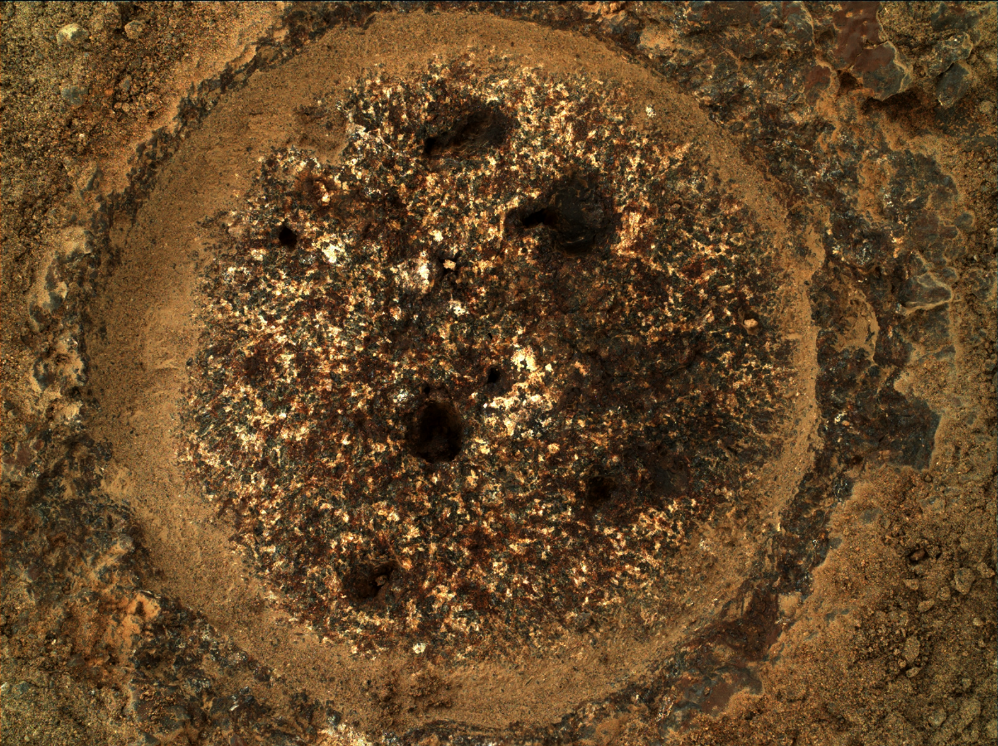
Gas Dust Removal Tool (gDRT) Operations
Vent plenum.
Fill plenum.
“Triplets” puff 1.
Refill plenum.
“Triplets” puff 2.
Refill plenum.
“Triplets” puff 3.
Refill plenum.
Normal puff.
Rotational angle of 120°
Angle relative to normal of 15°
Lateral offset of 5 mm
Vertical offset of 80 mm
Mass of gas of ~0.1g per shot
Adjust plenum pressure and on time based on temperature
PRT
Vertical offset of 80 mm
Mass of gas of ~0.1g per shot
Adjust plenum pressure and on time based on temperature
Guillames abrasion after gDRT puffs, Sols 159-160.
Notes:
1 min
Explain how abrading + gDRT enables prox sci
Brief overview of gDRT hardware and how system is used in ops

Slide 22
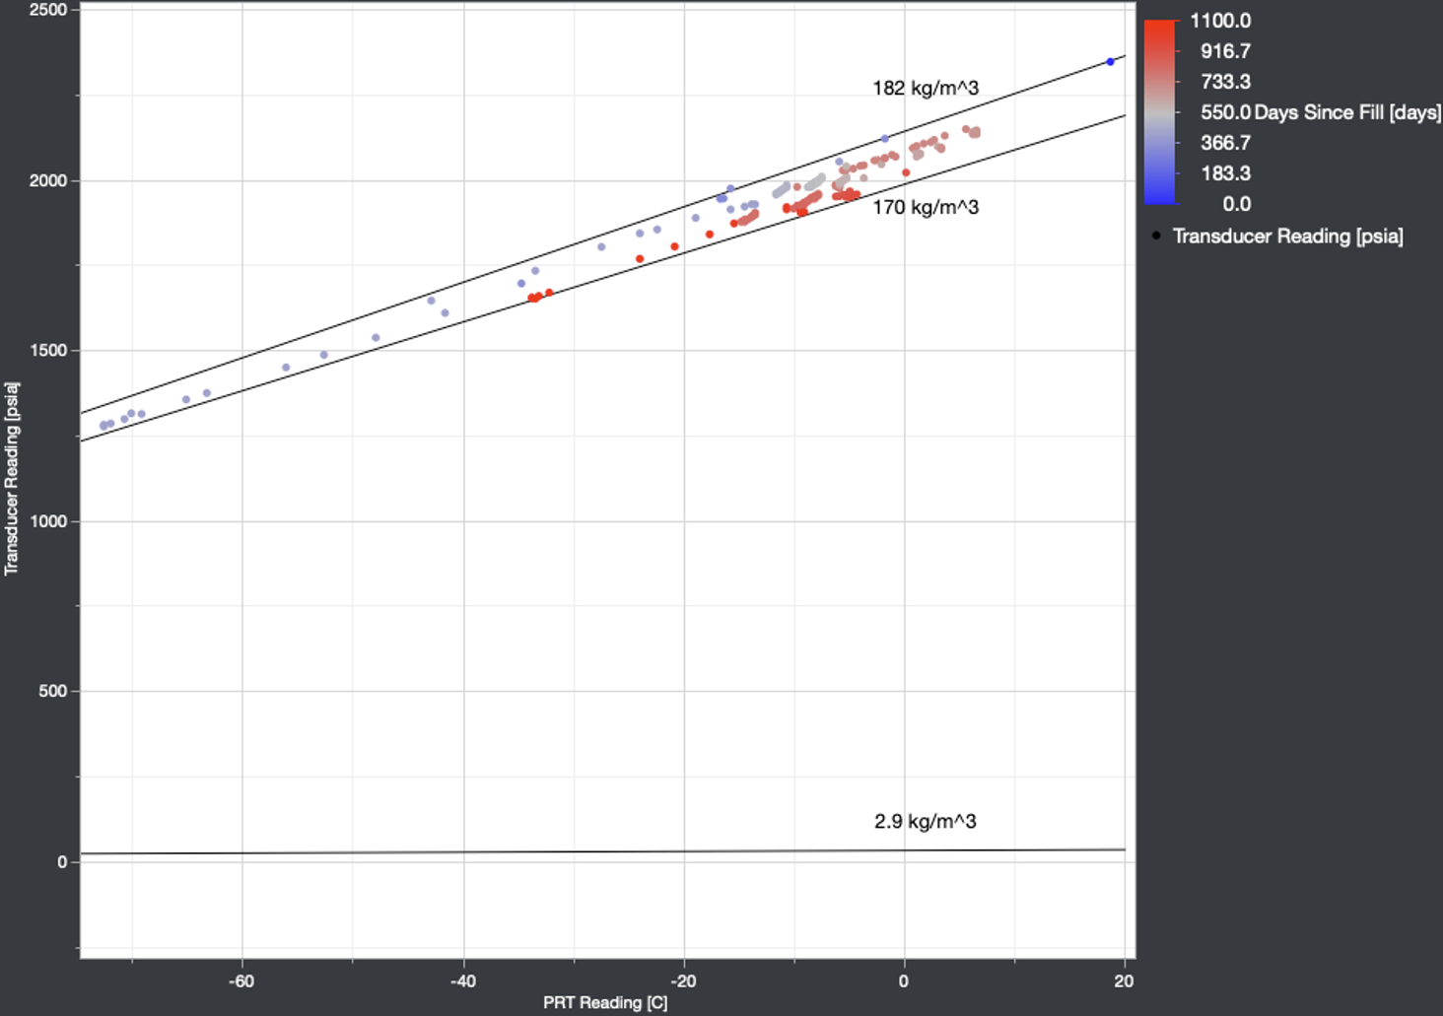
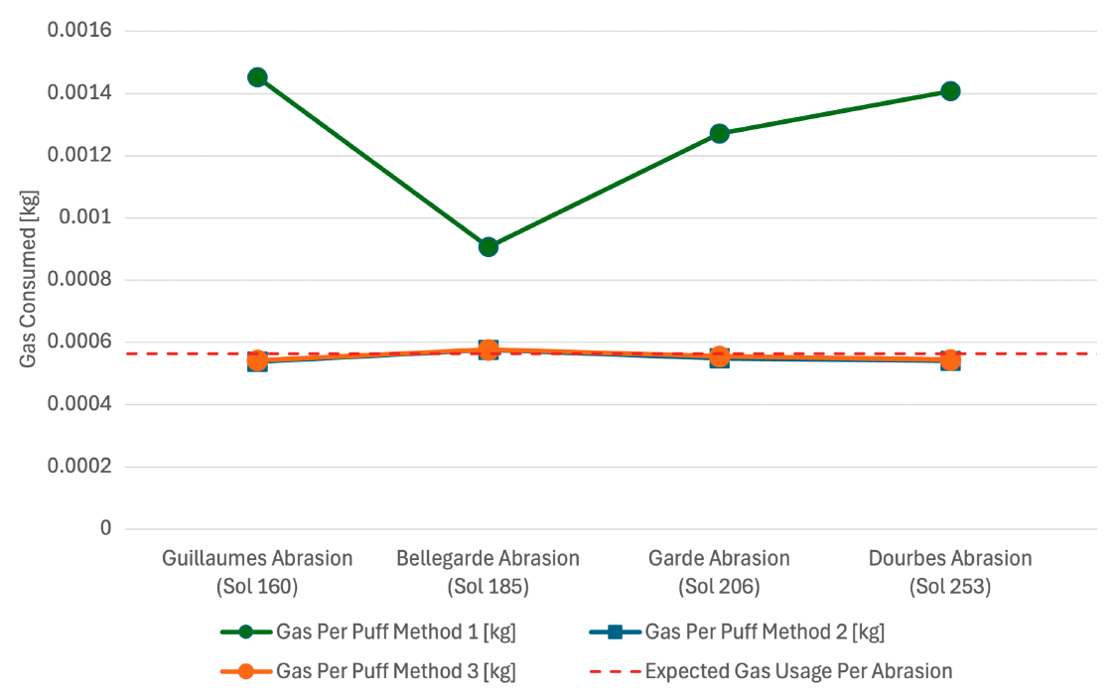
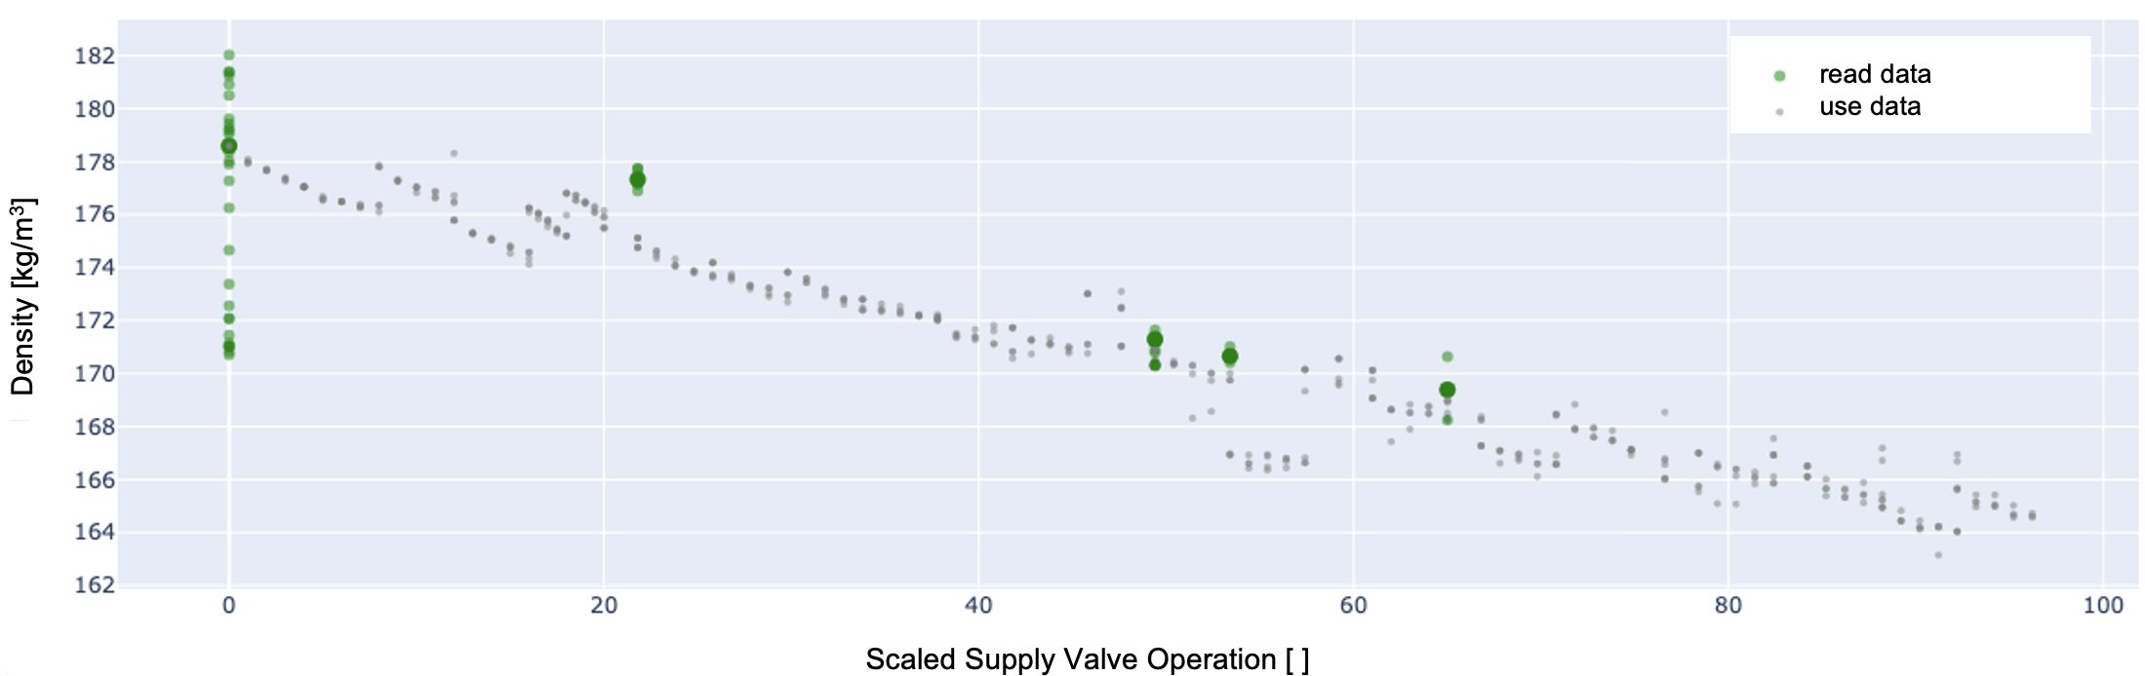
gDRT Budget Error
Notes:
2 min
Describe the 3 methods of gas budgeting and what the budgets showed in the first few puffs
Point out why this was concerning – what the life req. is and how much gas we thought we filled to
Explain concept of isochoric lines on P-T plot and how some data points deviated from this even when the system wasn’t in use
Began separating out use data (noisy) from read data (more consistent, but very little of it)
Change in pressure read strategy – intentionally collect data in between uses and at differing temperatures (begin to plot isochor)
Found out that temperature and rate of change in temperature resulted in poor pressure estimates – lead into next slide

Slide 23
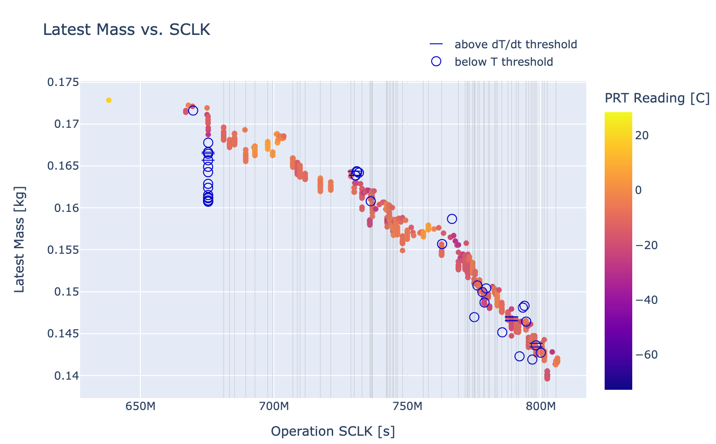
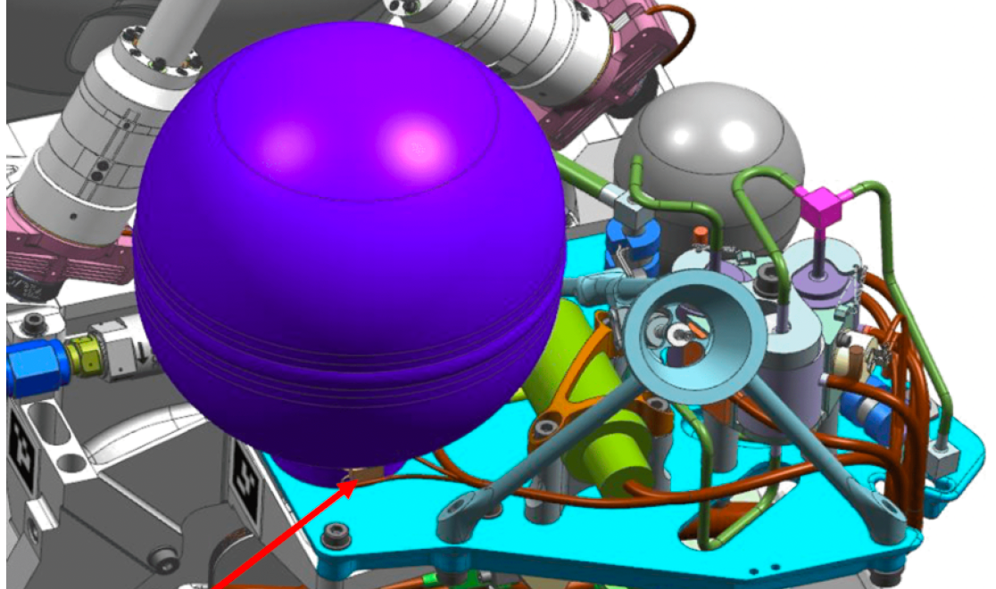
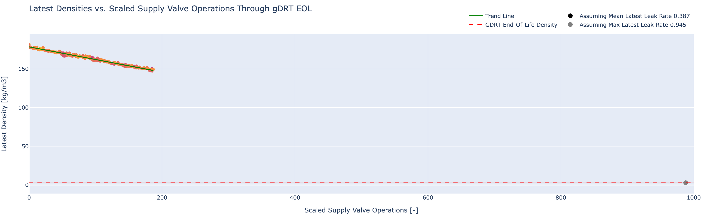
gDRT Budget Error Resolution
Notes:
Explain inconsistencies with temperature data due to PRT placement on tank boss and temp lag
Point out filtered out data points based on PRT thresholds
Describe concept of latest density using most recent data points from read periods (“zero out” error)
Emphasize that there is more than sufficient gas to achieve Science mission

Slide 24
In-Situ Recalibration of a 6-DoF Force / Torque Sensor
Ethan Schaler

Slide 25
Force / Torque Sensor Overview

Slide 26
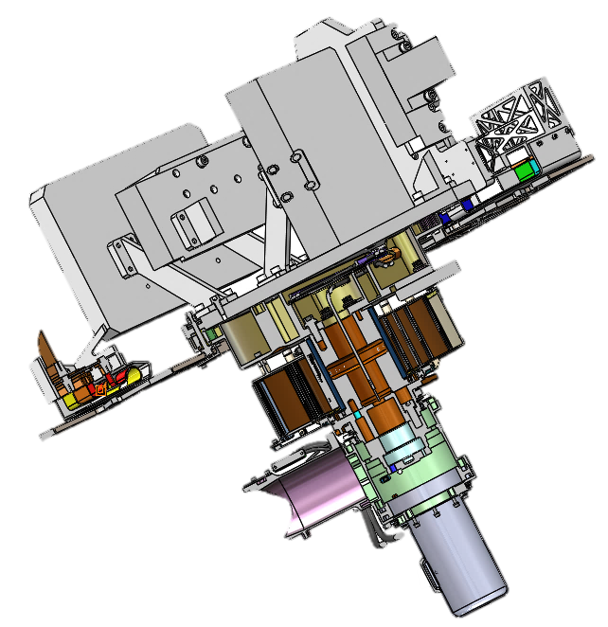
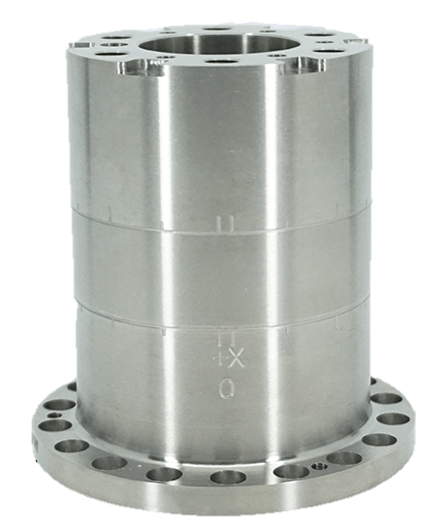
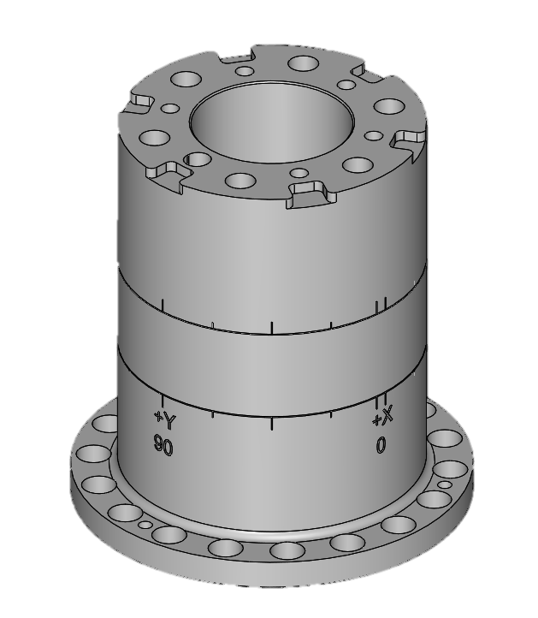
Force / Torque Sensor Overview
Interface to Turret Output Plate (distal)
Sensor Frame
Turret Mass Model
τ_{y}
τ_{x}
F_{y}
F_{x}
Turret Output Plate
Turret Actuator
Interface to Turret Actuator (proximal)
τ_{z}
F_{z}

Slide 27
FTS Calibration Models
Linear Coeffs.
Temp
Coeff.
Offset
Coeff.
$F_{x},F_{y},M_{x},M_{y},M_{z}={\left[\begin{matrix}c_{1} \\ … \\ c_{6}\end{matrix}\right]}^{T}∙\left[\begin{matrix}{sg}_{1} \\ … \\ {sg}_{6}\end{matrix}\right]+c_{T}∙t_{0}+C_{0}$ $=$ ${\left[\begin{matrix}c_{1} \\ … \\ c_{6} \\ c_{T}\end{matrix}\right]}^{T}∙\left[\begin{matrix}{sg}_{1} \\ … \\ {sg}_{6} \\ t_{0}\end{matrix}\right]+C_{0}$
Nonlinear Coeffs.
Linear Coeffs.
Offset Coeff.
$$F_{z}= {\left[\begin{matrix}{sg}_{1} \\ … \\ {sg}_{6} \\ t_{0}\end{matrix}\right]}^{T}∙\left[\begin{matrix}c_{1_{1}} & ⋯ & c_{T_{1}} \\ ⋮ & ⋱ & ⋮ \\ c_{1_{T}} & ⋯ & c_{T_{T}}\end{matrix}\right]∙\left[\begin{matrix}{sg}_{1} \\ … \\ {sg}_{6} \\ t_{0}\end{matrix}\right] + {\left[\begin{matrix}c_{1} \\ … \\ c_{6} \\ c_{T}\end{matrix}\right]}^{T}∙\left[\begin{matrix}{sg}_{1} \\ … \\ {sg}_{6} \\ t_{0}\end{matrix}\right]+C_{0}$$
sg₁ to sg₆ are the strain gauges values in mV/V
t₀ is the FTS PRT temperature in deg C

Slide 28
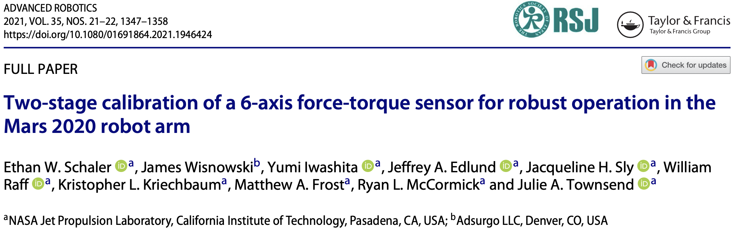
Pre-Landing Calibration Strategy

Slide 29
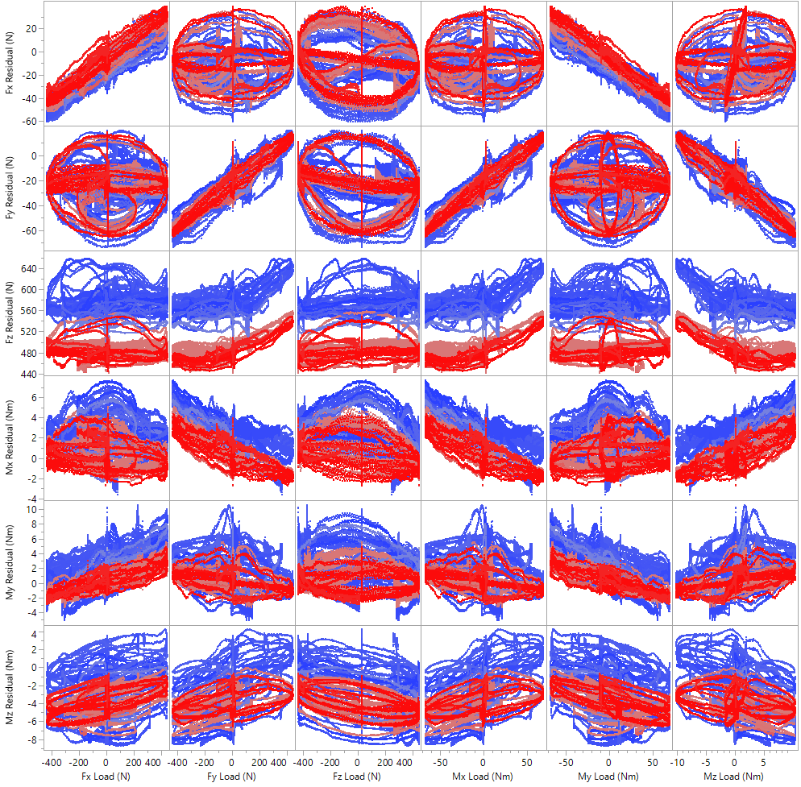
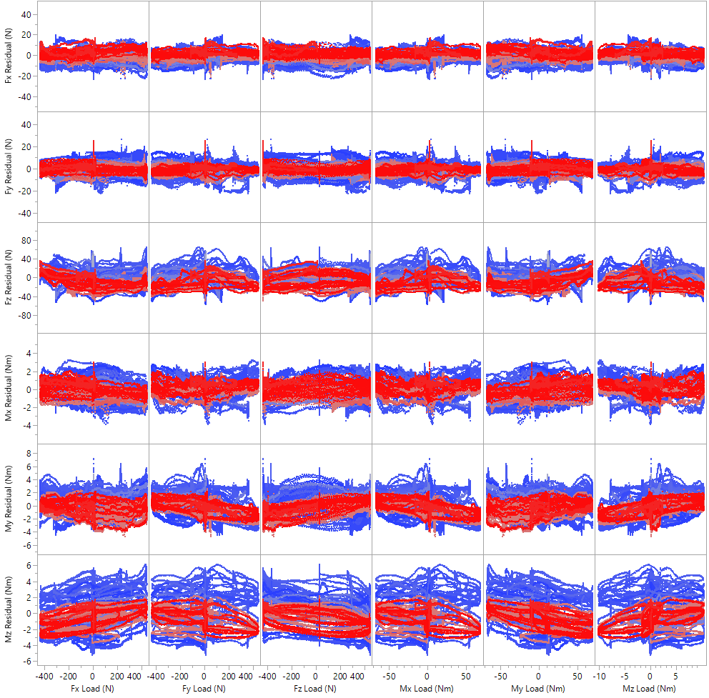
Pre-Landing Calibration Performance
System-Level calibration successfully eliminated significant cross-coupling, thermal effects, and other error sources, versus a Sensor-Level calibration.
Sensor-Level Calibration
System-Level Calibration
Colored by FTS temperature from –70 degC (blue) to +22 degC (red)

Slide 30
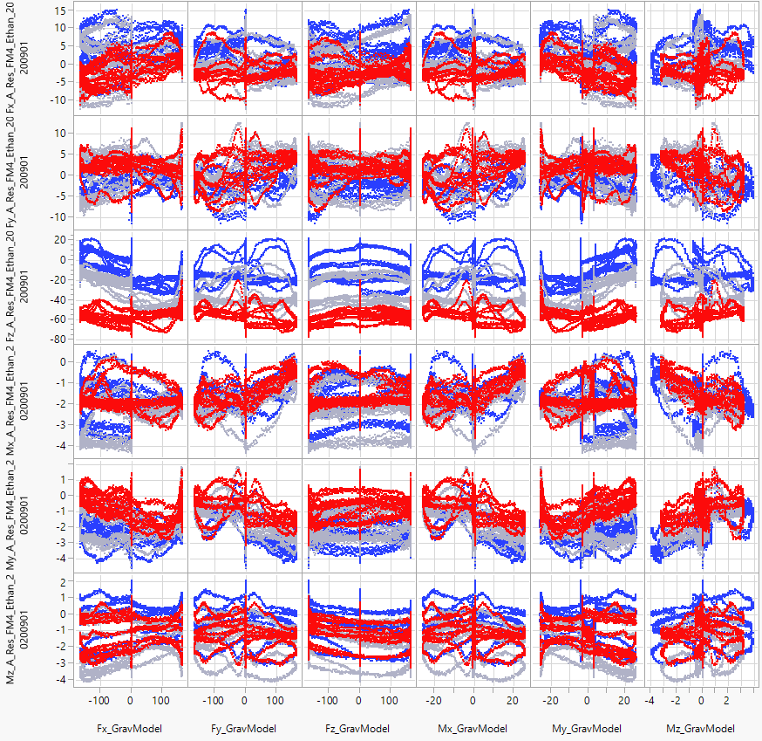
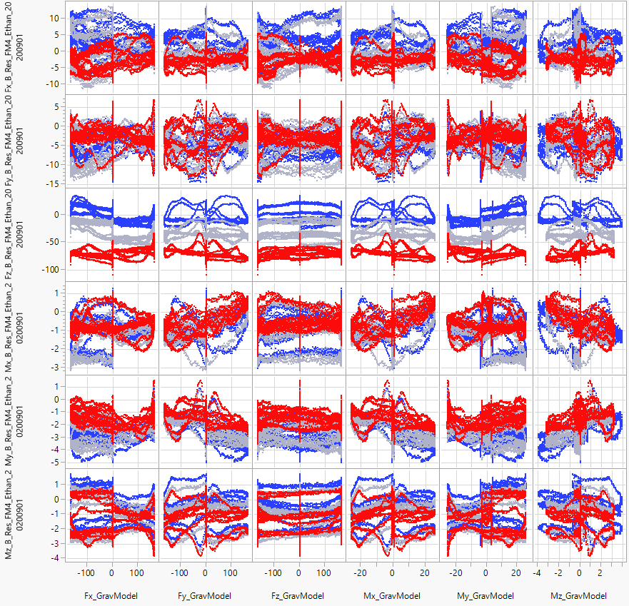
After ~1 Mars Year
Blue is Sol 18 data
Grey is Sol 287 data
Red is Sol 621 data
Visible time-dependent offset drift in residual error (primarily on FZ) – all data taken at similar warm temp, but over time and colored by Sol #
FTS-A Error (colored by Sols 18 – 621)
FTS-B Error (colored by Sols 18 – 621)

Slide 31
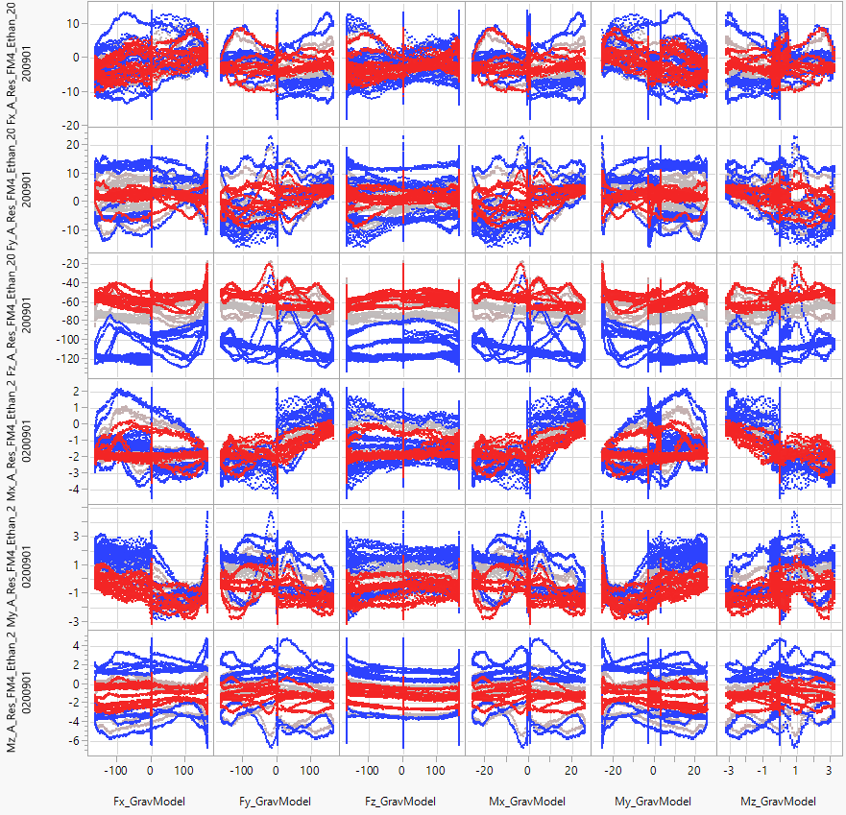
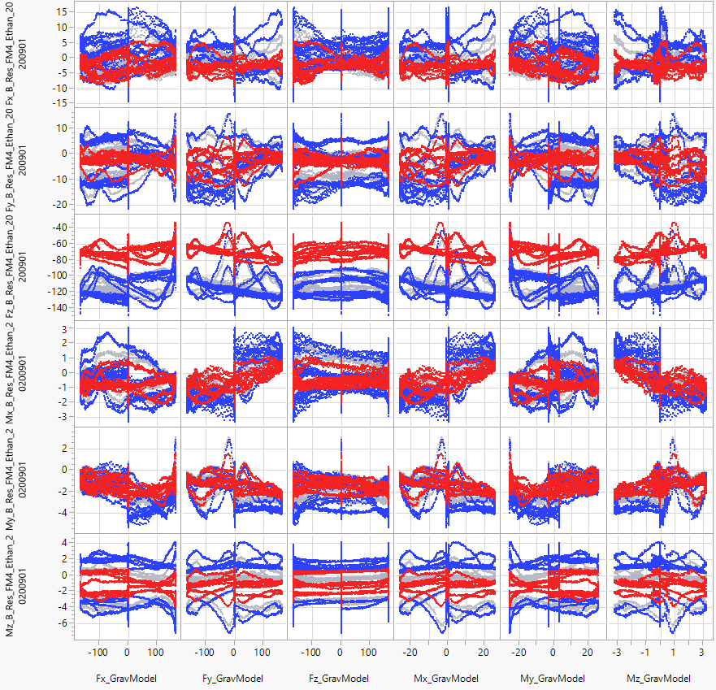
After ~1 Mars Year
Blue is -71 degC data
Grey is -40 degC data
Red is -15 degC data
Visible non-linear, temperature-dependent error (primarily on FZ) – data from identical checkouts run at 3 temperatures over 26 Sols
FTS-A (colored by Temp, Sols 595 – 621)
FTS-B (colored by Temp , Sols 595 – 621)

Slide 32
In-Situ Calibration Strategy
Problem: How do you recalibrate an FTS in-situ? Unlike science instruments, there are no dedicated calibration targets…
Strategy: We again use the turret weight gravity model as a truth load, and we find a calibration that minimizes the residual error to this truth load.
Modify – not replace – the preceding system-level calibration
Dataset is collected by (carefully) waving the turret + wrist about for 1 hour
Constraints: limited load ranges + coupled loads, temperatures by time-of-day

Slide 33
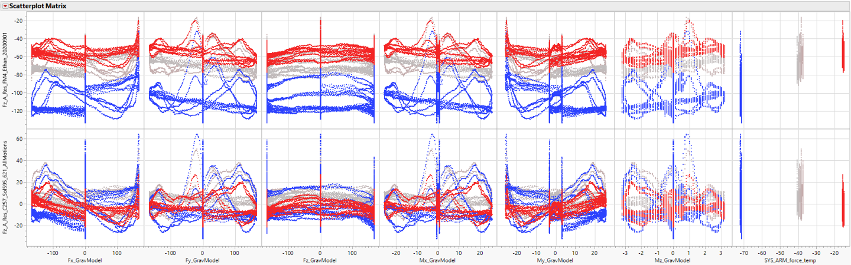
In-Situ Calibration Results
FZ (before in-situ calibration)
FZ (after in-situ calibration)
Colored by FTS temperature from -70 degC (blue) to -15 degC (red)

Slide 34
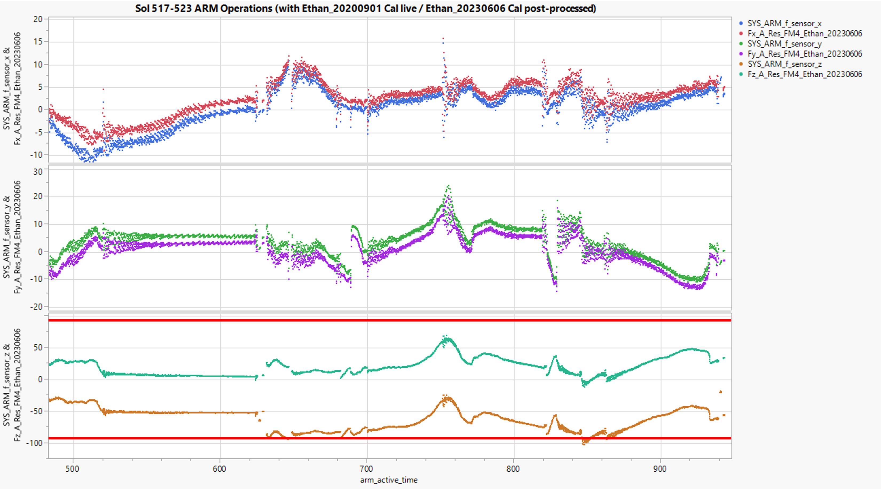
Impact of In-Situ Calibration on Fault Case

Slide 35
Continuing Operations on Mars
The In-Situ Calibration was uplinked to the rover on Sol 881 and has successfully been running on Mars since then (now Sol 1600+).
Ongoing trending of FTS performance:
Quarterly trending of margin to fault protection limits
FTS checkout exercise every Martian summer / winter

Slide 36
Sneak Peek
The next Mission Chronicles talk will continue the discussion of Mars 2020 Robotic Operations on September 18, 2025 and will cover:
Mobility
Record-setting drives! 90% of all driving has been autonomous!
Mechanisms
Dealing with faults that occur due to specific terrains
Next steps for Ingenuity
A look into the post-flight use of Ingenuity and supporting hardware
Technology Development
Using commercial Snapdragon CPU for Global Localization on Mars

Slide 37
Q & A
Questions? Answers!
To be called on for a question, please raise your hand in Teams or go to a microphone in the auditorium

Slide 38
Backup

Slide 39
Lessons Learned
Some of the Lessons Learned during this period:
Success in extended mission by designing for the unknown
Robotics software leaves hooks for future capabilities, parameters to control processing
Integrated System Verification & Validation and ground software dependencies delay new technology deployment
Flight-based Global Localization was delayed for months by ground tool deployment
Prepare for recalibration
Fiducials, sensor redundancy
Include all teams in flight software scheduling
Original plan did not account for substantial robotics test time
Grouping brake channels is not so simple
Come to the next talk for details!
Future missions can have ripple effects
MSR changes necessitated additional life tests, disabling VSTB mobility for months

Slide 40
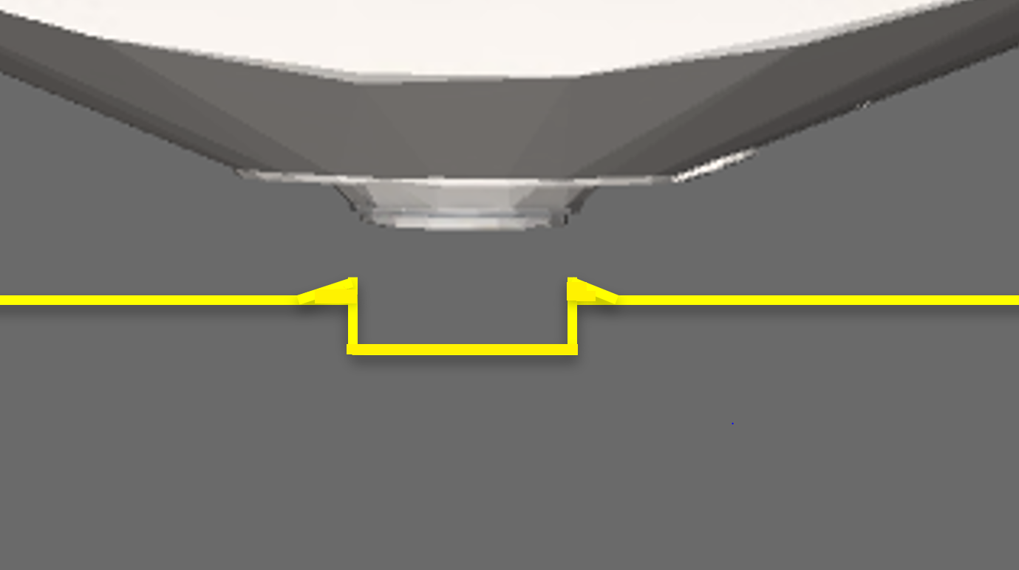
PIXL Placement Example
11 mm
3.5 mm tailings height
25.5 mm
11 mm abrasion depth

